Slide 1



Strengthening the Community Investment Ecosystem
February 3, 2026

Slide 2
The scale of transformation needed in communities can’t be achieved through grants or policy alone.
USING INVESTMENT TO ACHIEVE SOCIAL ENDS
© Copyright Center for Community Investment 2024
2

Slide 3
Why Use Investment to Achieve Social Ends?
Tapping investment capital means:
  More dollars can flow to the changes we want
  Precious grant dollars can be saved for things that cannot be funded in other ways
  More strategies can be used to solve the problems we care about
Spending | Investment
Salaries | Buildings
Food banks | Grocery stores
Housing vouchers | Affordable housing units
Workforce training | Loans to small businesses
Transit passes | Transit system buildout
Childcare subsidies | Early childhood centers
© Copyright Center for Community Investment 2024

Slide 4

Community Investment: Making Money “Flow Uphill”
Traditional investment flows to its easiest and most profitable uses – the path of least resistance.
Community investment is meant to get capital to underserved communities; it is designed to make money “flow uphill”
Like irrigation moving water, a whole system is required
© Copyright Center for Community Investment 2024

Slide 5


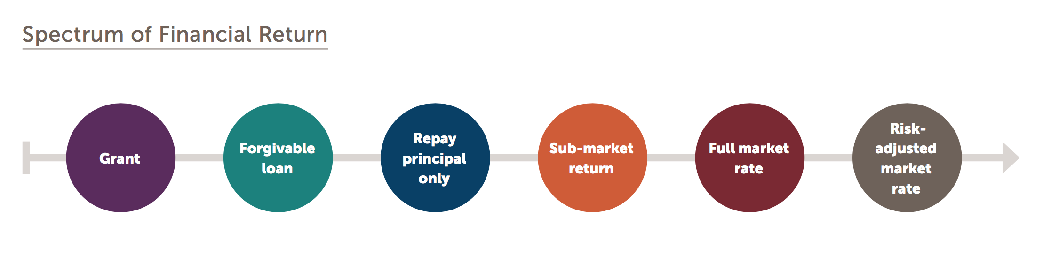
Making Money Flow Uphill
Community investment is designed to get capital to underserved communities; like a pump, it makes money “flow uphill”
Community investment works by recognizing that different kinds of investors have different risk/return expectations
  “Finance first” vs. “impact first”
  Impact investors may trade off some financial return for the promise of social or environmental returns
Impact is primary
Financial return is primary
© Center for Community Investment 2023
5
Notes:
Robin

Slide 6


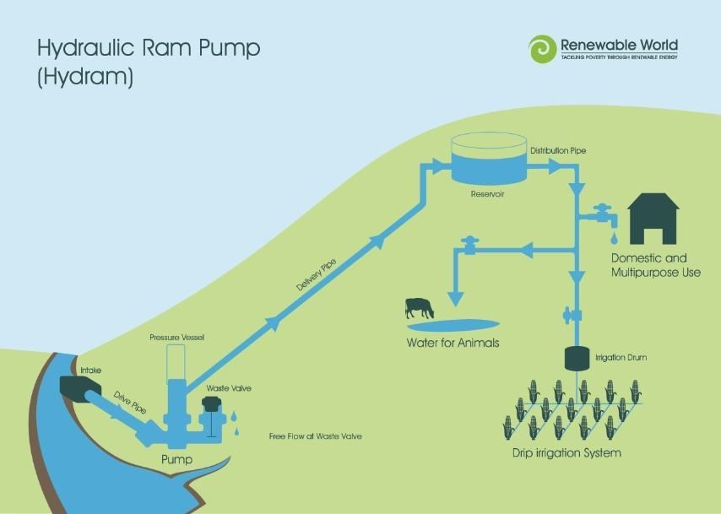
Making Money “Flow Uphill” Takes a System
This doesn’t work on a transactional basis (one project at a time)
vs
Like irrigation moving water, a whole system is required:
  Sources – the capital
  “Pump” – the power
  “Plumbing” – the vehicles/infrastructure
  Distribution network – partners
  Viable end uses - projects
A systems-level approach
Notes:
Paul

Slide 7



Investment or financing tools – Everyday Translation
Taking out a car loan
Making a down payment
Debt
(financial)Equity
Co-signing a loan
Guaranty
A guaranty is a kind of credit enhancement.
Notes:
Robin

Slide 8
Spending vs Financial Investment
Achieving results costs money. Community projects usually require multiple kinds of money - different forms and different implications.
  Spending: payment for goods and services without the expectation that the money will be repaid. Grants and subsidies (grants from the public sector) go in, but don’t come out. Spending sources can fill operational or capital/project gaps.
  Financial Investment: payment now for goods and services that will have value over time, with the expectation of some form of monetary return. Investment is repayable capital. Once it is repaid, it can be recycled for new investment. Financing is another word for investing.
© Center for Community Investment 2023
8
Notes:
Robin

Slide 9
Why Use Investment to Achieve Social Ends?
Humans do not live by grants alone…
Tapping investment capital means:
More dollars can flow to making the changes we want to see
Precious grant dollars can be saved for things that cannot be funded in other ways
More strategies can be used to solve the problems we care about
Spending | Investment
Salaries | Buildings
Food banks | Grocery stores
Housing vouchers | Affordable housing units
Workforce training | Loans to small businesses
Transit passes | Transit system buildout
Childcare subsidies | Early Education centers
© Center for Community Investment 2023
9
Notes:
Robin

Slide 10
When is Investment an Option?
Investment is an option when you can demonstrate how the investor will get repaid (and even earn a return?!)
Examples: buying a house with a mortgage; paying for college with student loans
Financial investors usually expect to receive the original sum (principal) plus a return in the form of:
  Interest (e.g. bank loans)
  Capital gains (e.g. real estate or stocks) and/or
  Savings/avoided costs (tax credits)
Repayment may come from:
  Cashflows produced directly by the investment (e.g. rental properties, toll roads)
  Other sources (e.g. taxes in the case of bonds; improved earning potential in the case of student loans)
© Center for Community Investment 2023
10
Notes:
Robin

Slide 11
Grants Can Pave the Way for Investment
Thoughtful use of grants can lay the groundwork for much larger amounts of investment to flow.
Prepare for transactions by paying for:
Market studies – assess demand; review comparable transactions; examine area demographics and trends
Inventories of vacant/underutilized properties – where is land available
Business plans for users of capital – how will local businesses and organizations grow and what are their capital needs
Predevelopment support – surveys, appraisals, cost estimates, zoning and permit fees, architectural drawings
Unlock transactions by providing:
Risk reduction: financial investors may require credit enhancements such as loss reserves or equity for a fund or intermediary like a CDFI to feel confident enough to lend (grant dollars may recycle)
Reduced cost of capital: using grants (including recoverable grants at 0% interest) can lower the “blended cost of capital” to the user of capital, making a transaction feasible
Gap financing: grants may fill the gap between available subsidy and available loans to allow a transaction to proceed
© Center for Community Investment 2023
11
Notes:
Robin

Slide 12
What is Credit Enhancement?
Any financial tool employed to reduce risk to third party investors, used to encourage or secure that investment.
Examples: Loss reserves, Subordinated debt, Guarantees, or Collateral
Organizations may need credit enhancement when:
  the organization has a limited repayment track record
  there is uncertainty about whether the business/venture will generate sufficient revenue to repay the investor
  there is appropriation or subsidy risk
  they are exploring a new investment area, program or approach
  a program or project is otherwise too risky to gain investment
© Center for Community Investment 2023
12
Notes:
Robin

Slide 13

Reducing Risk using a Capital Stack
A capital stack is a structure that layers together capital from investors with different risk and return expectations to finance a particular project or group of projects.​
$40 million fund
Senior Debt
($30 million)
This includes capital from multiple sources that is pooled and organized by a third party – like a CDFI.
Investors can participate in different ways and at different risk levels.
Often, but not always, the pool is anchored by credit enhancement, a bottom layer that absorbs the first losses.
Subordinate Debt
($6 million)
Loss Reserve
($4 million)
© Center for Community Investment 2023
13
Notes:
Paul

Slide 14
Blended Capital Approach
Flexible, Partnership-First, Risk-Sharing
Aligning IA and Partner Capital Sources to Meet Community Priorities
Stacking Capital to Fit the Opportunity
Creating a Deal Structure That Works for the Project
Notes:
Paul

Slide 15
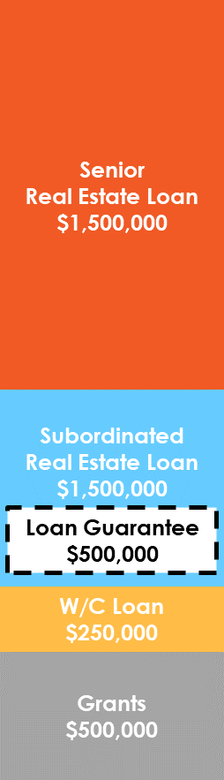

Blended Capital Co-Investment Case Study
The Scenario
The Stack
The Impact
$3 million Main Street revitalization project by nonprofit developer
Partially owner- occupied mixed-use property will house the developer and an affiliated startup nonprofit on ground floor and provide eight workforce housing units on the upper floors
Cost includes energy efficient retrofits and rooftop solar installation
CDFI lending partner wants to provide financing but has collateral / appraisal concerns on the real estate and is unable to finance startup costs for the affiliated nonprofit
Sector Aligned Impacts on Clean Energy, Housing, & Downtown Revitalization
Fully secured loan from local CDFI partner
for acquisition, renovation/ retrofits, and solar installation
Local Ownership, Affordable Housing, & 7 Quality Jobs
Partially secured loan from IA Fund to finance remaining real estate costs
$750,000
Builds on Funding From AFN Member & Other Sources
Funded loan guarantee from IA Catalytic Capital Pool to mitigate collateral risk
Unsecured working capital loan from IA Fund to finance startup operations
Subsidy: $300k Federal grant, $150k AFN member predevelopment grant, $30k donations, $20k TA grant from IA Catalytic Capital Pool
Referral from CDFI Lending Partner, Subordinated Co-Investment, & Leverage
Notes:
Paul

Slide 16
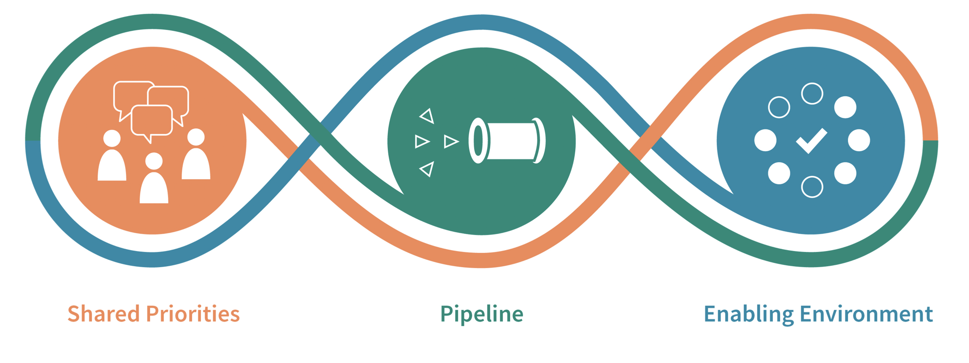
Strengthening Local Community Ecosystems
The capital absorption framework helps communities achieve ambitious goals by creating collaborations that move the focus from individual deals to entire pipelines, with systematic attention to improving the enabling environment.
© Copyright Center for Community Investment 2025
16

Slide 17
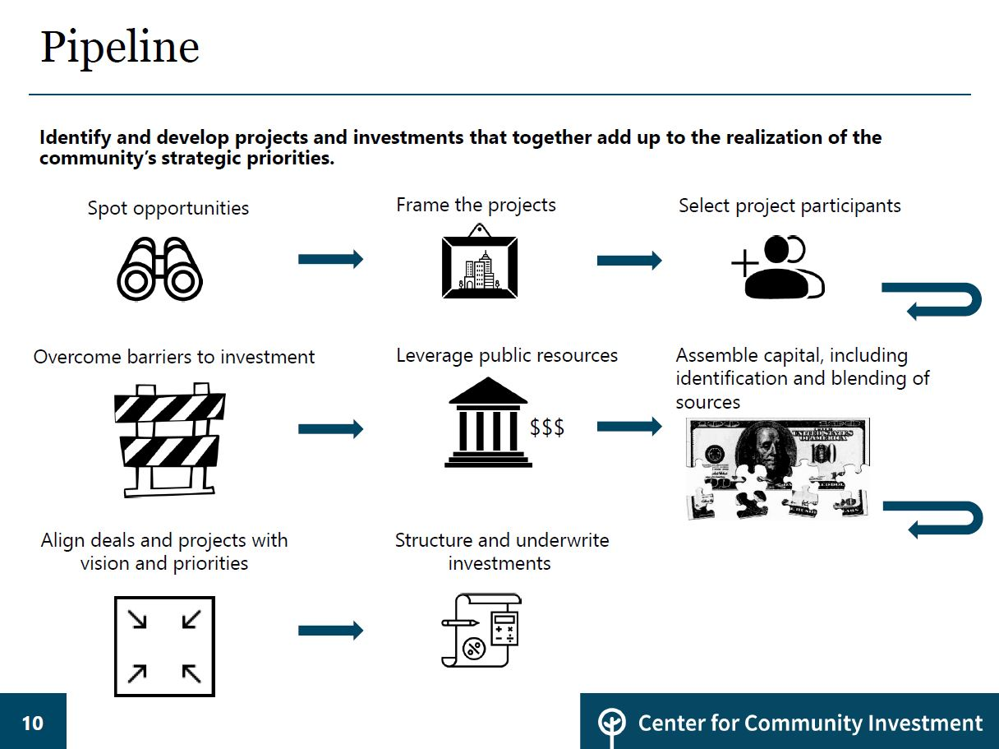
Mapping Barriers and Bottlenecks in the Process from Idea to Investment
Notes:
Robin introduce
Paul - provide Appalachia context:
Rural CDFIs more likely to lack local funders, cite staff capacity as a challenge.
Steps for an actual project from an Alumni…

Slide 18




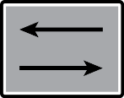
Shifting the Community Investment System
From | From | To | To
 | What can be financed … |  | What community prioritizes
 | Transactional focus |  | System/Ecosystem focus
 | Single projects |  | Pipelines and batches of projects
 | Gap filling |  | Ambitious and scaled
 | Technical, Siloed |  | Integrative, Adaptive, and technical
© Copyright Center for Community Investment 2024
18

Slide 19

Making Investment Work: The Capital Absorption Framework in Coachella Valley

Slide 20



Shared Priority
The Capital Absorption Framework
A Shared Priority is the North Star that guides collaborative work on community investment.
It has two parts:
Aspiration
Specific Result
It should be broad enough to matter and specific enough to guide decision-making.
The Martian test: If a Martian landed and asked how to invest $10 million to further the most important thing to the community, would they get a consistent response?
© Copyright Center for Community Investment 2025

Slide 21
The Denominator Exercise
Set the ambition of your shared priority with this little math exercise:
What is the total need/number needed to solve the problem you wish to address (denominator):
B=__________________________
What difference will your effort make over the life of your collaboration (numerator):
A=_________________________
How do you feel about the portion of your aspiration that you are in a position to address?
Your fraction: A_________________ / B__________________
© Copyright Center for Community Investment 2025

Slide 22

Pipeline
By focusing on a pipeline of deals instead of one deal at a time, a community can:
See all the potential opportunities to advance their shared priority
Reduce costs, increase efficiency and flexibility
Understand the enabling environment and Identify chokepoints where the system is stuck
Attract and align more stakeholders to expand the community investment system
© Copyright Center for Community Investment 2025

Slide 23

Enabling Environment
Seven elements that shape the context to facilitate the realization of the shared priorities:
Influencing and implementing policies and regulations
Adjusting institutional practices
Identifying/aligning additional funding and other resources
Ensuring the availability of needed skills and capacities
Fostering formal and informal relationships
Building forums and platforms for ongoing collaboration
Shifting narratives
© Copyright Center for Community Investment 2024

Slide 24
Deals in the Community Investment System
Deals are central to the community investment system:
    They are units of progress towards the shared priority
    They are shaped by the context in which they take place.
          Looking at deals helps us understand the dynamics at work in the enabling environment
    They can be interventions in the enabling environment, in which we test or change new ways of working.
Shared Priority
Deals/Pipeline
Enabling Environment
© Copyright Center for Community Investment 2025

Slide 25
What Makes a Deal or Project Catalytic?
A deal or project is catalytic if it changes how the community investment system functions or shows what is possible (the “four-minute mile effect”), rather than simply generating benefits for the people or place directly affected by the project.
Catalytic deals or funds may:
Bring new actors into the system
Bring new types of resources into the system
Involve an existing stakeholder in a new role (e.g. health system goes from grant-maker to investor or master lessor)
Create durable new relationships (new level of scale; new type of product; geography that was not considered feasible)
The capital absorption framework shifts the focus from one-time heroic efforts to changing “business as usual.”
© Copyright Center for Community Investment 2025

Slide 26
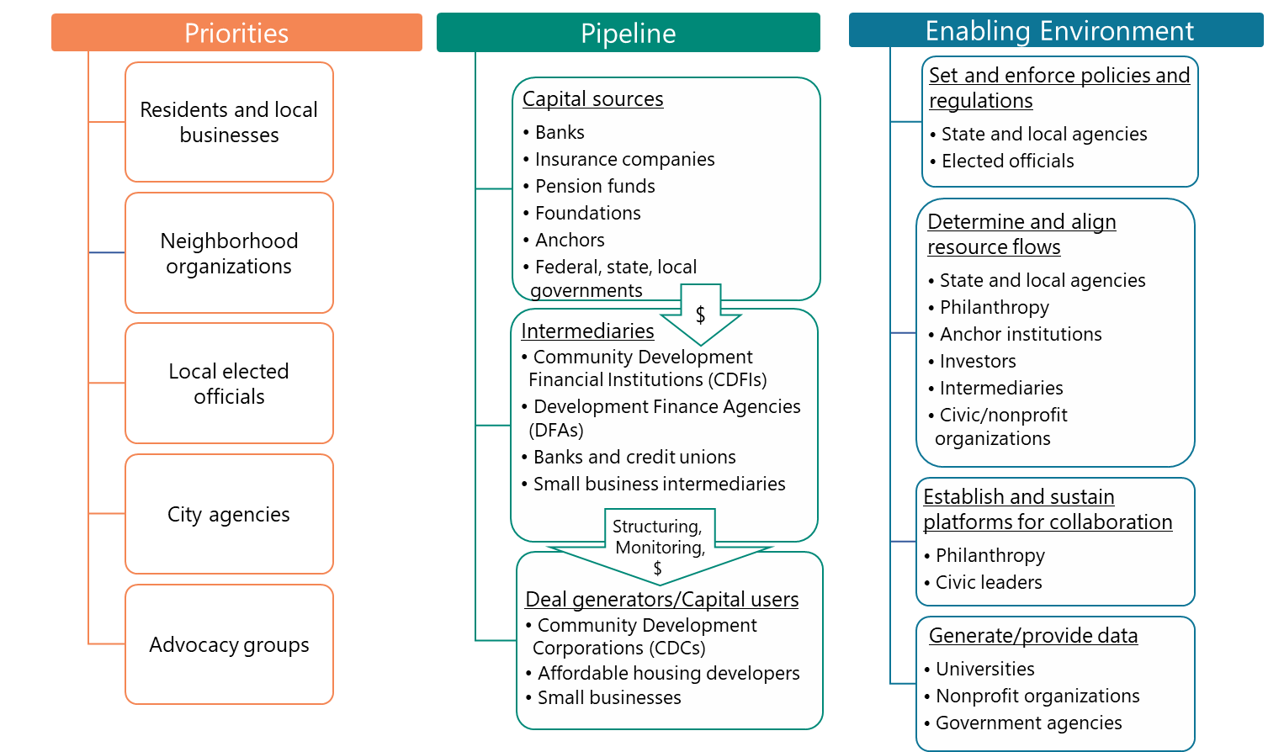
Actors in your Ecosystem
26
Notes:
Robin

Slide 27
Community Investment: Key Players
Sources of Capital
Intermediaries
Users of Capital
Public sector (local, state, national)
Banks
Insurance companies
Foundations
Institutional investors (church, public pension funds, wealth managers)
High-net worth individuals and family offices
Retail investors (Donor-Advised Funds, Calvert, etc.)
Connect Suppliers of capital with users of capital
Community Development Financial Intermediaries (CDFIs)
Development Finance Agencies (DFAs)
Tax credit syndicators
Federal agencies
CDFI Fund (federal)
State & Local agencies
CDCs
Mission-oriented for-profit and nonprofit developers
Small businesses
Nonprofit organizations
Public Actors
© Center for Community Investment 2023
Notes:
Nora

Slide 28
Banks
The Community Reinvestment Act (CRA) encourages depository institutions (like banks) to meet the credit needs of low and moderate-income areas where they have branches. They are assessed for performance on lending, investment, and service.
Strengths and Preferences | Challenges
Bank foundations, community development staff, and lenders may all be involved but tend to be siloed | Bank consolidation has distanced executives from many markets
Banks vary in size (community, regional, national) and community development motivation (serving their borrowers, PR, compliance (CRA)) | Branch closures in divested neighborhoods may limit where they want to invest
Lending can include construction finance, permanent and “mini-perm” products, business loans, and home mortgages | Regulations limit the ability to absorb risk – credit requirements for collateral, cash flow, etc.
National banks are big purchasers of LIHTCs and lend to CDFIs | CRA creates minimal obligations – typically is not enough to get banks to stretch or innovate
© Center for Community Investment 2023
28
Notes:
Nora

Slide 29
Foundations
Foundations must pay out 5% of their endowments in grants annually.
Most foundations try to maximize returns on their endowment either through internal or external investment managers; program staff concentrate on grant-making
PRIs (Program-Related Investments) straddle the divide between grants and investments by making loans, equity investments, guarantees for the primary purpose of advancing mission
Strengths and Preferences | Challenges
Ultimate flexibility to advance mission | Most program officers lack financial sophistication and don’t know how to use grants to unlock larger flows of investment
Multiple tools: grants, convening power, influence, investments, guarantees | May suffer from limited attention span; grant cycles tend to be no more than 3 years
Able to persist/pursue interests over the long-term
© Center for Community Investment 2023
29
Notes:
Nora

Slide 30
CDFIs
Community Development Financial Institutions are financial intermediaries (loan funds, banks, credit unions, venture funds) that provide financial services to expand opportunity for low-income and low-wealth people, businesses, and communities. Certified by the CDFI Fund in the US Treasury Department. Opportunity Finance Network (www.ofn.org) offers financing, programs, and services to CDFIs and their investors.
Strengths and Preferences | Challenges
Diversity – More than 1200 institutions. CDFIs vary in size, focus, and business model (housing vs. business focus; local/regional/national, nonprofit vs. for-profit, variety of services, etc.) | Capital tends to come from banks (mostly debt); grants from the federal CDFI Fund; grants and loans from philanthropy
Mission-oriented | Capitalization is destiny: hard to take risks without an adequate equity cushion
Tend to be experts in blending different financing sources | Compensation depends on closing deals: triage means picking easier transactions with faster closings – limiting potential for innovation
Flexibility in implementation: able to work on or off balance-sheet | Small dollar transactions are less efficient than deals with large established borrowers
© Center for Community Investment 2023
30
Notes:
Nora

Slide 31
Loans – typically from Banks and CDFIs
Lenders underwrite the borrower and loan: what is the loan for, how and when will it be repaid, borrower track record, risks and mitigants to the loan. Lenders usually want collateral (something of value, often property) as a backup repayment source. If the repayment is risky in some way, lenders may ask for credit enhancement to support the loan.
Strengths:
  Clear process with clear rules
  Repaying conventional loans is a good way to build a track record and credit history
Limitations and Ramifications:
  Loans have to fit clear underwriting guidelines; lenders seek to ensure repayment on schedule
  Limited flexibility in terms and requirements (such as loan to value ratios)
  Collateral requirements benefit white borrowers who have been able to take advantage of systemic privilege to build wealth
© Center for Community Investment 2023
31
Notes:
Nora

Slide 32










Key Success Factors for Implementing the Work
A successful community investment effort:
leverages all system assets and unlocks capital from new stakeholders.
has dedicated, knowledgeable staff.
draws on multiple disciplines and types of expertise and lived experience.
works adaptively and learns along
the way.
requires sustained, multi-year commitment.
is done in partnership with others, rather than by a single organization on its own.
centers racial equity.
treats community organizations as full partners and funds them.
joins/supports community collaboratives.
creates accountability mechanisms.
© Center for Community Investment 2024

Slide 33
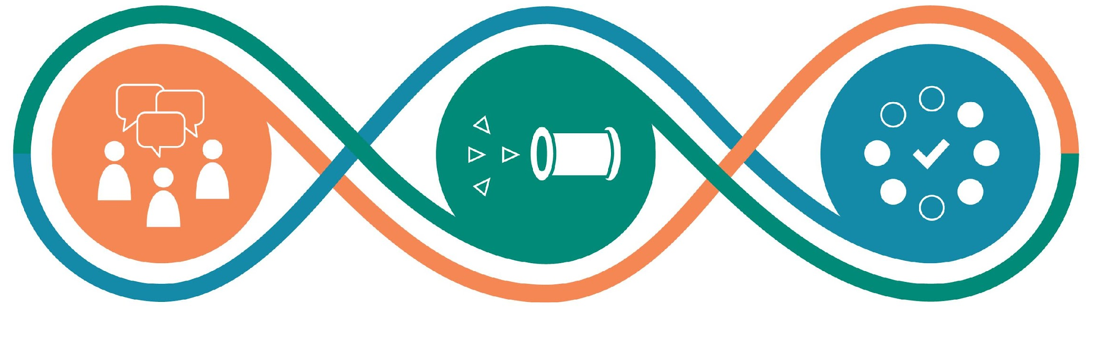
Initial Ecosystem Assessment
SHARED PRIORITIES
Is community voice organized? How and by whom? Are they collaborating?
What are the shared priorities in your community? How clear are they?
To what extent do they reflect the scale needed?
If process is not being led by those most affected, how do the priorities align with theirs?
PIPELINE
How strong is local capacity to move the pipeline? (developers, nonprofits, sponsors, etc.)
Is there an identified pipeline large enough to meet shared priorities?
If you had to form a batch today, what would it be, based on alignment and readiness?
What projects currently in progress advance the shared priorities?
ENABLING ENVIRONMENT
To what extent do public actors support the shared priorities?
Do public actors collaborate with each other and other nonprofit or for-profit local actors? How and for what goals?
What are the key policies, practices, funding sources, and skills that are advancing or impeding pipeline progress?
© Copyright Center for Community Investment 2025

Slide 34
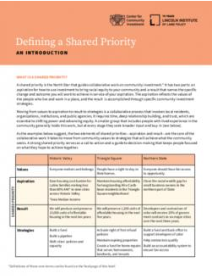
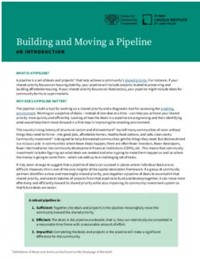
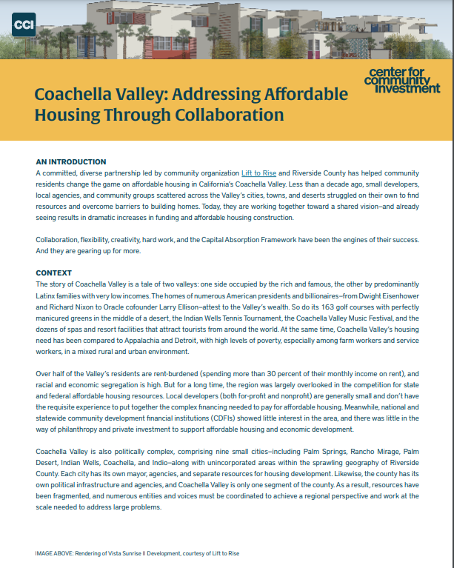
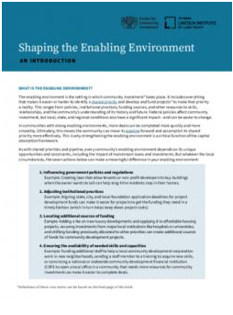
Learn More
Access more resources on our website:
centerforcommunityinvestment.org/resources
Contact:
Omar Carrillo Tinajero
ocarrillo@centerforcommunityinvestment.org
Introductions to Capital Absorption:
Defining a Shared Priority
Building and Moving a Pipeline
Shaping the Enabling Environment

