Slide 1


California Statewide Communities Development Corporation
OVERVIEW OF NEW MARKETS TAX CREDITS
June 5, 2024
Jon Penkower, Managing Director, CSCDA

Slide 2
Agenda
  CSCDC and CSCDA
  New Markets Tax Credits Overview
  NMTC Eligibility
  Potential Benefit
  Limitations
  CSCDC NMTC Projects Financed
  Q & A

Slide 3
CSCDC and CSCDA
CSCDC is a “Community Development Entity” (CDE) that was created to participate in NMTC program.
CSCDC’s controlling entity is California Statewide Communities Development Authority (“CSCDA”).
  CSCDA is a joint powers authority sponsored by the League of California Cities and California State Association of Counties.
  Created in 1988 to enable local government and eligible private entities access to low‐cost, tax‐exempt financing.
  Completed over 1,800 financings totaling more than $75 billion since 1988.
CSCDC competed for and has received six allocation awards totaling $313 million since 2013.
  CSCDC has closed 25 projects to-date utilizing NMTCs.
  Service area is the entire state of California.
  Focus is on healthcare, education and manufacturing projects that have significant community impacts in low income communities.

Slide 4
NMTC Overview
The New Markets Tax Credit (NMTC) program was enacted in 2000 as part of Community Renewal Tax Relief Act.
Program goals: place-based anti-poverty and community revitalization (i.e. through creation of services and jobs benefitting low income persons).
Federal oversight: CDFI Fund (US Treasury Dept.) allocates NMTC authority to Community Development Entities (CDEs).
In the 19 rounds to date, the CDFI Fund has awarded more than $75 billion in tax credit authority, resulting in the creation or retention of more than one million jobs.
  For every $1 invested by the federal government, the NMTC Program generates more than $8 of private investment.
  NMTC program has been reauthorized on an annual, or multi-annual basis.

Slide 5
NMTC Allocation Process
CDFI Fund (program within U.S. Treasury Dept.) allocates NMTC authority to certified Community Development Entities (CDEs).
CDEs are generally financial institutions, community-based lenders, municipalities, economic development agencies, or developers.
  CSCDC is a certified CDE
Each CDE has discretion to identify projects that will benefit from the NMTC subsidy.
There are many more projects than there are allocations from CDEs.
  Perhaps 10x oversubscribed by some estimates
  Highly competitive process to secure NMTCs

Slide 6
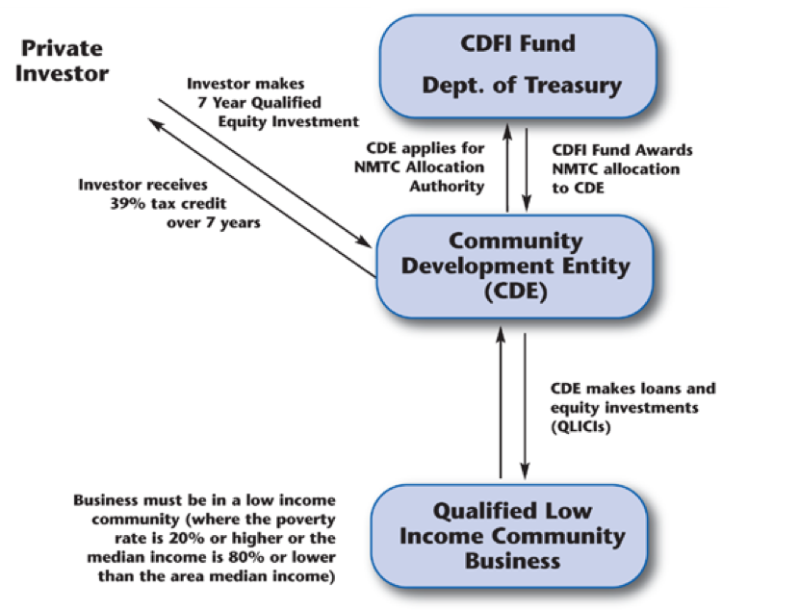
NMTC Allocation Process

Slide 7
NMTC Eligibility
A project or business that is eligible to receive NMTC subsidy from CDEs is referred to as a:
Qualified Active Low Income Community Business
(QALICB)
Commercial real estate*
Mixed use real estate
Community facilities
Business loans to operating companies
*With the exception of certain prohibited uses

Slide 8
NMTC Eligibility
Qualified Active Low Income Community Business
• Located in a “highly distressed” census tract – any one of the following:
• Poverty > 30%
• Median income < 60% of AMI
• Unemployment > 1.5 times national average
• Non-metropolitan county

Slide 9
Ideal CSCDC Selection Criteria
NMTC Eligibility: location readily meets high distress criteria
Community Impact
  Borrower provides significant community benefits for low-income persons
  Demonstrated community support for project
  Project addresses regional priorities or community needs
Financial Feasibility
  Other capital sources of financing are committed
  Other sources of financing can be funded or bridged at NMTC financial closing
“But For” Test
  Clearly articulated financing gap
  Can only be closed with the benefit of NMTC subsidy (versus simply raising more debt)
Timing
  If real estate is involved, all development issues are in order (site control, environmental remediation, entitlements, construction drawings, detailed budget, guaranteed maximum price contract, permits, etc.)

Slide 10
NMTC: Potential Benefit
Lender
1
Investment Fund
2
NMTC Investor
3
At closing
Lender makes $7.5M loan to Investment Fund
NMTC Investor invests $2.5M in Investment Fund
IF makes $10M “Qualified Equity Investment” into project specific Sub-CDE
CDE receives fees & expenses from Sub-CDE
Sub-CDE makes $7.5M Loan A to Project at same terms as upper-tier loan in #1
Sub-CDE makes $2.5M Loan B to Project at very low rates (partially or fully forgiven after 7 years – this is the net NMTC subsidy)
Sub-CDE
4
CDE
5
6
QALICB

Slide 11
NMTC: Potential Benefit
Lender
4
Investment Fund
6
NMTC Investor
3
5
During compliance period:
QALICB services debt on Loan A and Loan B
Loan B debt service is distributed to CDE as a fee
Loan A debt service is distributed to Investment Fund
Investment Fund pays debt service on Loan A with proceeds from #3
Sub-CDE distributes $3.9M in tax credits to Investment Fund over 7 years
Tax credits are received on an annual basis by NMTC Investor
Sub-CDE
2
CDE
1
QALICB

Slide 12
NMTC Limitations
Lender is required to forbear on their foreclosure rights for 7 year compliance period – greatly limits pool of potential lenders
Extremely limited refinancing potential for 7 years
Can’t sell property for 7 years
Projects with total development costs of < $7 million are generally not competitive

Slide 13
NMTC Limitations
  Mixed Use Real Estate
  At least 20% of gross income must be generated from commercial component (should project at >30%)
  Master lease will likely be required (developer will guarantee passage of 20% test)
  Not compatible with Low Income Housing Tax Credits

Slide 14
CSCDC Project Closing (Carson Block Building)
$7,000,000 of New Markets Tax Credit (NMTC) allocation to Northern California Indian Development Council (NCIDC) to fund upgrades that will preserve and revitalize their headquarters office — the historic Carson Block Building in downtown Eureka, California
.
The project provides a permanent headquarters and provide long-term stability for NCIDC, as well as provide permanent, affordable space for nonprofit organizations and small businesses serving the local community.
The improvements will bring the building into compliance with current state and local building codes, allowing for greater occupancy levels than presently allowed, and opening the door to tenants that are currently unable to lease space.
The project will provide 50 temporary construction jobs, retain 41 FTE positions for current NCIDC staff and building tenants, and provide an estimated 15 new FTE positions through new tenants.

Slide 15

CSCDC Project Closing (Open Door Community Health Centers)
$8,500,000 of New Markets Tax Credit (NMTC) allocation to Open Door Community Health Centers, a federally qualified health center, to finance the repayment of existing loans — freeing up debt capacity and enabling Open Door to fund expansion throughout Humboldt and Del Norte Counties.
Open Door operates nine health clinics spread throughout Humboldt and Del Norte counties in northern California. They have actively focused on providing quality healthcare and healthcare education in areas where people do not have access to care due to financial, geographical or social barriers.
Refinancing will enable Open Door to acquire at least one private practice in the Eel River Valley and to start construction on two new facilities within the next 24 months. The new facilities are targeted in Arcata and Fortuna — both highly distressed, non-metropolitan NMTC census tracts.
Future expansions, enhanced by the NMTC financing, will enable Open Door to retain 97 FTE jobs and add 31 new FTE jobs.

Slide 16

CSCDC Project Closing (Elica Health Center)
$11,000,000 of New Markets Tax Credit (NMTC) allocation to Elica Health Centers, a federally qualified health center, for renovation and expansion of its clinic operations in the Arden Arcade community of Sacramento County.
Will enable Elica to renovate its existing Arden Arcade clinic, and also acquire and renovate an adjacent 19,880 SF office building, creating a 28,000 sq. ft. health center campus that will provide comprehensive health services for over 14,000 low-income patients each year.
Elica patients will have access to primary medical care, integrated behavioral health, comprehensive dental care, and a new full-service pharmacy.
Approximately 98% of Elica’s patients are low-income individuals.
The project is also expected to result in approximately 100 new and retained FTE permanent, quality jobs.

Slide 17
CSCDC Project Closing (Shasta College Community Leadership Center)
$11,000,000 of New Markets Tax Credit (NMTC) allocation to Shasta-Tehama-Trinity Joint Community College District (Shasta College) for development of the new Shasta College Community Leadership Center (CLC) in Redding, California.
Will support the development of the new 25,325 sq. ft. Community Leadership Center. Located in downtown Redding, the CLC will serve as a hub for Shasta College community education programs.
The CLC will also house Shasta College’s innovative education and workforce development programs that support low-income students and students with barriers to education and employment.
The CLC will occupy floors 2-5 of the newly constructed five-story building. The project is expected to result in approximately 80 new and retained FTE permanent, quality jobs.

Slide 18
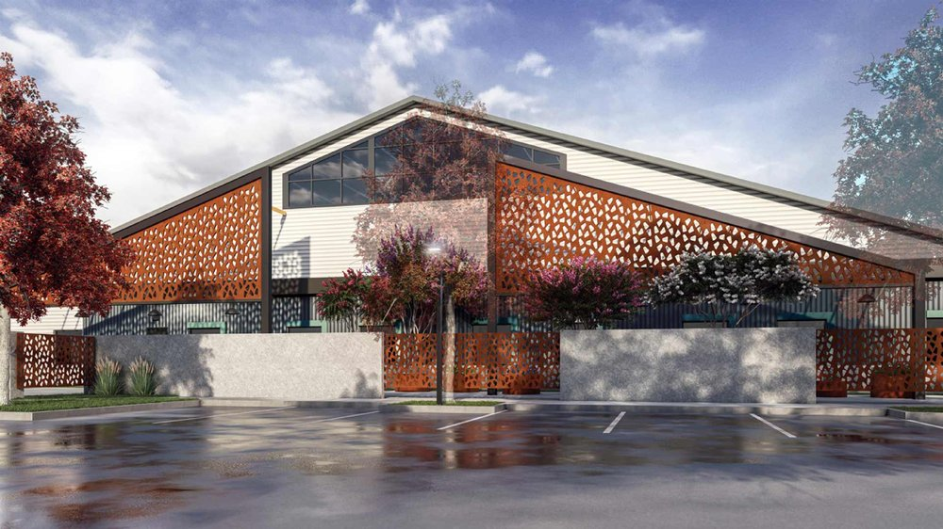
CSCDC Project Closing (Renewal Center)
$8,500,000 of New Markets Tax Credit (NMTC) allocation to development of the Renewal Center Campus in Chico, California. Expanded facility will provide comprehensive services for individuals experiencing homelessness.
Renovation of a 20,000 sq. ft. building to provide new headquarters, expanded shelter space for homeless men and women, and a commercial kitchen.
Construction of a 27,000 sq. ft. building to include:
  Shelter space for individuals and families experiencing homelessness;
  Medical facility providing primary care, behavioral health, and substance use disorder treatment; and
  Butte County crisis services, housing navigation, and eligibility enrollment.
The project is expected to result in approximately 60 new and retained FTE permanent, quality jobs.

Slide 19
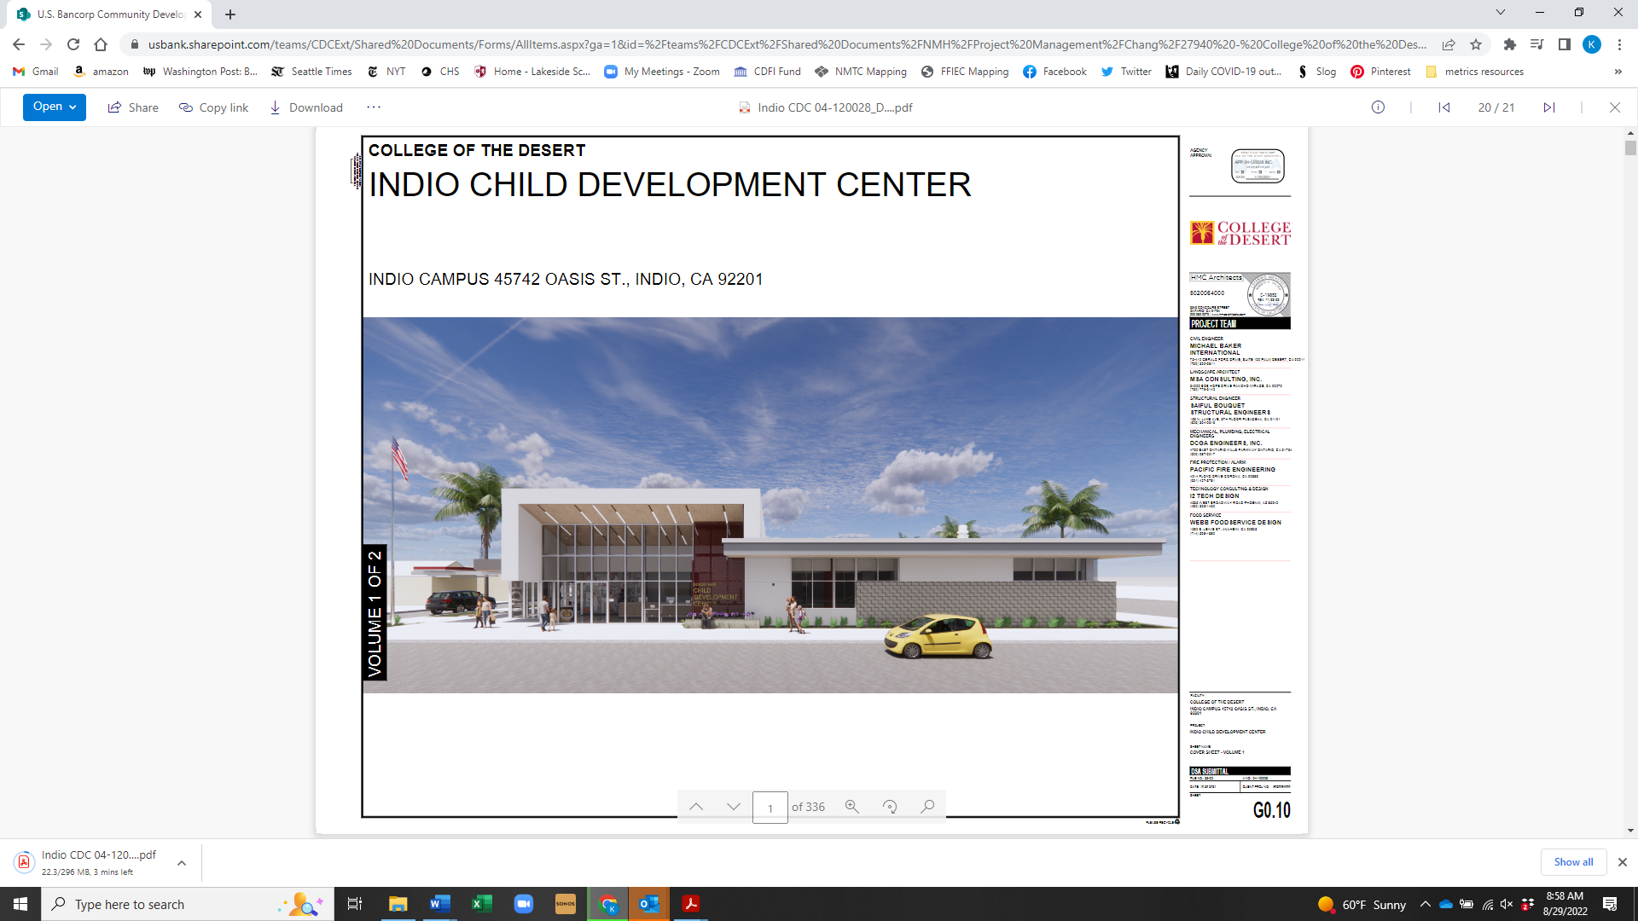
CSCDC Project Closing (College of the Desert Child Development Center)
$8,500,000 of New Markets Tax Credit (NMTC) allocation to College of the Desert (COD) for development of its new Child Development Center (CDC) in Indio, California.
The new CDC will extend COD’s Indio campus with a new 18,000 SF building, 7,000 SF of outdoor play yards with shade structures, and parking.
The new building will include toddler and preschool classrooms, and support spaces for a state-of-the-art childcare facility. The building will also house an adult early childhood education classroom and observation spaces.
The CDC will serve as a hands-on training facility for COD students working toward a range of majors under the school’s Child Development Education program.
The CDC will also include a low-cost, full-service childcare center to meet the needs of COD students, faculty, and families in the surrounding low-income community.

Slide 20

CSCDC Project Closing (Fireclay Tile, Inc.)
$8,500,000 of New Markets Tax Credit (NMTC) allocation to Fireclay Tile, Inc. for expansion and enhancement of the Fireclay Tile manufacturing facility in Aromas, California.
Will support the expansion and enhancement of the Fireclay manufacturing facility through construction of two new buildings, renovation of existing buildings, purchase and installation of tile manufacturing equipment, and extensive infrastructure work and site improvements.
The facility expansion is expected to allow Fireclay to quadruple its production and sales by 2025.
The project is expected to create and retain 400 permanent jobs.

Slide 21

CSCDC Project Closing (Shasta Community Health Center)
$11,000,000 of New Markets Tax Credit (NMTC) allocation to Shasta Community Health Center for construction of its new Women, Babies and Children’s Clinic in Redding, California.
Will enable Shasta Health to construct a two-story, 31,400 sq. ft. modern medical facility across the street from its main health center in Redding.
The Women, Babies & Children’s Clinic will include 24,000 sq. ft. of clinical space to provide primary care pediatric, maternal, and vision care services, serving approximately 13,000 patients annually. The building will also include 7,400 square feet of administrative space.
By relocating its pediatrics and financial services departments to the Women, Babies & Children’s Clinic, Shasta Health will free up additional capacity in its main health center to allow for additional services and program growth.

Slide 22

CSCDC Project Closing (Ampla Health - Marysville)
$7,500,000 of New Markets Tax Credit (NMTC) allocation to Ampla Health, a federally qualified health center, for the development of clinic operations in Marysville, California.
Will enable Ampla Health to develop a new 10,000 sq. ft. medical clinic in Marysville that will provide comprehensive health services for 9,000 low-income patients each year.
Ampla Health patients will have access to primary medical care, case management, and integrated behavioral health.
Approximately 92% of Ampla Health’s patients are low-income individuals.
The project is expected to result in approximately 50 new FTE permanent, quality jobs.

Slide 23
CSCDC Project Closing (Ampla Health – Yuba City)
$11,000,000 of New Markets Tax Credit (NMTC) allocation to Ampla Health, a federally qualified health center, for the expansion of clinic operations in Yuba City, California.
Will enable Ampla Health to renovate and rehabilitate its existing 14,500 sq. ft. clinic, and also construct a two-story, 41,000 sq. ft. clinic expansion.
The project will upgrade and add exam rooms, dental exam rooms, pediatric rooms, administration and meeting space, and expand the pharmacy and laboratory space to better serve the community.
The resulting 55,500 sq. ft. healthcare campus will greatly enhance Ampla’s ability to provide comprehensive primary medical, dental, behavioral health, pediatric, chiropractic, optometry, and specialty care for low-income patients.
Approximately 85% of Ampla’s patients are low-income individuals.
The project is expected to result in approximately 171 new and retained FTE permanent, quality jobs.

Slide 24

CSCDC Project Closing (FIELD)
$12,000,000 of New Markets Tax Credit (NMTC) allocation to Farmworkers Institute of Education & Leadership Development (FIELD) for development of its new Career Training Center (CDC) in Bakersfield, California.
The financing will support FIELD’s rehabilitation of an 11.2-acre site in Bakersfield to serve as FIELD’s new headquarters, and a comprehensive Career Technical Education (CTE) campus for adults participating in FIELD’s programs.
FIELD provides CTE in industry sectors that are growing, and that offer living wages, benefits, and career advancement.
Current CTE programs include recycling, construction, firefighting, agriculture, early childhood education, natural resources, business, and solar installation.
The site will serve as FIELD’s central CTE campus, allowing the organization to grow the number of programs offered and the number of people served.

Slide 25
Additional Questions?
For further information, or to discuss potential NMTC projects in your community, please contact:
Jon Penkower, CSCDA Managing Director
(925) 476-5887
jpenkower@cscda.org

