Slide 1
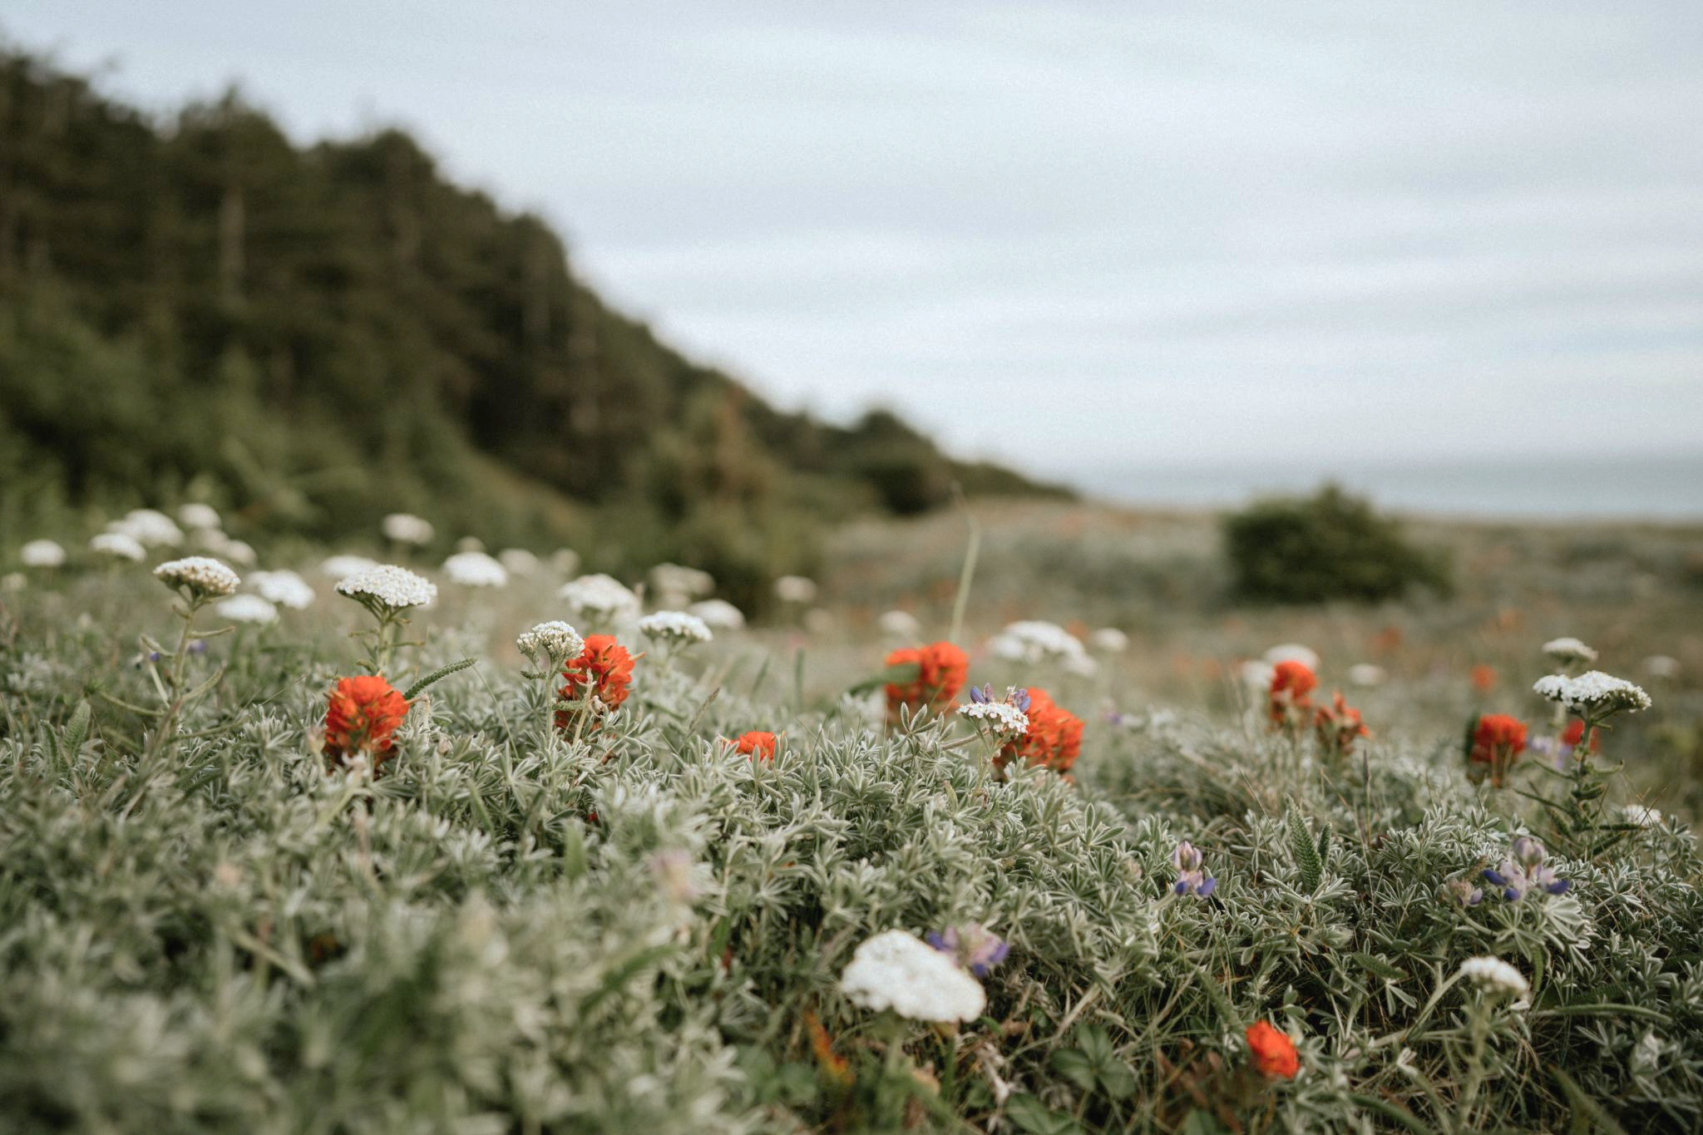


October 26, 2023
Redwood Region RISE (Resilient Inclusive Sustainable Economy)
Monthly Collaborative Meeting
Learn More: bit.ly/Redwood-RISE

Slide 2

Welcome Everyone / ¡Bienvenidos todos!
You have arrived at the October Collaborative Meeting of
Redwood Region RISE (Resilient Inclusive Sustainable Economy).
Please introduce yourself in the chat–name, affiliation (if applicable) and where you are zooming in from: https://native-land.ca/
Icebreaker:
What was your best ever Halloween costume?
Let us know in the comments!
Notes:
Before moving to housekeeping, lets do the Cal Poly Land Acknowledgement

Slide 3
Land Acknowledgement
Land Acknowledgement
Redwood Region RISE’s Collaborative is located on the present and ancestral Homeland and unceded territory of Indigenous People. Tribes and Nations in our region include:
Bear River Band of the Rohnerville Rancheria; Big Lagoon Rancheria; Big Valley Band of Pomo Indians; Big Valley Band Rancheria; Blue Lake Rancheria; Cahto Tribe; Coyote Valley Band of Pomo Indians; Elem Indian Colony; Elk Valley Rancheria; Guidiville Indian Rancheria; Habematolel Rancheria of Pomo Indians; Hoopa Valley Tribe; Hopland Band of Pomo Indians; Karuk; Koi Nation; Manchester Band of Pomo Indians; Mattole; Middletown Rancheria of Pomo Indians; Pinoleville Pomo Nation; Potter Valley Tribe; Redwood Valley Little River Band of Pomo Indians; Resighini Rancheria; Robinson Rancheria; Round Valley Reservation; Scotts Valley Band of Pomo Indians; Sherwood Valley Rancheria; Tolowa; Tolowa Dee-ni' Nation; Trinidad Rancheria; Wiyot; Wailaki; Wiyot; Yurok Tribe.
We make this land acknowledgement in recognition that our words must be matched by action and approach.
Learn more: "What Good Is a Land Acknowledgment?"
Notes:
Before moving to housekeeping, lets do the Cal Poly Land Acknowledgement

Slide 4
Some Housekeeping Notes
Team👋🏽
Are you new? Welcome!
Spanish Interpretations
Speak at a manageable pace → and let us know if we aren’t!
Questions in chat (or DM: Leoni/Alisha)→ we gather & answer your questions
Calendar invites: synced calendar bug
New meeting format: Voting Members will increasingly drive the show
  Specific times for community input (Public Discussion).
  If applicable: Let us know who you are so we can pay you, and please send us your Partnership Agreement Letter & Data Collection Form
  Voting members👋🏽

Slide 5
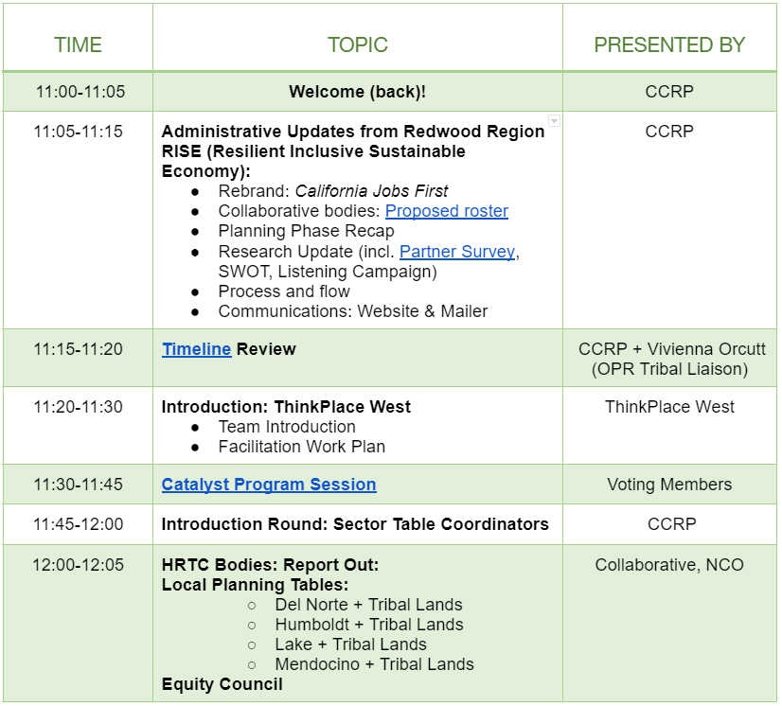
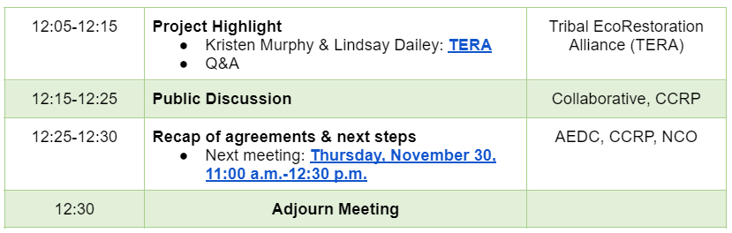
Agenda
Collaborative Meeting: 26 October, 2023
Notes:
Note to self: make sure document is dropped in chat.

Slide 6
Administrative Updates RRRISE
Rebrand: Transitioning to “California Jobs First”
Planning Phase Recap
Research Update (Regional Summary Part 1- Partner Survey, SWOT, Listening Campaign)
Process & Flow
Communications: Website & Mailer + RISE onboarding

Slide 7
Update - Planning Phase Recap
Collaborative’s Major Achievements in Q1-4:
Governance Structure (five Planning Tables).
Identifying of Voting Block, Equity Council, preliminary Sector Tables
Input to our Regional Summary Part 1: “Ground truthing” data, filling out Partner Surveys, participatory SWOT Analysis, and Listening Sessions.
Your convening team is rounding the corner on key research deliverables (more on that later).
Communications & Outreach plans completed and being implemented.
Voting Members, Equity Council, and Local Tables are meeting. Tribal Table will start meeting soon. Sector Tables will launch in the next couple of months. More trainings & special sessions with experts (broadband, entrepreneurship etc., will start first half of 2024).

Slide 8
Planning Phase- What’s next for Voting Members?
Mentimeter exercise: www.menti.com/almtkj19oe6j
Our Voting Members will guide us through the next phase of developing our Collaborative. Please rank in order of importance and urgency:
  Bylaws
  Charter
  Consistent Administrative and Research updates
  Mission and Vision
  Process for pursuing funding opportunities together
  Steering Committee/ Chair
  Theory of Change

Slide 9
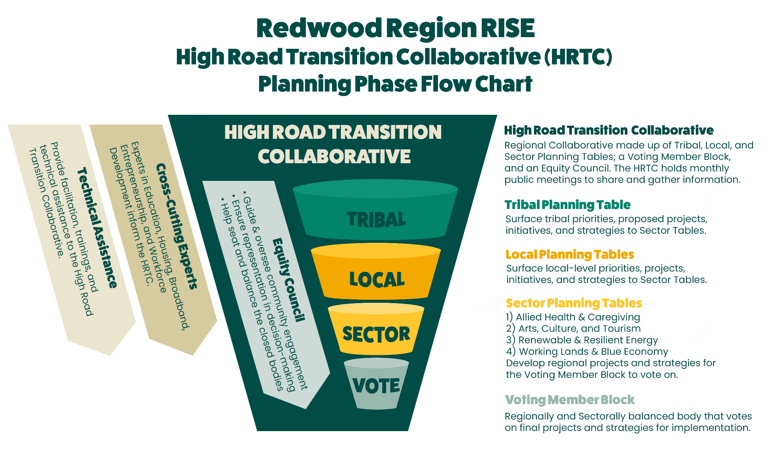
Update + Recap - Collaborative Bodies Overview
Latest Roster: Seated Representatives

Slide 10
Update - Proposed Voting Members
 | Del Norte | Humboldt | Lake | Mendocino
Business Organization | Del Norte Chamber of Commerce & Visitor Bureau | North Coast Small Business Development Center | Lake County Chamber of Commerce | West Business Center
Community-Based Organization | True North Community Organizing | Northern California Indian Development Council | TBD | Project Sanctuary
Economic Development | Del Norte Economic Development Corp. | Redwood Region Econ. Dev. Commission | Lake County Economic Development Corporation | County of Mendocino Econ Development Lead
Education/ Training | College of the Redwoods | Cal Poly Humboldt | Lake County Office of Education | Mendocino Community College
Government | TBD | Humboldt County Association of Governments | Lake County Community Development | Mendocino County Council of Governments
Environmental Justice | Environmental Protection Information Center | Northcoast Environmental Center | Tribal EcoRestoration | GrassRoots Institute
Philanthropy | Wild Rivers Foundation | Humboldt Area Foundation | TBD | Community Foundation of Mendocino
Priority | Resilient DNTL | Centro del Pueblo | Latinos United of Lake County | Project Sanctuary, Ukiah Vecinos en Acción
Workforce Development | SMART Workforce Center | Humboldt Workforce Dev. Board | Workforce Alliance of the North Bay | Economic Development & Financing Corporation
Labor | Treston Shull- LiUNA Jeff Hunnerlach- Operators 3
Notes:
Note to self: Make sure document is dropped in chat.

Slide 11
Update - Proposed Voting Members
Tribes who have indicated intent to participate as voting members
Bear River Band of the Rohnerville Rancheria | Middletown Rancheria of Pomo Indians
Big Lagoon Rancheria | Pinoleville Pomo Nation
Big Valley Band Rancheria | Potter Valley Tribe
Blue Lake Rancheria | Redwood Valley Little River Band of Pomo Indians (Redwood Valley Rancheria)
Cahto Tribe | Resighini Rancheria
Coyote Valley Band of Pomo Indians | Robinson Rancheria
Elem Indian Colony | Round Valley Reservation
Elk Valley Rancheria | Scotts Valley Band of Pomo Indians
Guidiville Indian Rancheria | Sherwood Valley Rancheria
Habematolel Rancheria of Pomo Indians | Tolowa Dee-ni' Nation
Hoopa Valley Tribe | Trinidad Rancheria
Hopland Band of Pomo Indians | Wiyot (Table Bluff Reservation)
Manchester Band of Pomo Indians | Yurok Tribe

Slide 12
Update - Proposed Sector Tables (1)
Allied Health and Caregiving Adventist Health Area 1 Agency on Aging Changing Tides County of Mendocino -IHSS department First 5 Heart of the Redwoods Community Hospice Hospice of Humboldt Humboldt Del Norte Medical Society Mad River Community Hospital Mendocino Coast Healthcare Foundation North Coast Clinics Network Open Door Community Health Centers Providence/St. Josephs Redwood Community Action Agency Redwood Community Services Redwoods Rural Health Center Sutter Coast Hospital TANF Tribal Health Ukiah Senior Center United Indian Health Services United Indian Health Services (Del Norte) | Working Lands & Blue Economy Alexandre Family Farms Blue Ribbon Committee for the Rehab of Clear Lake CalForest WRX Cooperative Agriculture Network Crescent City Fishermen's Association Del Norte Food Council Foggy Bottoms Boys Lake County Climate Resilience Officer Lake County Farm Bureau Mattole Restoration Council North Coast Growers Association North Fork Lumber Noyo Harbor District Noyo Ocean Collective Redwood Forest Foundation Rumiano Cheese Six Rivers Initiative

Slide 13
Update - Proposed Sector Tables (2)
Resilient and Renewable Energy Blue Lake Rancheria Calpine Climate Action Mendocino CORE hub Crescent City Harbor District Humboldt Harbor District Mendocino County Resource Conservation District Noyo Harbor District Redwood Coast Energy Authority Schatz Energy Research Center Scotts Valley Energy Corporation Vineyard Offshore | Arts, Culture, Tourism Arts Council of Mendocino Crescent City Department of Economic Development & Recreation Del Norte Association for Cultural Awareness Dell’Arte International Greater Ukiah Business & Tourism Alliance Ink People Lake County Arts Council Middletown Arts Center Southern Humboldt Visitors Bureau Visit Lake County (Tourism improvement district)

Slide 14
Update - Equity Council
Buffey Bourassa - Sherwood Valley Band of Pomo Indians Council Member
Jack Buckhorn - Executive Director of North Bay Labor Council (serving Sonoma, Lake, Mendocino & Marin Counties)
Kay Richards - Community Member in Covelo
Kaylee Simili
Valerie Starkey - Del Norte County Supervisor District 2
Paul Garza
Angelica Lua
Ashley Taylor
Jessica Johnson
Alissa Norman
Thomas Nicholson Stratton
Jody Himango
Leann Greene
Carol De Lorme Larsen
Debra Garnes
Elizabeth Hassler
Steve Aviv Kleinman
Julie Eby-McKenzie
Walter Gray III
Maria Dahlin
Monique Harper-Desir
Theresa Showen
Joey Luiz
Lynette Kirkwood

Slide 15
Update - Research
Partner Mapping: 88 Respondents
SWOT Analysis: Thank you! Share preliminary findings at our November Collaborative meeting.
Listening Campaign: 80+ Participants providing more input to SWOT, partner mapping, governance design and more.
Labor Market Analysis, Public Health Analysis, Industry Cluster Analysis, Climate Vulnerability Analysis- all due to be delivered November 15th!
Between November 15-December 15 we will be asking our Collaborative (you!) on your thoughts on these key data products and
what the data means for our collective work.

Slide 16
Update - Communications: Website & Mailer
Website: bit.ly/Redwood-RISE (or ccrp.humboldt.edu/redwood-rise)
  Landing Page
  Getting Started
  News
  Calendar
  Helpful Resources
  Governance: Our Tables
Newsletters
  Collaborative Mailer (“big group”)
  Tailored Mailers for all Collaborative bodies
Onboarding RRRISE

Slide 17
Timeline Review: RRRISE & Tribal Funding Opportunity
Welcome Back Vivienna Orcutt (OPR Tribal Liaison)

Slide 18
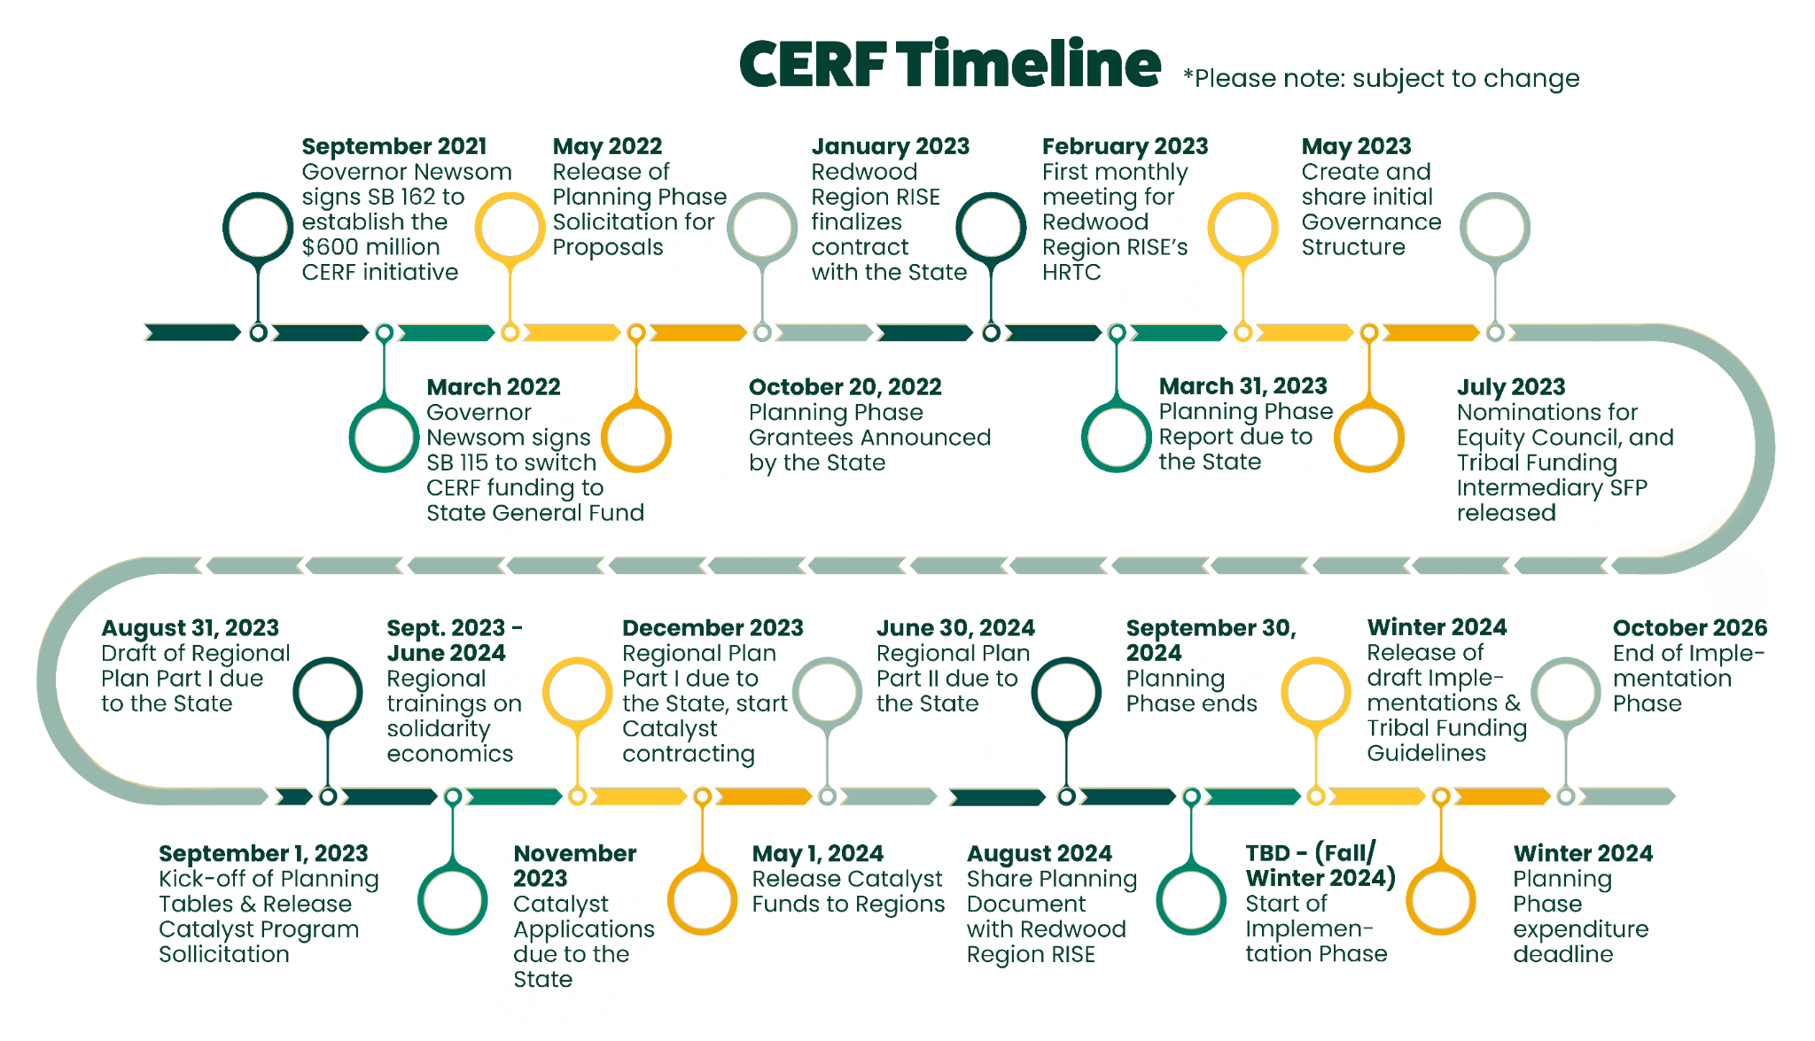

Slide 19
Introduction: ThinkPlace West
Equity Council (proposal reviews)
Team 👋🏽
Facilitation Work Plan

Slide 20
Catalyst Program Session
Too many communities across California lack the funds necessary to move projects through the development process e.g.:
Conducting feasibility studies;
Conducting environmental studies;
Identifying, and controlling sites for development;
Negotiating Community Benefits Agreements, etc.
“Disinvested communities” have suffered the most from this dynamic, while better-resourced communities are able to allocate capital to developing projects that are ‘ready-to-go,’ or ready for immediate implementation.
Notes:
Maximize historic investment into communities: $190 Billion in Federal Funding for CA*, $48 Billion for CA’s Climate Commitment.
*Inflation Reduction; CHIPS; Infrastructure, Investment and Jobs Acts

Slide 21

Catalyst fund - Voting Members Discuss
How should our Collaborative ensure that these pre-development funds reach the most “disinvested parts” of our Region? What would it take?
What do we want our Equity Council to consider?

Slide 22
Introducing: Our Sector Table Coordinators
Working Lands & Blue Economy:
  Conner Hackett, CEO of the Six Rivers Initiative
  Mary Anne Petrillo, CEO of West Business Development Center
Arts, Culture and Tourism:
  Calder Johnson, Managing Artistic Director, North Coast Repertory Theatre
  Sabrina Clement, Creative Education Consulting

Slide 23
Next steps for Sector Tables
In Process: Recruiting Industry experts to serve as Sector Table Coordinators for Renewable & Resilient Energy, and Allied Health & Caregiving Tables
Create charters, meeting schedules, finalize work plans
First Meetings: TBD in December 2023
January-June 2024, Tables work on:
  Identifying strategies for growing respective sectors, sustainably and inclusively;
  Identifying projects that represent strategic investments in those strategies.
This will be achieved with input and guidance from Local and Tribal
Tables, and the Equity Council.
Notes:
Examples the state shared include: technical assistance to small businesses, development of sustainable industries, entrepreneurship and commercialization programs, projects that connect small and minority owned businesses to industrial hubs and research, etc.

Slide 24
Collaborative Bodies: Report Out
Local Planning Tables:
  Del Norte + Tribal Lands
  Humboldt + Tribal Lands
  Lake + Tribal Lands
  Mendocino + Tribal Lands
Introduction: Rev. Dana (Del Norte Project Coordinator)

Slide 25
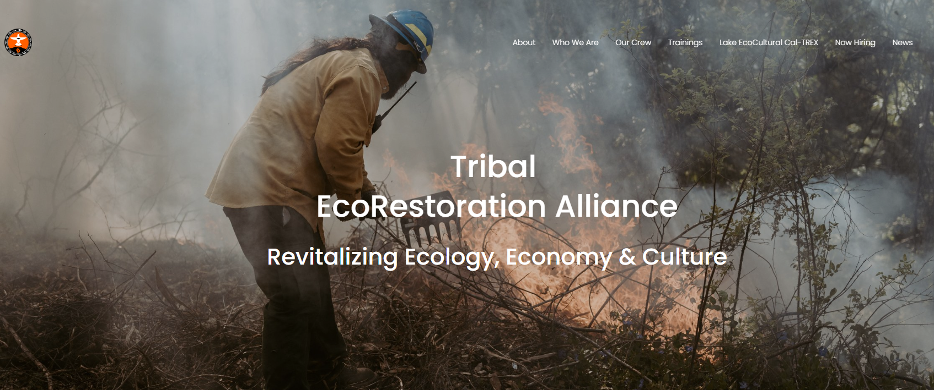
Project Highlight: Tribal EcoRestoration Alliance (TERA)
Presentation by Kristen Murphy & Lindsay Dailey: TERA
Q&A

Slide 26




www.tribalecorestoration.org
A cross-cultural, multi-organizational collaborative that works to revitalize ecology, economy, and culture through indigenous-led land stewardship.
Notes:
Started with wildfire resilience focus
Today’s wildires are a result of removal of indigenous land stewardship practices
We would like to build relationship with Big Valley Rancheria and see how we can work together and support your goals

Slide 27
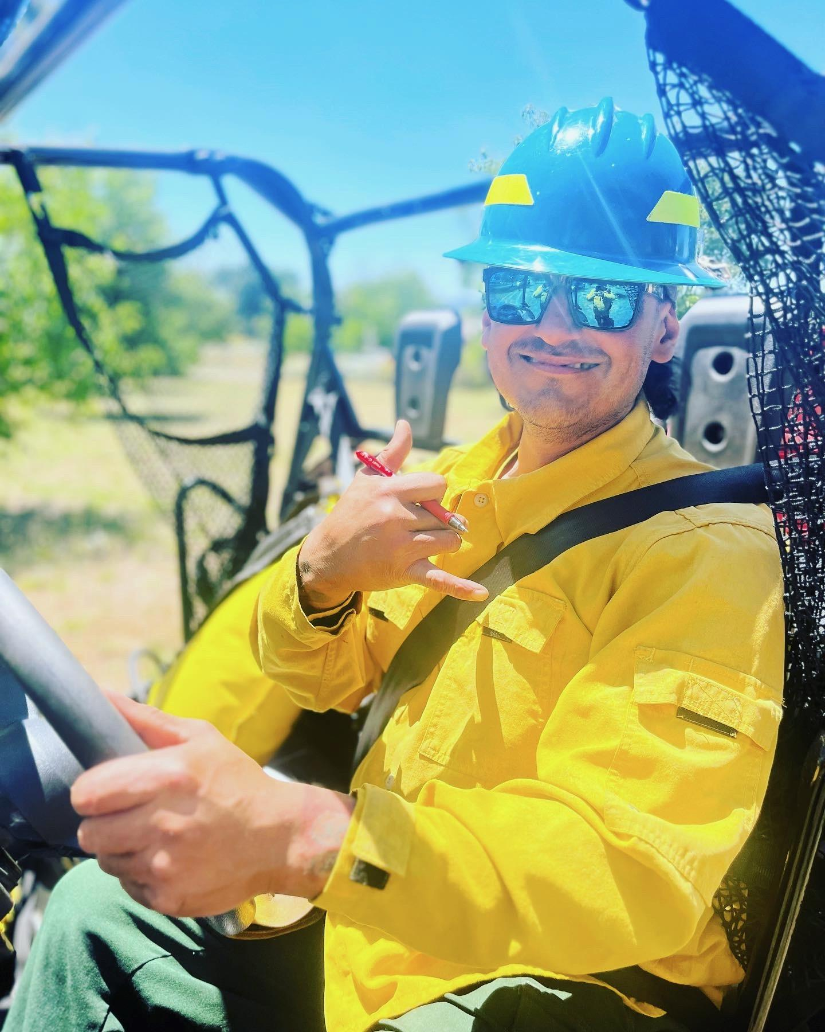
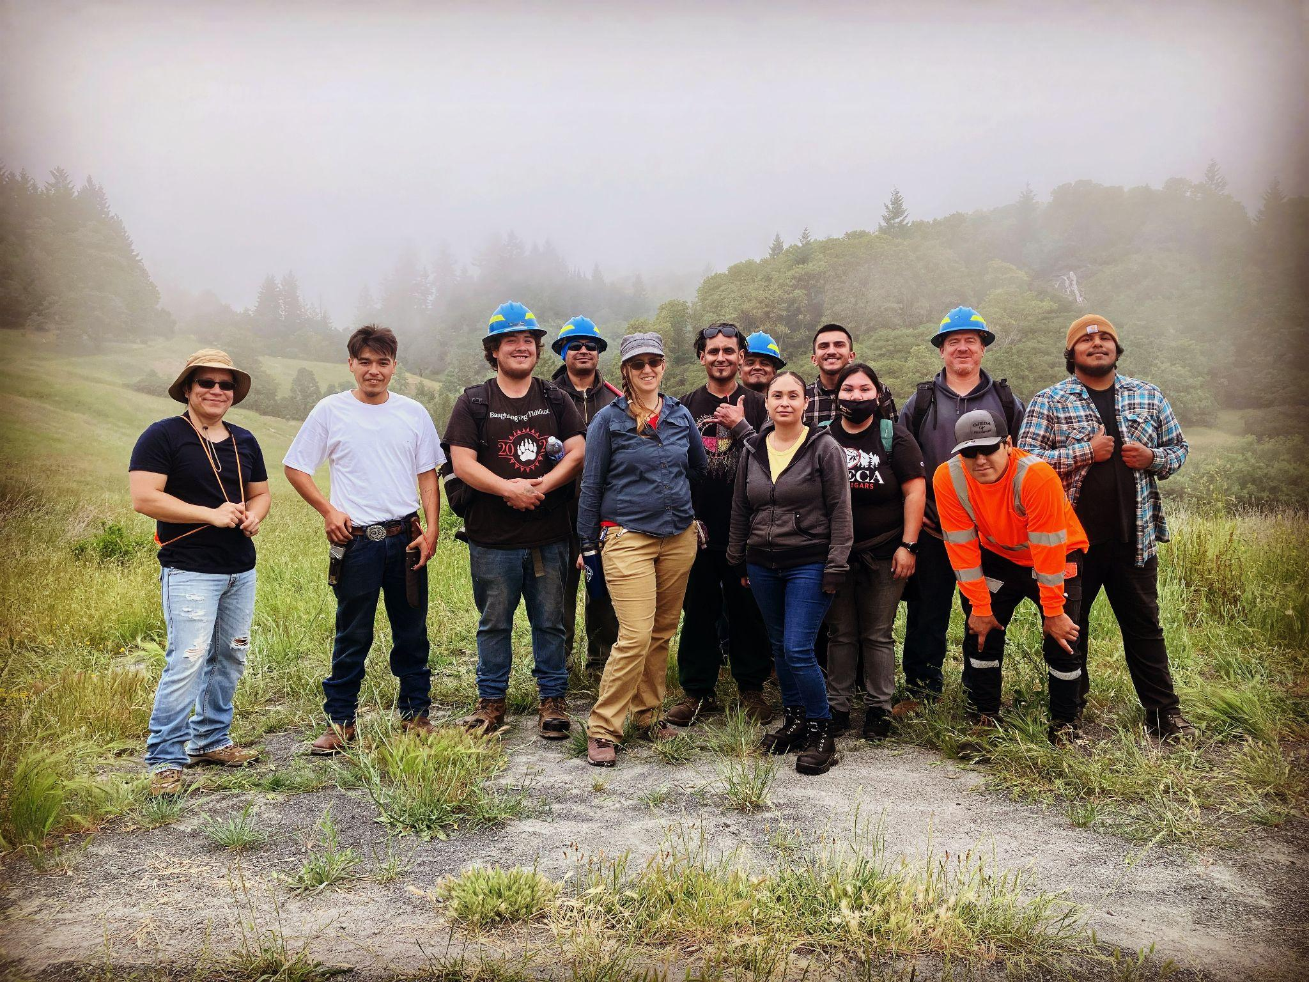
BUILDING CAPACITY FOR THE NATIVE COMMUNITY IN
LAKE & MENDO COUNTIES TO PLAY A CENTRAL ROLE IN STEWARDING ANCESTRAL LANDS
Training
EcoCultural Stewardship

Slide 28
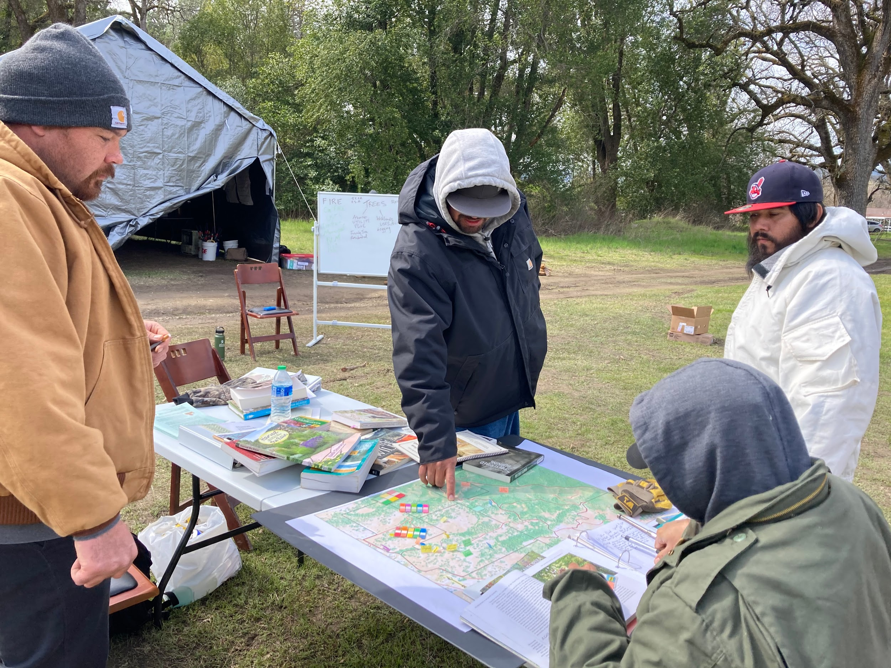
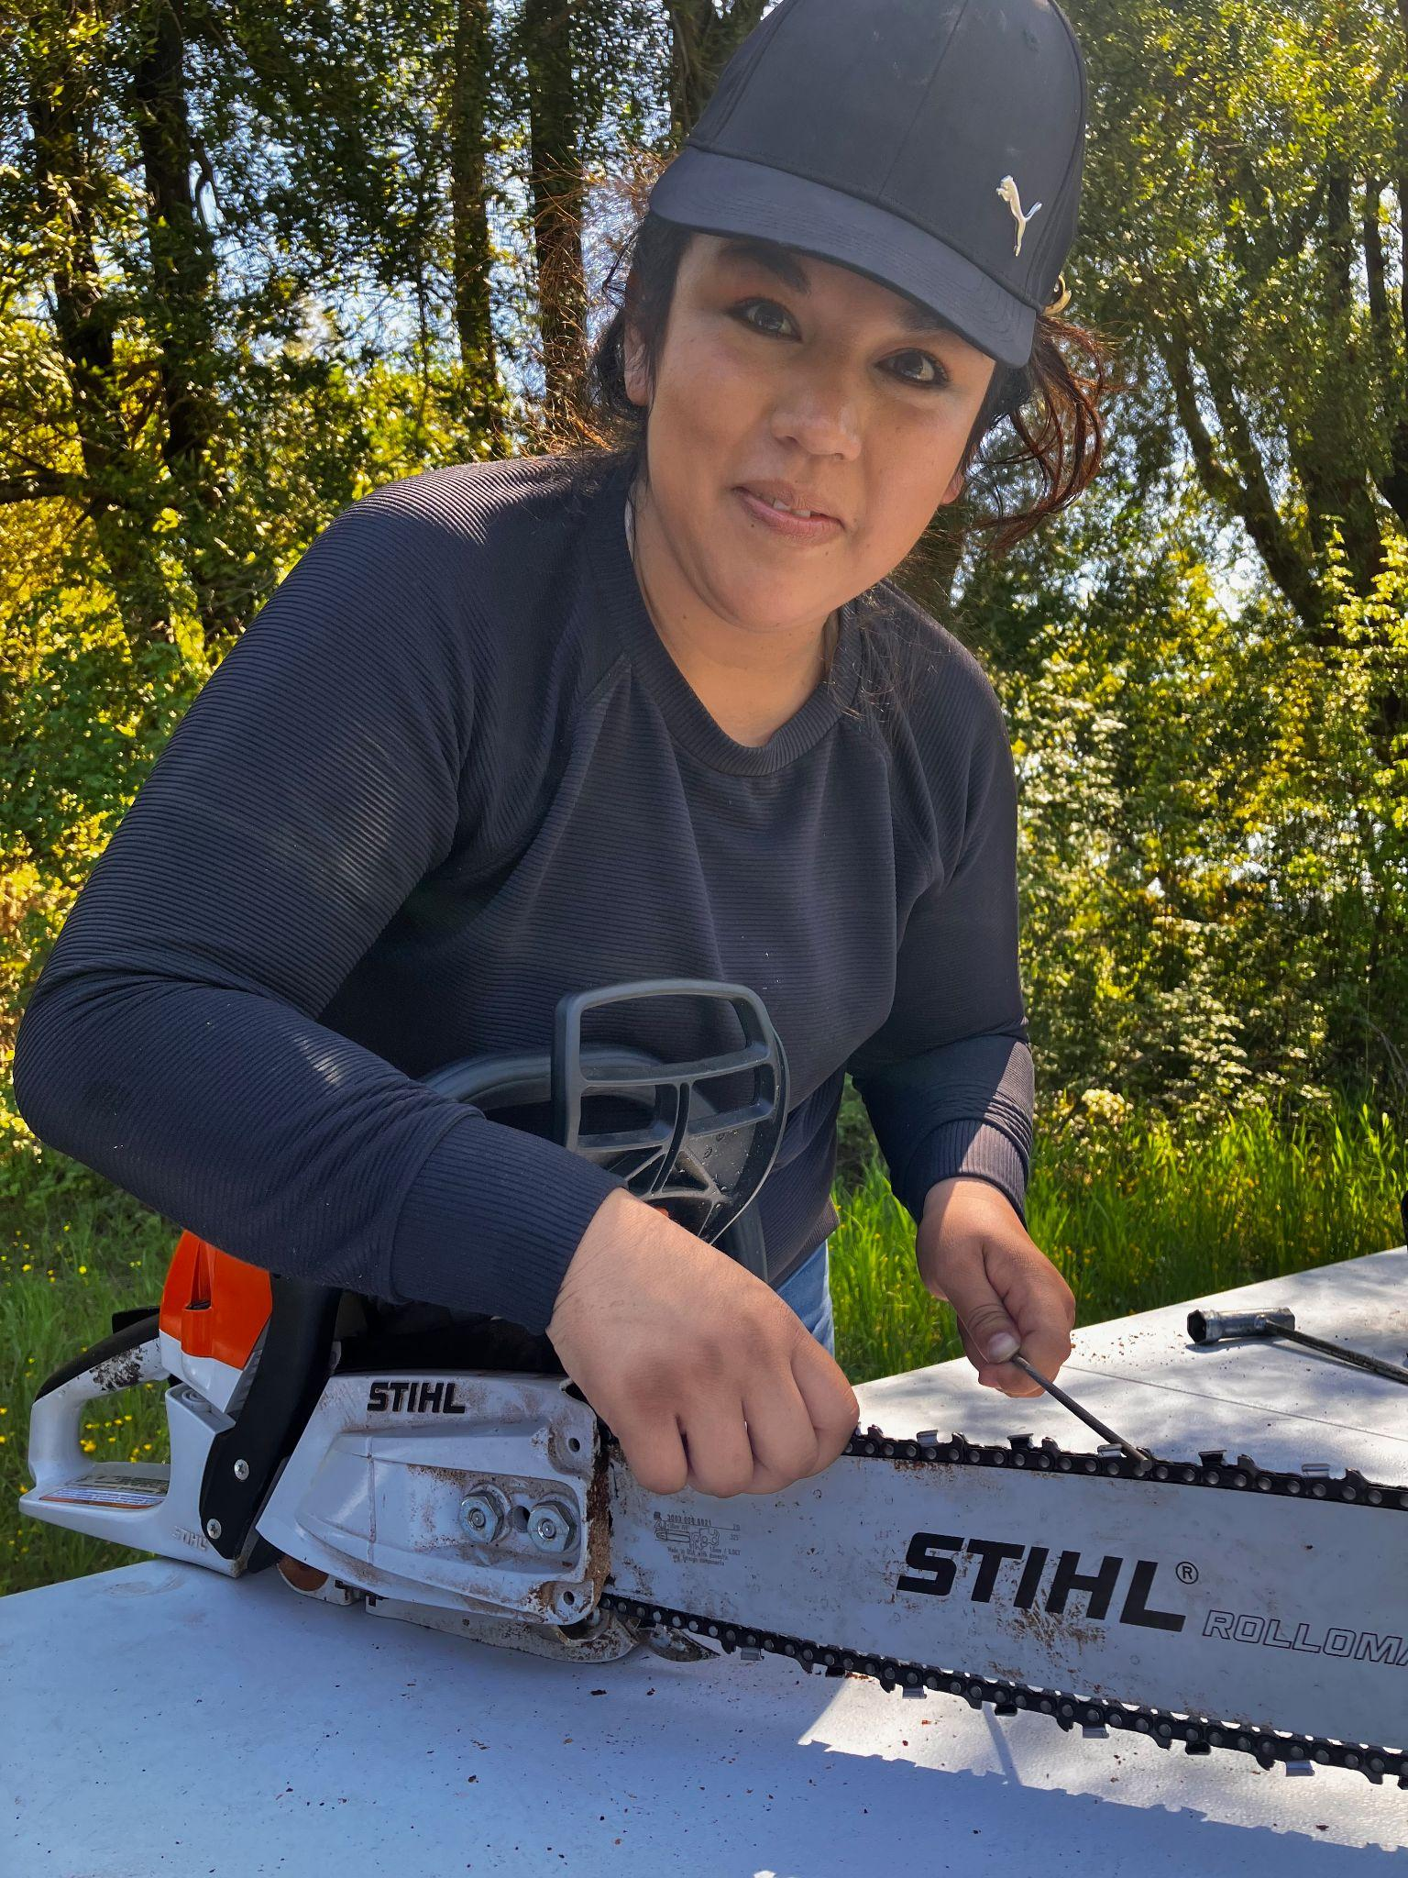
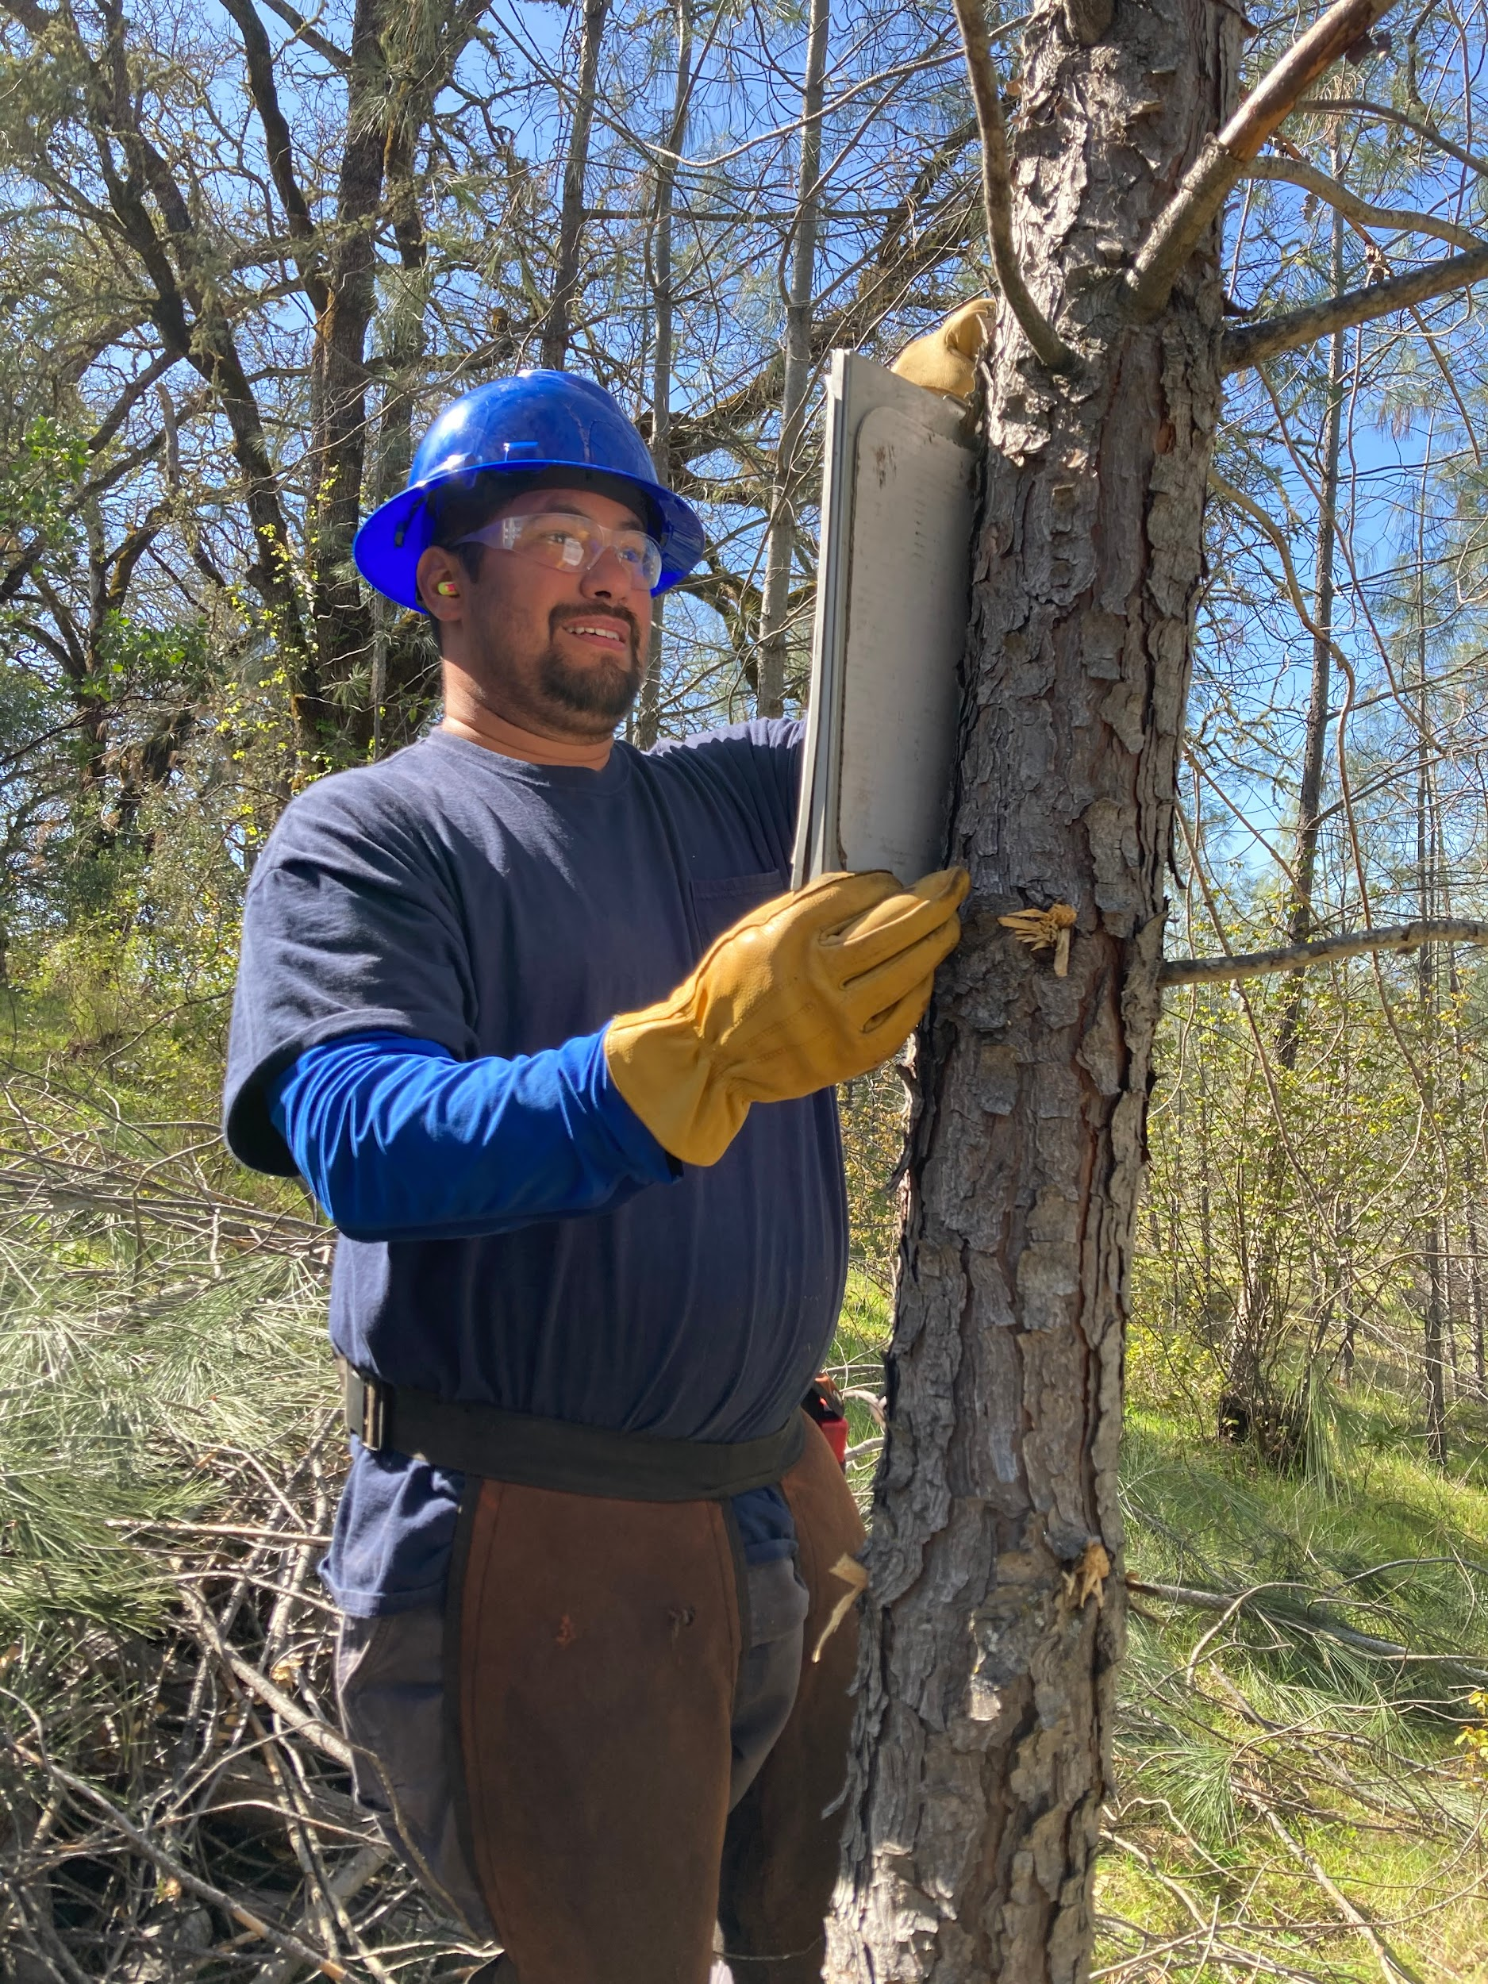
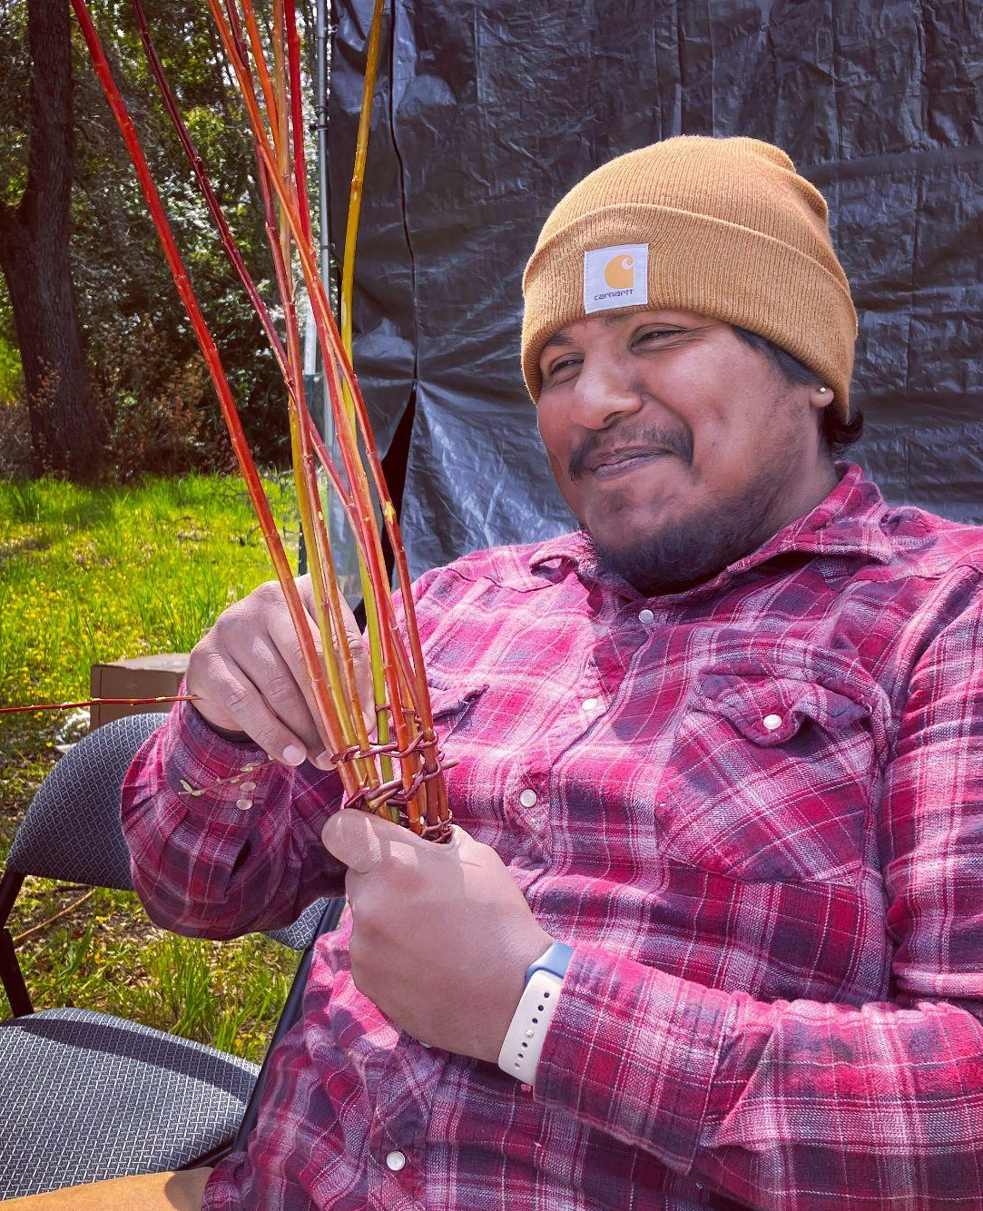
Training

Slide 29
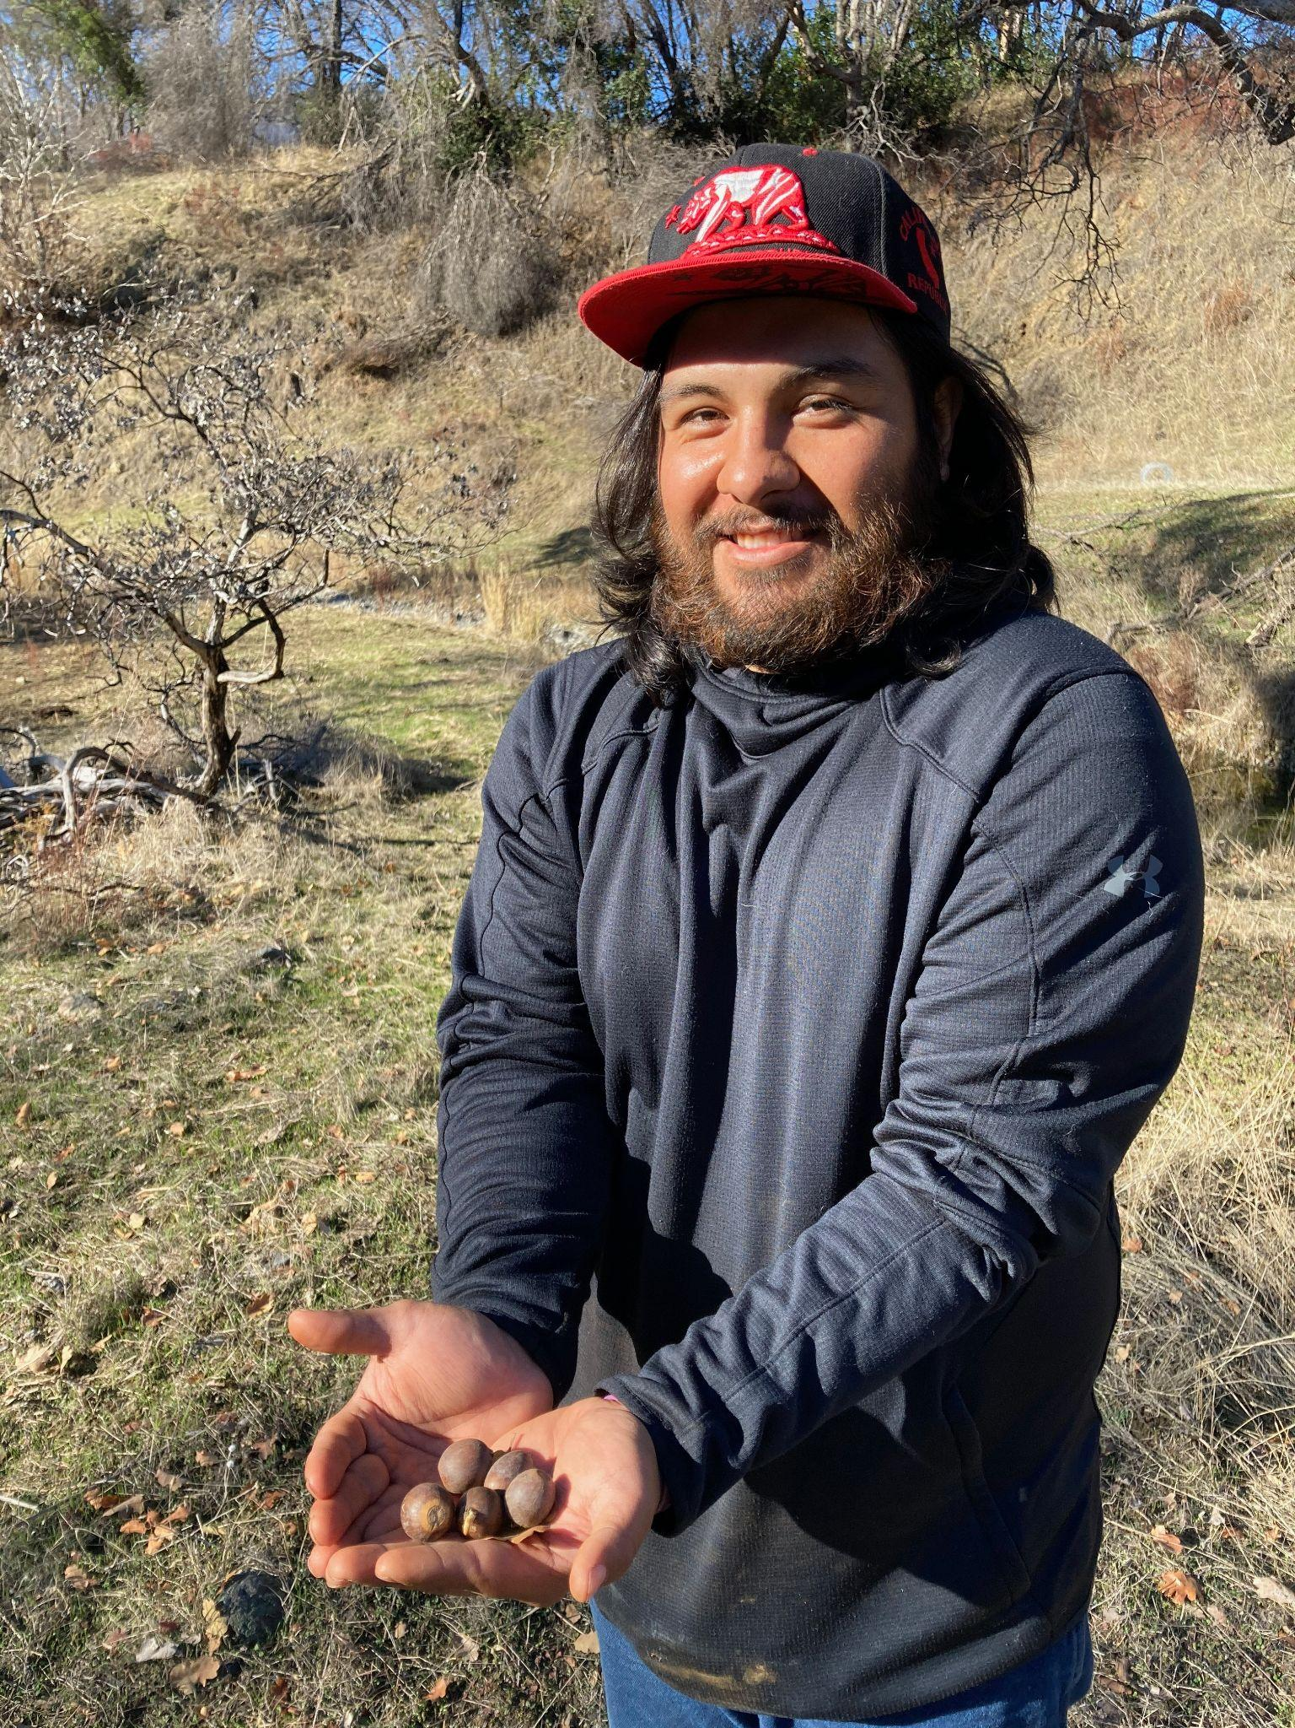
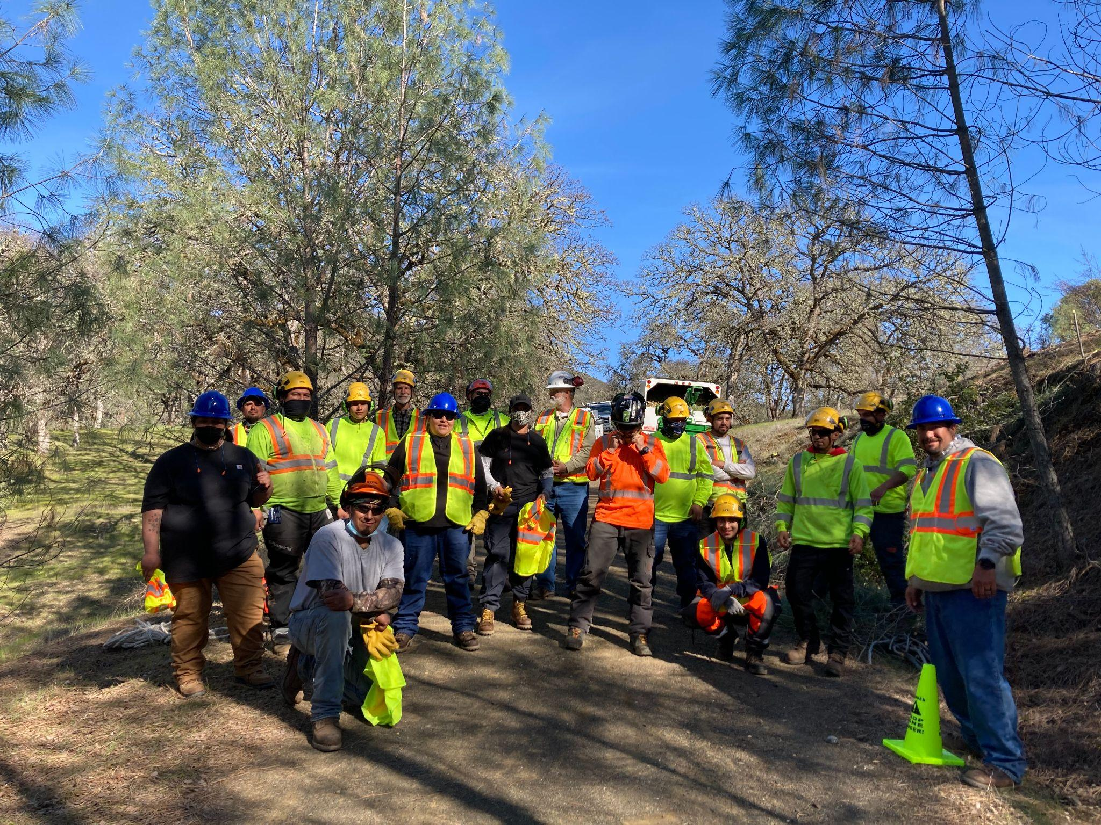
EcoCultural Stewardship
Enhance native biodiversity
Increase water quality and quantity
Sequester carbon
Strengthen culture and
reciprocal relationship with land

Slide 30
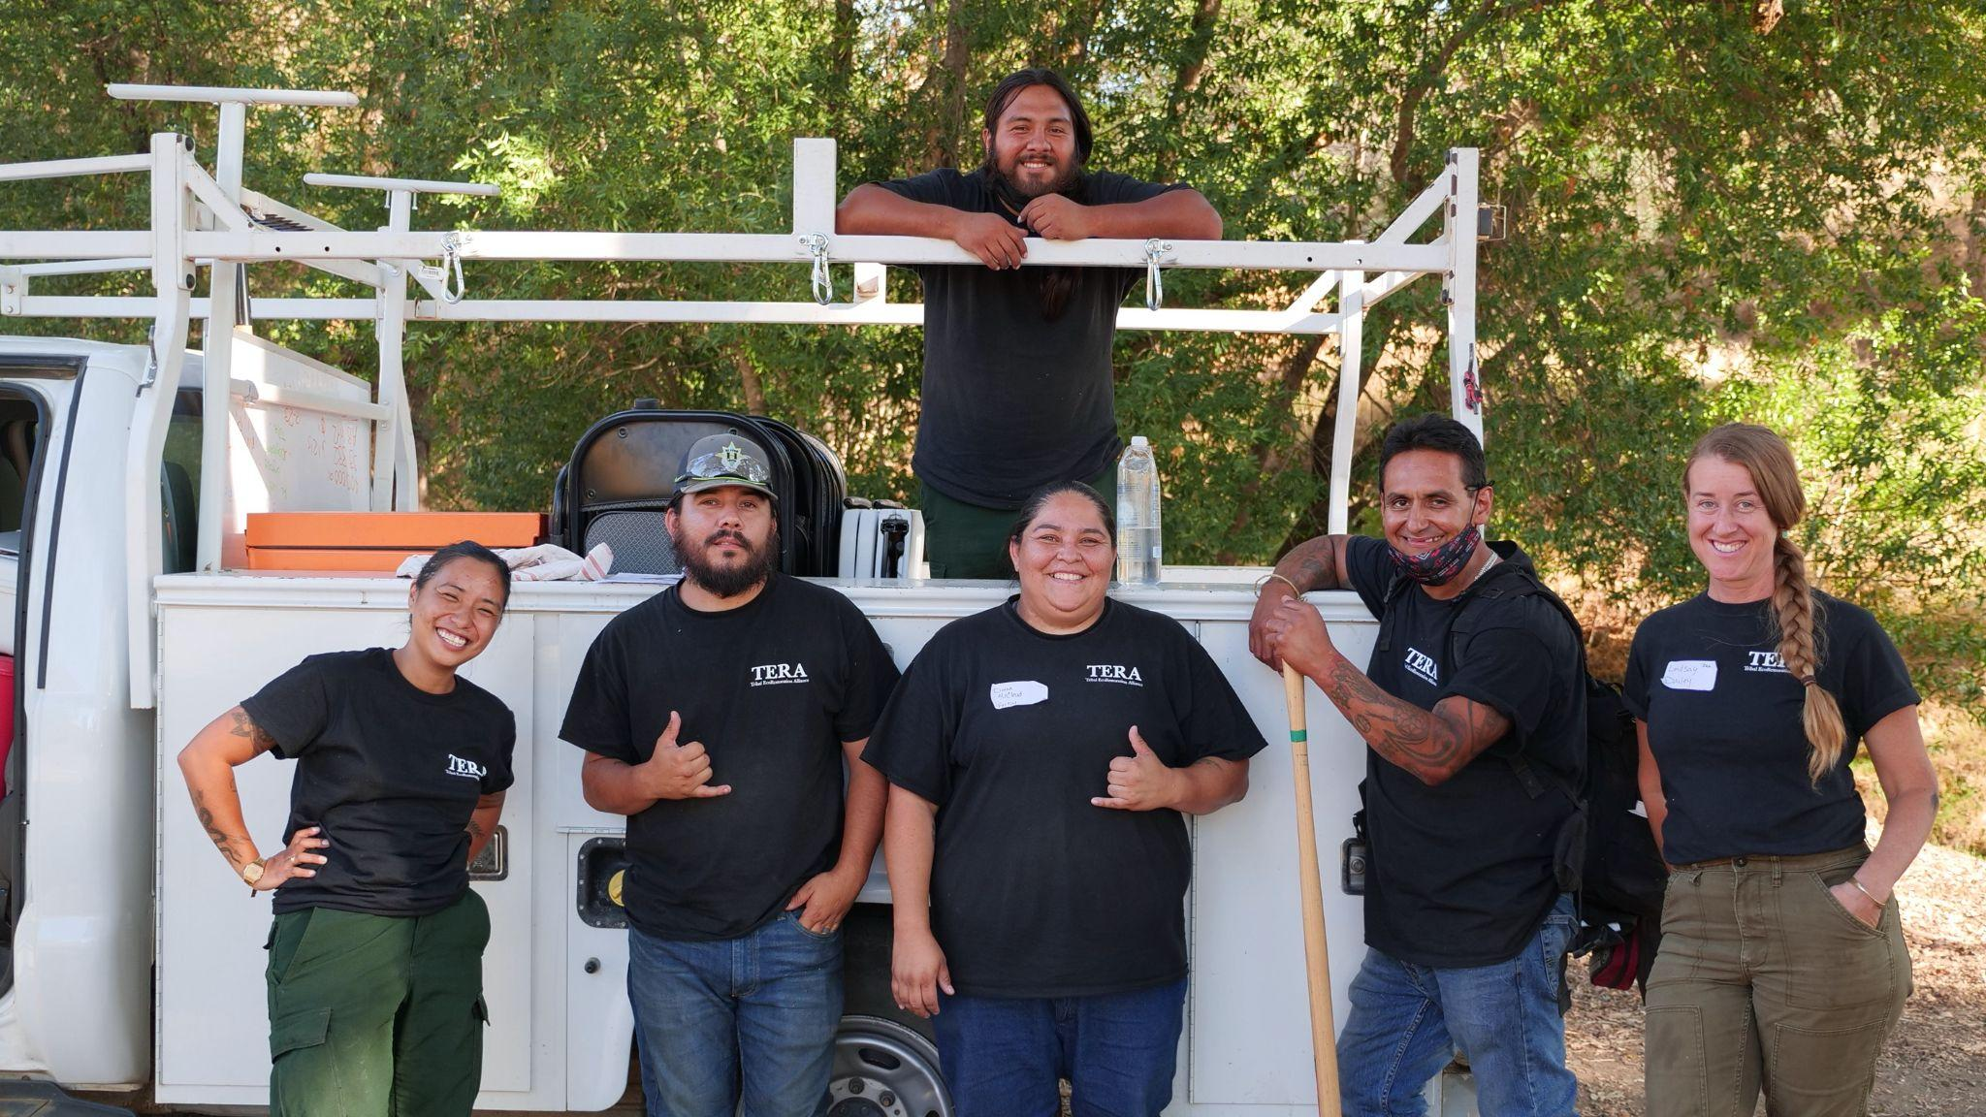
TRIBAL HAND CREW
LAND BACK VISION:
→ Contracts on public, private, and tribal land that create ongoing
access for ecocultural stewardship

Slide 31

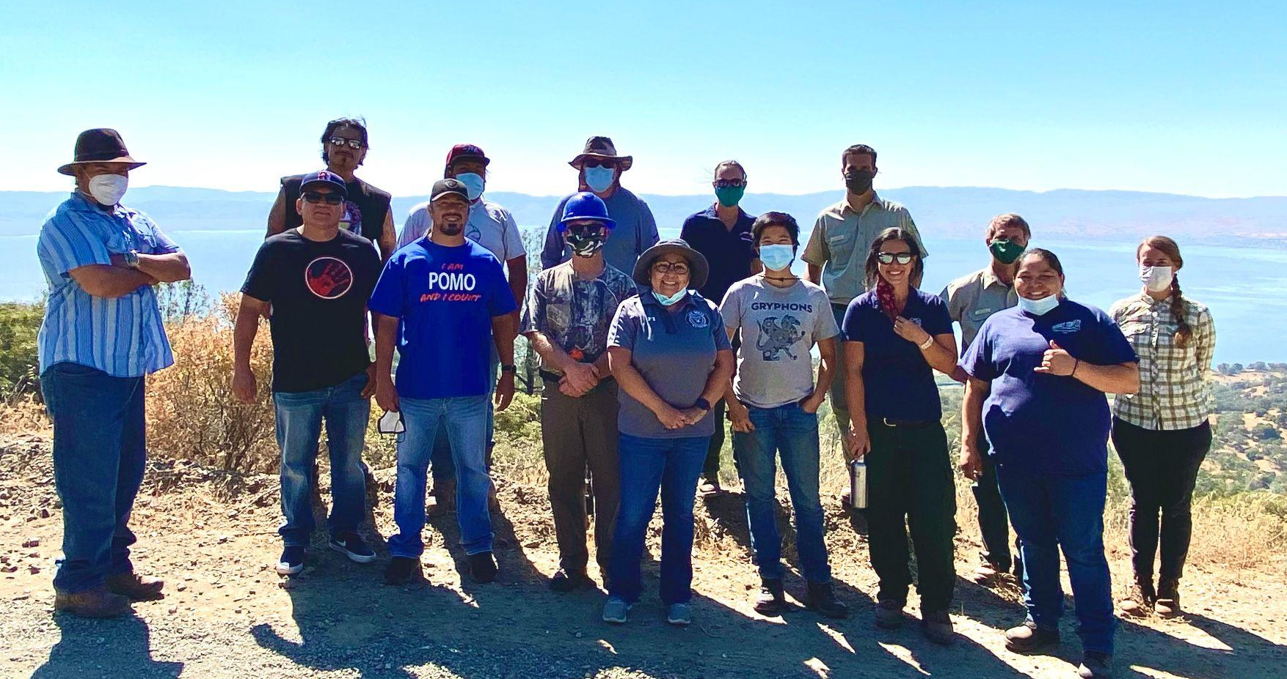


Agency Partnerships
Notes:
Hazardous fuels reduction - oak woodland restoration - erosion control - improving water quality for salmon bearing stream - come back to collect black oak acorns!

Slide 32
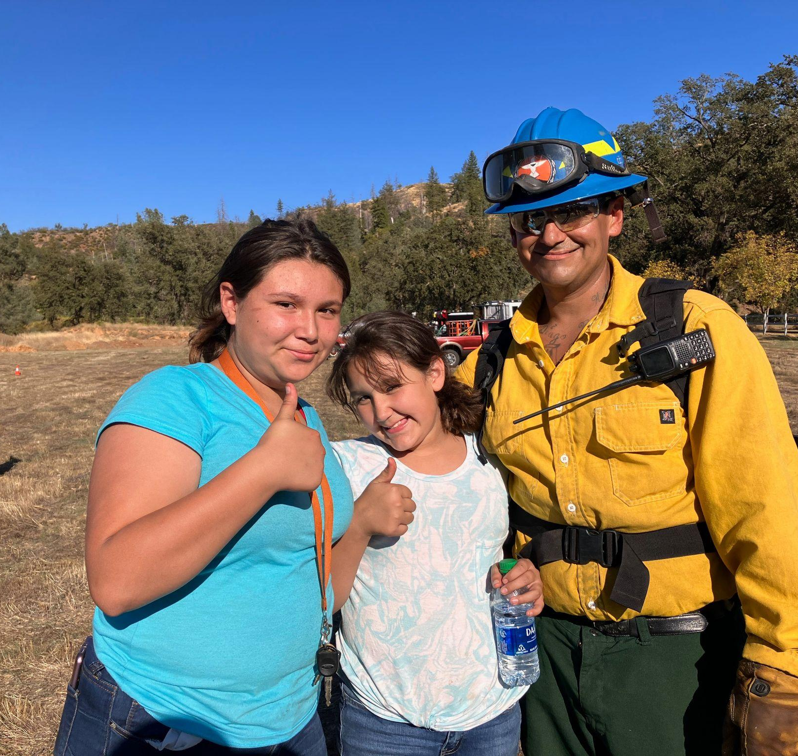
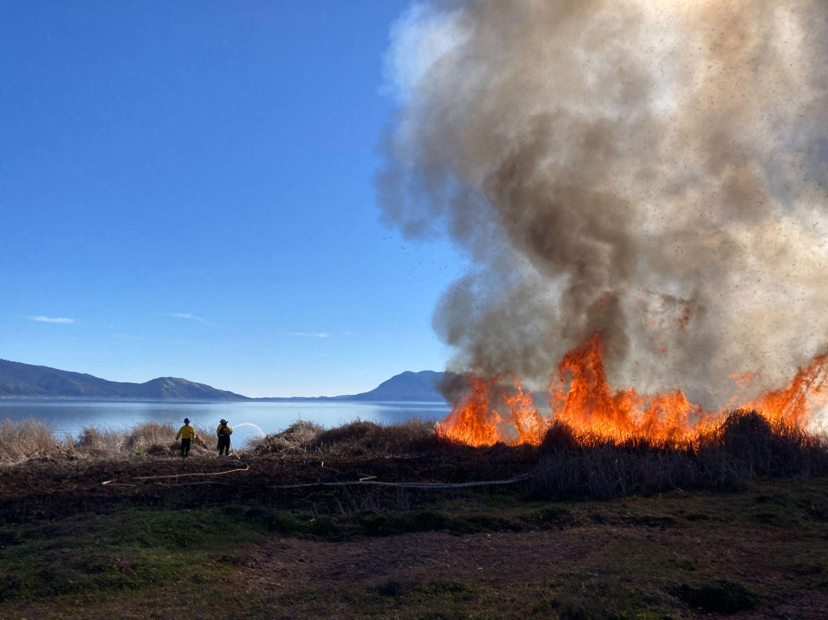
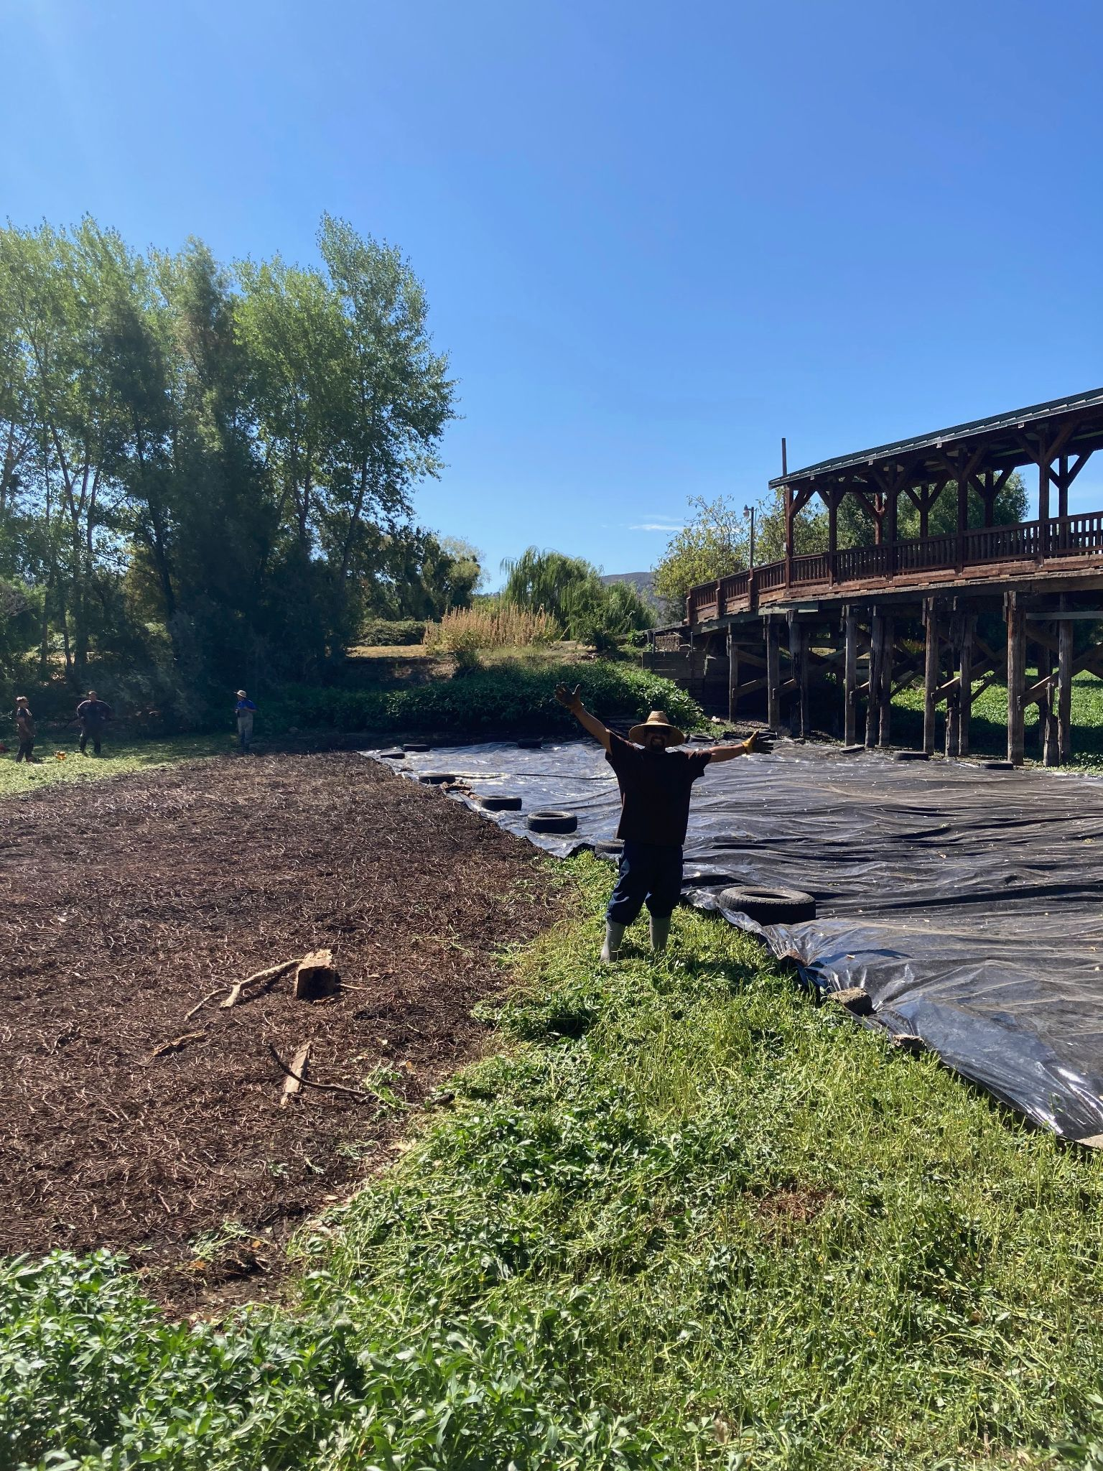

Cultural Burning & Prescribed Fire Program
Notes:
Training tribal members with fire skills to bring good fire back to the land

Slide 33

Public Discussion
The floor is yours!
Please raise your (Zoom) hand ✋🏽
and unmute yourself

Slide 34
Save the date for our
next Collaborative meeting:
Google Calendar Link / Direct Zoom Link
Please contact us with any questions or concerns: ccrp@humboldt.edu
November 30th
11:00 a.m.-12:30 p.m.

