Slide 1
Welcome/bienvenidos
Everyone!
You have arrived at the June Convening of the Redwood Coast Region’s High Road Transition Collaborative—called Redwood Region RISE (Resilient Inclusive Sustainable Economy).
Please introduce yourself in the chat- name, affiliation (if applicable) and where you are zooming in from: https://native-land.ca/
Icebreaker: Tell us something that makes you proud (about yourself, family & friends, or your community)!

Slide 2
Agenda

Slide 3
Updates
Logo Contest: Whoops!
Contracting and hiring:
Contracts just about executed with North State and Eastern Sierra partners.
Welcome back Ursula Bischoff.
Research Deliverables: On track…
Listening Campaign: 50+ Partners contacted, 30+ sessions completed.
Early focus on health and social services, due to deliverable schedule.
Rest of summer reaching out to Govt, Econ Dev, Sustainability, and priority community partners.
Governance Structure: We submitted our initial structure to the state on June 6th…

Slide 4
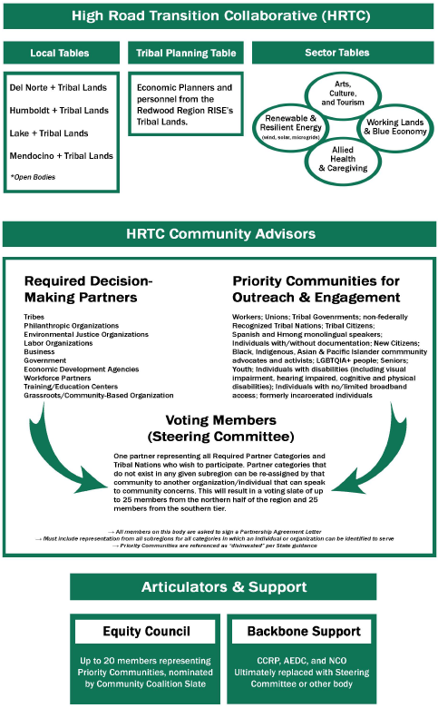
Governance Overview
“A high road transition collaborative is a broad based regional group convened by a skilled and impartial intermediary to plan for economic recovery and a sustainable and equitable economic future. These collaboratives shall prioritize equity, sustainability, and job quality, and advance a shared prosperity where workers and communities share equally in the benefits of a carbon-neutral future.”
The Regional Convener must ensure that the HRTC includes balanced representation from:
Labor
Employers, Business, Business Associations
Grassroots/CBOs
Government Agencies
Economic Development Agencies
Philanthropic Organizations
Education and Training providers
Workforce Entities
Environmental Justice Organizations
“Disinvested communities”
CA Native American Tribes

Slide 5
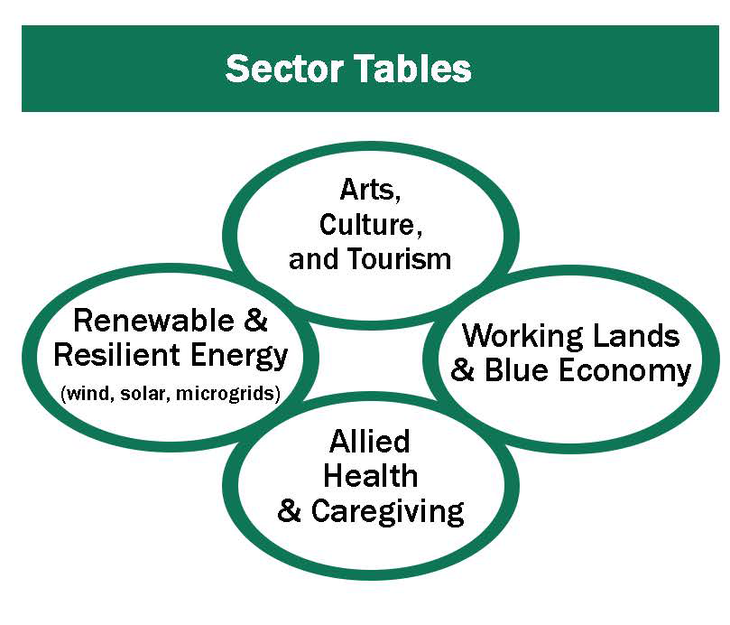
Sector Tables
Responsible for surfacing strategies, identifying constraints and solutions, identifying projects for implementation and leveraging opportunities for their sector.
Include members representing workforce development and labor/trades to help guide those aspects of strategy development.
Sector Tables will put forward projects and strategies to be voted on by the Voting Block.
Partnership Agreement letters will be required and awards available.
Groups will be co facilitated by a sector expert and trained facilitator. They will be evaluated by the Equity Council for balance and representation.
June-August 31, 2023
Sept 1- June 2024
Into the future…
RFP for Table Facilitators/Leads. Members identified and onboarded Members review and provide comment on Regional Summary Part 1.
Develops strategies, identifies projects in various stages of readiness. IDs synergies between sectors, etc.
Reflection/lessons learned from planning process. Evaluate opportunities and id needs for continued group work..

Slide 6
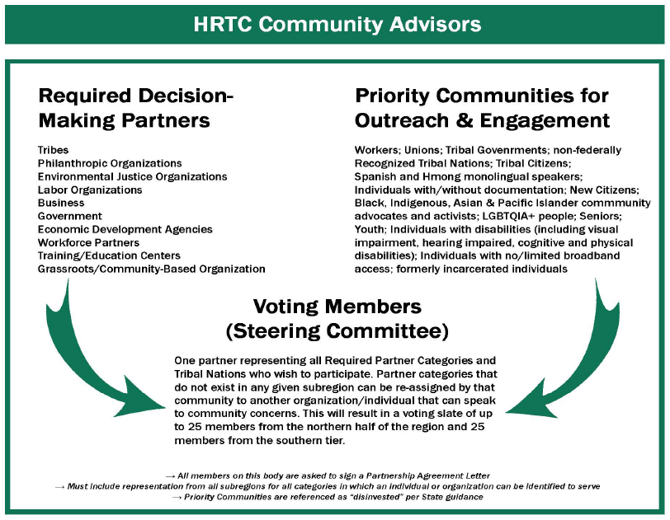
Voting Member Block
Members identified from our community here to serve in a voting role- per state guidance on from each partner category in each county/tribal land, including representatives and advocates of priority communities.
Decides final strategies/projects.
Builds organizational structures for HRTC to function as autonomous group.
June-August 31, 2023
Sept 1- June 2024
Into the future…
Voting members from each sub region are confirmed and onboarded. Members review and provide comment on Regional Summary Part 1.
Set criteria for project/strategy evaluation. Finalize decision making processes. ID implementation priorities.
Reflection/lessons learned from planning process. ID governance issues for reform, look to build sustainable and autonomous group.

Slide 7
Local Planning Tables
Public input process
Meets quarterly to surface local priorities, give input to decision making bodies, help identify key projects and strategies for inclusion in the plan.
Ensure alignment with CEDS.
June-August 31, 2023
Sept 1- June 2024
Into the future…
Local tables confirm voting member slate. Review and provide comment on Regional Summary Part 1.
Local tables give input on projects and strategies at quarterly meetings. Align with CEDS and local priorities.
Local tables give input on projects and strategies at quarterly meetings. Align with CEDS and local priorities.

Slide 8
Tribal Planning Table
Community of Practice for Tribal Economic Development practitioners.
Explore innovative and best practice strategies for advancing economic initiatives on tribal lands.
Can be a coordinating and cooperation space for upcoming Tribal CERF or other opportunities..
June-August 31, 2023
Sept 1- June 2024
Into the future…
Participants onboarded. Facilitator identified. ID priority topics, set meeting schedule/agenda. Review and provide comment on Regional Summary Part 1.
Exploring best practices/opportunities for collaboration. Connecting to TA for Tribal CERF opportunity, etc.
Reflect on planning process, opportunities to strengthen value add, etc.

Slide 9
Equity Council
Guides NCO &HRTC outreach and engagement work.
Provides oversight to HRTC bodies on equity and inclusion, helps maintain balance and supports priority communities to engage and make decisions.
June-August 31, 2023
Sept 1- June 2024
Into the future…
Members onboarded. Provide guidance and comment on composition of Voting Member Slate and Sector Tables. Guide Outreach and Engagement.
Guide Outreach and Engagement. Assess equity implications of strategies and projects…
Reflect on planning process, id opportunities for improvement…

Slide 10
Next Steps
County groups will be contacted to solidify their voting slate
Onboarding packet sent to members
RFP for Sector Table leads
Confirmation process for Sector Tables

Slide 11
Understanding the Redwood Region RISE
Child Care
Cost and Affordability

Slide 12
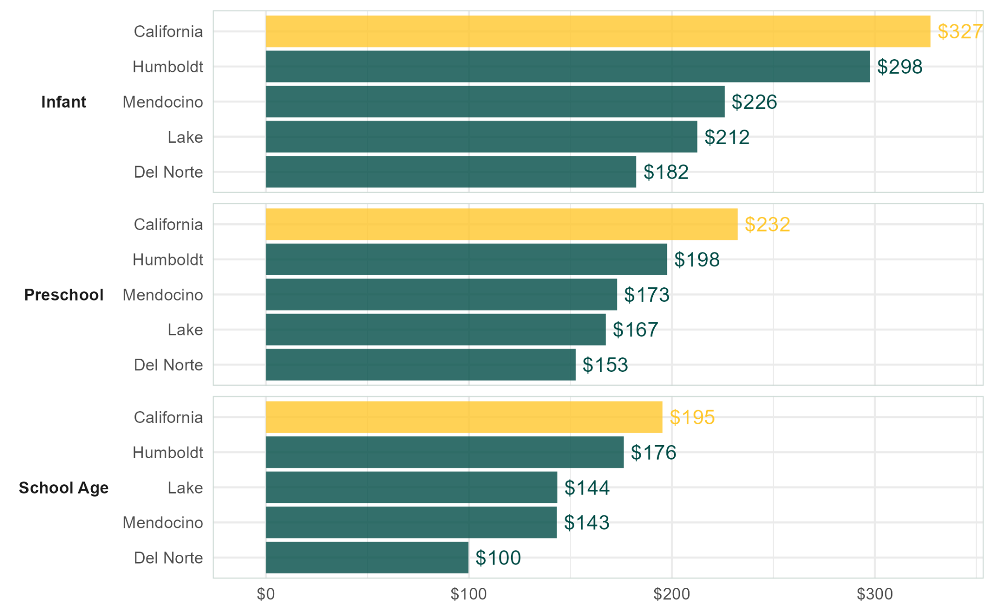
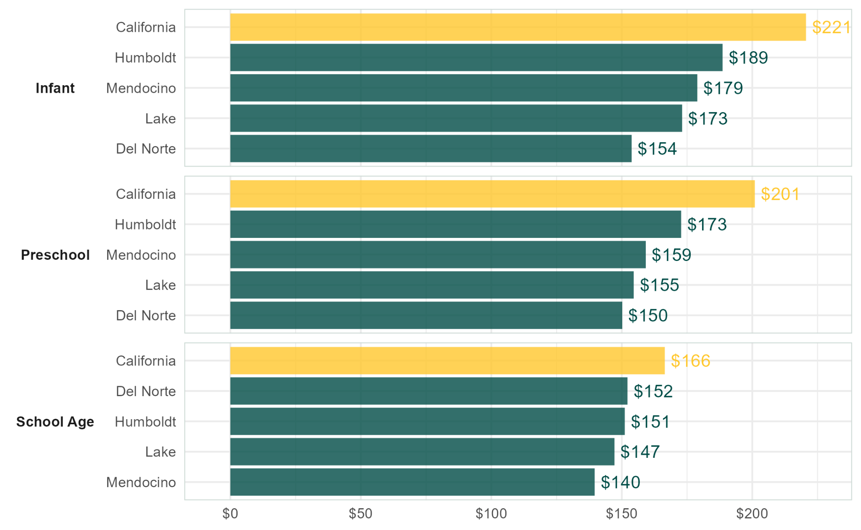
Child Care Full-Time Weekly Cost (2018 Data)
Center-Based Facilities
Family (Home) Facilities
Cost data sourced from National Database of Childcare Prices. Median earnings sourced from the American Community Survey, Table S2001. Ratios calculated by the author assuming 50 weeks of child care per year.

Slide 13
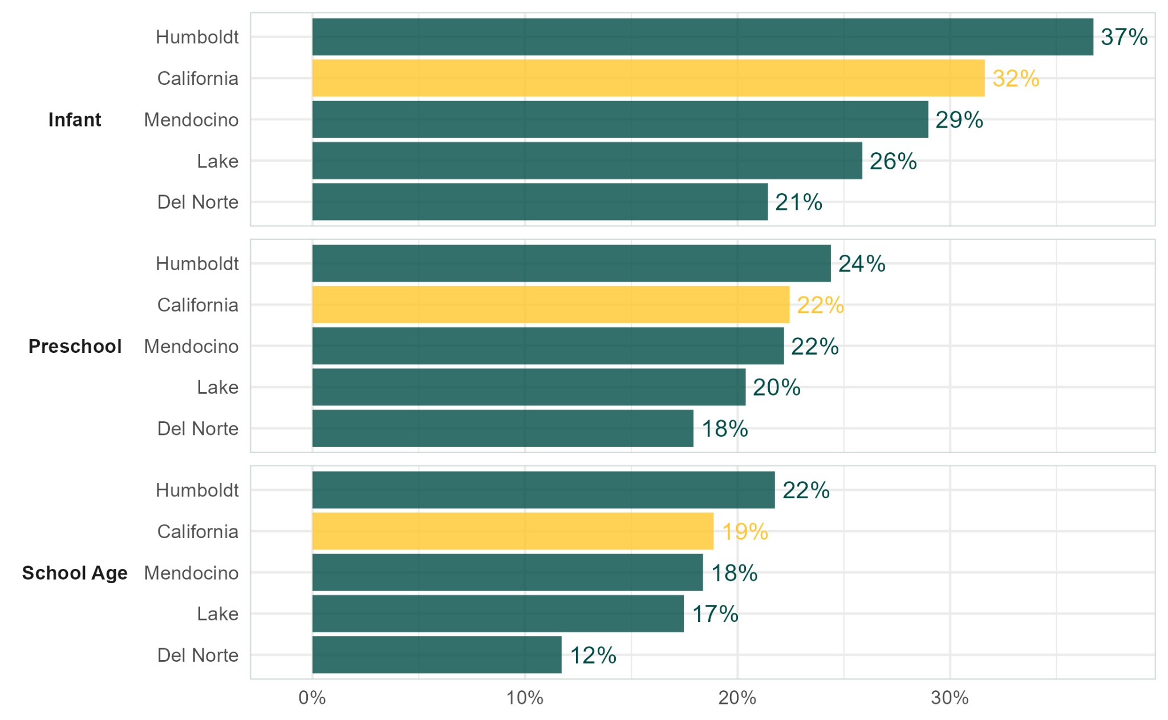
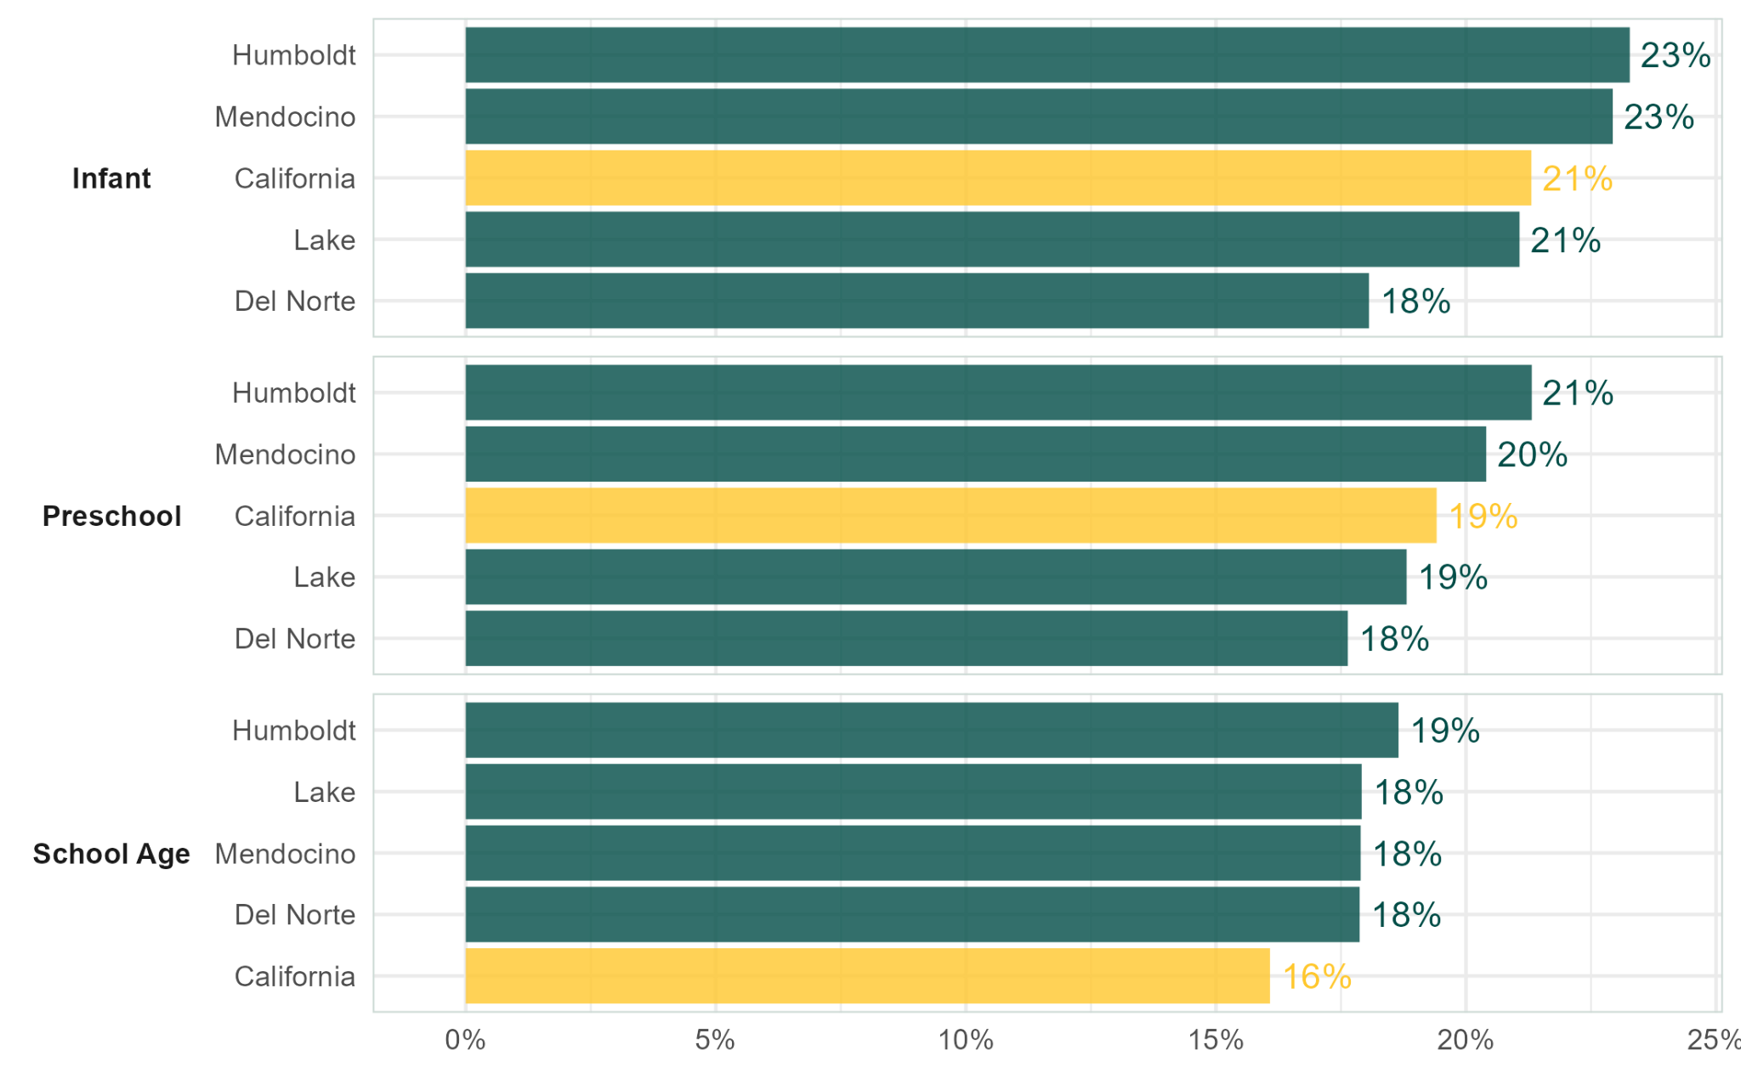
Affordability: Child Care as Percent of Median Full-Time Earnings (2018 Data)
Center-Based Facilities
Family (Home) Facilities
Cost data sourced from National Database of Childcare Prices. Median earnings sourced from the American Community Survey, Table S2001. Ratios calculated by the author assuming 50 weeks of child care per year.

Slide 14
Further Exploration of
Low Prime Age Labor Force Participation

Slide 15
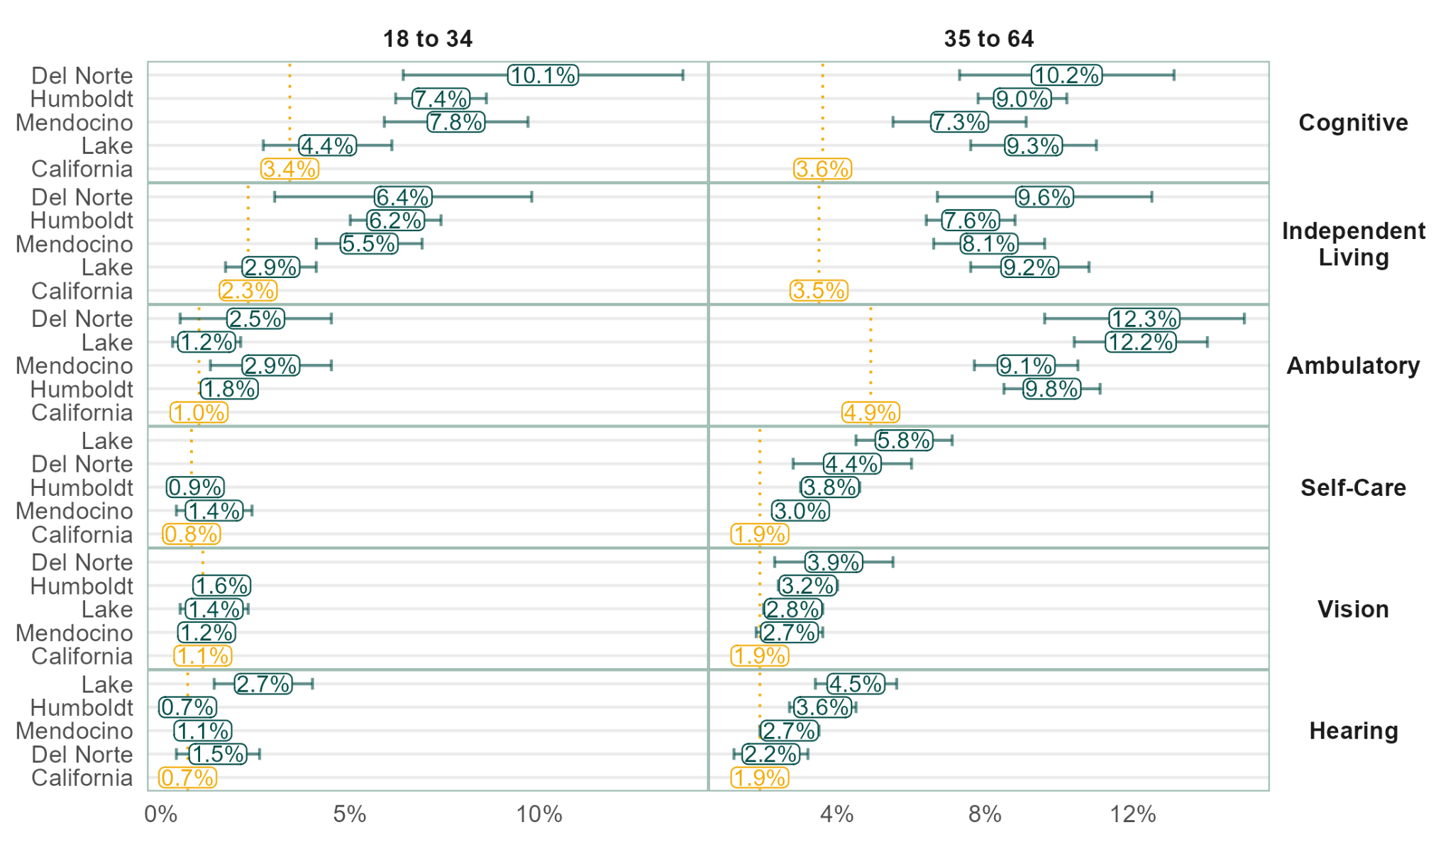
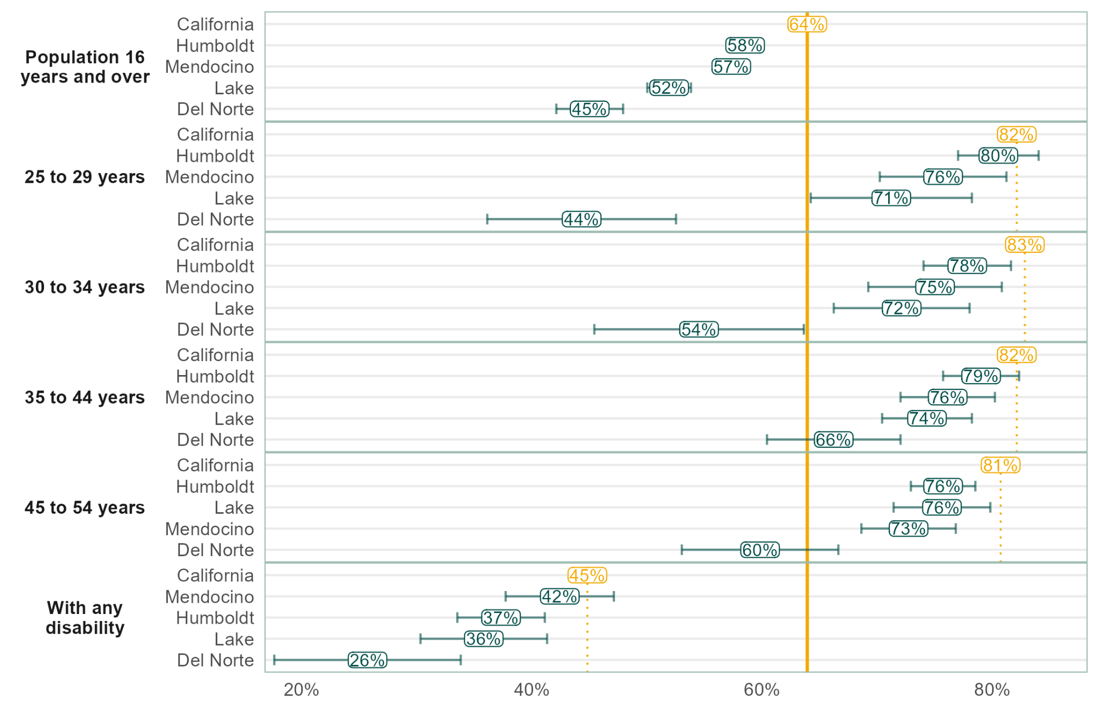
Disability as a Factor for Low Labor Force Participation
Labor Force Participation
Disability Rates
?
Data sourced from ACS five year estimates (2017 - 2021), Tables S1701 and S1703. Del Norte data for Table S1703 and poverty rates by disability and full-time employed are not available. “Worked full-time year-round” applies to the population aged 16 to 64.

Slide 16
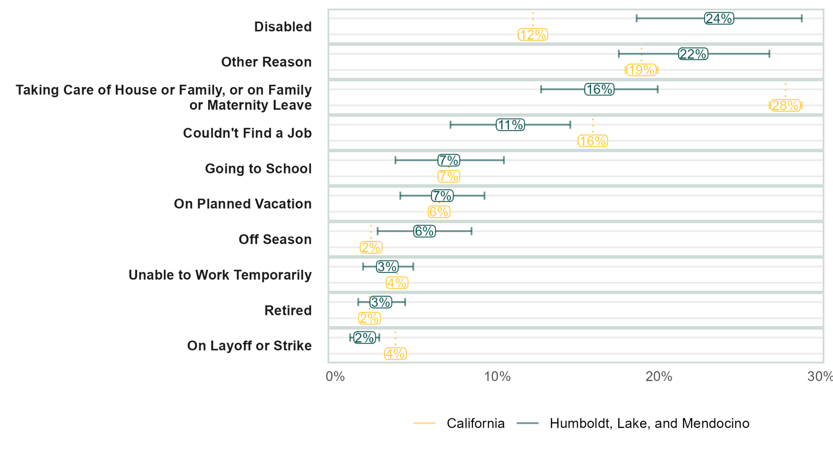
Reason for Not Working Prime Age Adults
(2011- 2021 Data, Adults 25 - 54)
Data sourced from California Health Information Survey, via AskCHIS.

Slide 17
Industry Exploration Tool

Slide 18
Industry Exploration Tool (BETA!)
Terms:
LQ = Location Quotient: A measure of relative size of an industry
Growth = Annualized rate of growth in employment from 2011 to 2021 (for this graph only)
Competitive Share Effect = The amount by which growth exceeds the amount expected compared to the state.
Wage Premium = The amount by which the local wage exceeds the state wage for an industry.
3 digit NAICS codes
Industry Tool Here: https://ccrp.humboldt.edu/ResearchData_Industry_CCRP.html
THIS IS PRELIMINARY WORK!!!

Slide 19
Takeaways
Child Care affordability varies across the region, but evidence indicates that Humboldt County is among the least affordable counties in the state.
Residents of Humboldt, Lake, and Mendocino counties who are not working are twice as likely to cite disability as a reason for not working compared to the state population.
Check out the Redwood Coast Preliminary Industry Exploration Tool

Slide 20
Community Outreach and Engagement
Updates North Coast Opportunities (NCO)

Slide 21
Project Highlight
Hoopa Valley Tribe COO: Walter D. Gray III
https://vimeo.com/708452716

Slide 22
Presenting the Catalyst Fund
Welcome, Jesus Salazar, Senior Program Analyst with the office of Planning and Research (OPR)
Please note the slides on the Catalyst Fund will be added as soon as possible

Slide 23
Save The Date!
Please feel free to contact us with any questions or concerns: ccrp@humboldt.edu
July 27th, 11:00 a.m.-12:30 p.m.

