Slide 1
February 29, 2024
Redwood Region RISE (Resilient Inclusive Sustainable Economy) Monthly Collaborative Meeting
Learn More: bit.ly/Redwood-RISE

Slide 2
Welcome Everyone / ¡Bienvenidos todos!
You have arrived at the February Collaborative Meeting for Redwood Region RISE (Resilient Inclusive Sustainable Economy).
Please introduce yourself in the chat–name, affiliation (if applicable) and where you are zooming in from: https://native-land.ca/
Icebreaker question:
What was your first job?
Let us know in the comments!
Notes:
Before moving to housekeeping, lets do the Cal Poly Land Acknowledgement

Slide 3
Land Acknowledgement
Land Acknowledgement
Redwood Region RISE’s Collaborative is located on the present and ancestral Homeland and unceded territory of Indigenous People. Tribes and Nations in our region include:
Bear River Band of the Rohnerville Rancheria; Big Lagoon Rancheria; Big Valley Band Rancheria; Blue Lake Rancheria; Cahto Tribe; Coyote Valley Band of Pomo Indians; Elem Indian Colony; Elk Valley Rancheria; Guidiville Indian Rancheria; Habematolel Rancheria of Pomo Indians; Hoopa Valley Tribe; Hopland Band of Pomo Indians; Karuk; Koi Nation; Manchester Band of Pomo Indians; Mattole; Middletown Rancheria of Pomo Indians; Pinoleville Pomo Nation; Potter Valley Tribe; Redwood Valley Little River Band of Pomo Indians; Resighini Rancheria; Robinson Rancheria; Round Valley Reservation; Scotts Valley Band of Pomo Indians; Sherwood Valley Rancheria; Tsnungwe; Tolowa; Tolowa Dee-ni' Nation; Trinidad Rancheria; Wailaki; Wiyot; Yurok Tribe.
We make this land acknowledgement in recognition that our words must be matched by action and approach. Learn more: "What Good Is a Land Acknowledgment?"
Notes:
Before moving to housekeeping, lets do the Cal Poly Land Acknowledgement

Slide 4
Some Housekeeping Notes
Happy 1-year anniversary!
Team👋🏽
Welcome!
Spanish Interpretations are available
Speak at a manageable pace → and let us know if we aren’t!
Questions in chat → we gather & answer your questions
Please mute your microphone while in the public Zoom room
Ask questions even if it feels awkward
Assume good intent
Step away from business as usual
Embrace the messiness
Be discouraged
Dream big for our region

Slide 5
Agenda for today’s meeting: Jobs, jobs, jobs!

Slide 6
Planning Phase Updates RRRISE
Partner Directory February 2024
Fill out our partner survey to join this list!
Visioning Exercise: ThinkPlace created the beginning of a shared agenda. We are buttoning that up into a statement–will send ASAP!
Where are we now and where are we going?

Slide 7
The Planning Phase
RRRISE is currently over mid-way through our Planning Phase.
This phase has two goals:
Create a regional Collaborative to direct economic planning efforts moving forward- a broad coalition centering regional balance and the inclusion of new voices and priority groups.
Produce a comprehensive Regional Roadmap for inclusive, sustainable Economic Development in our region.
→ In September 2024, we should have a 10-year vision to guide investment in our Region, and an inclusive Collaborative empowered to shepherd the process!

Slide 8
Redwood Region RISE
Agenda
Agenda
Agenda

Slide 9
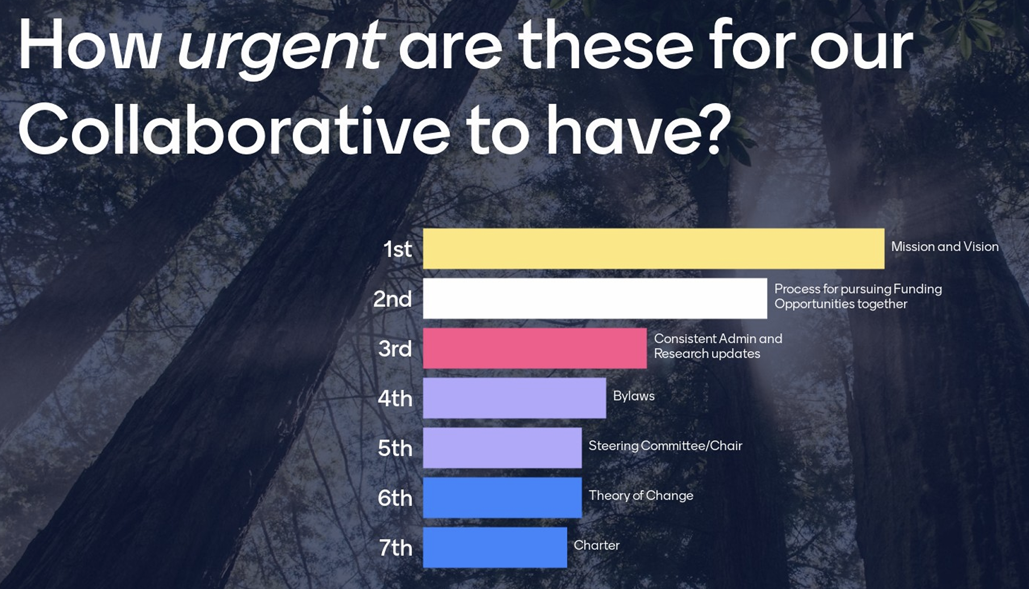
Collaborative Building
Accomplishments:
All our ‘seated’ Tables + Equity Council up & running!
Vision and Purpose session in January 2024
Next Steps:
Vision Statement coming soon
In-Person Meeting (postponed)

Slide 10
Regional Roadmap
Accomplishments:
Regional Roadmap Part 1- Data establishes baseline for our Region on key economic development and well-being indicators.
Next Steps:
Dissemination: Creating formatted summary of Regional Roadmap Part 1, short & sweet topical “issue briefs” with accompanying slide decks, videos, and social media content to easily digest key findings.
Elevate the key metrics and data points we want to use to track our progress.
Regional Roadmap Part 2: Develop our 10-year vision for our region.
Create Strategies and Identify projects that advance that vision (Deadline = end of August 2024)

Slide 11
Post Planning Phase
Catalyst Funding: Still waiting to (formally) receive our award. State DRAFT guidelines received last week. We hope to be through contracting by the end of the summer…
Implementation: Official guidelines to be released later this year. Public comment period will follow. DRAFT guidelines released last week (same as catalyst). Implementation will roll out in $100 million increments over three fiscal years.
Details to come in late Summer….

Slide 12
Collaborative Bodies: Report Out
Equity Council
Tribal Planning Table
Local Planning Tables:
Tribal Lands + Del Norte
Tribal Lands + Humboldt
Tribal Lands + Lake
Tribal Lands + Mendocino
Sector Planning Tables:
Arts, Culture, and Tourism
Health & Caregiving
Renewable & Resilient Energy (Wind, Solar, Microgrids)
Working Lands & Blue Economy
Notes:
Lets do one accomplishment, and the next step more in the mailer

Slide 13
Data Walk: Workforce Barriers in the Redwood Region
Senior Researcher at the California Center for Rural Policy,
Sky “the Data Guy” Schuyler

Slide 14
The Issue: Significantly Lower Employment Among Prime Age (25-54) Adults
Prime Age Employment-to-Population Rates (2018 - 2022)
Source: American Community Survey, 5 Year Estimates (2018-2022)
Notes:
Fewer working age adults have a job. Why?

Slide 15
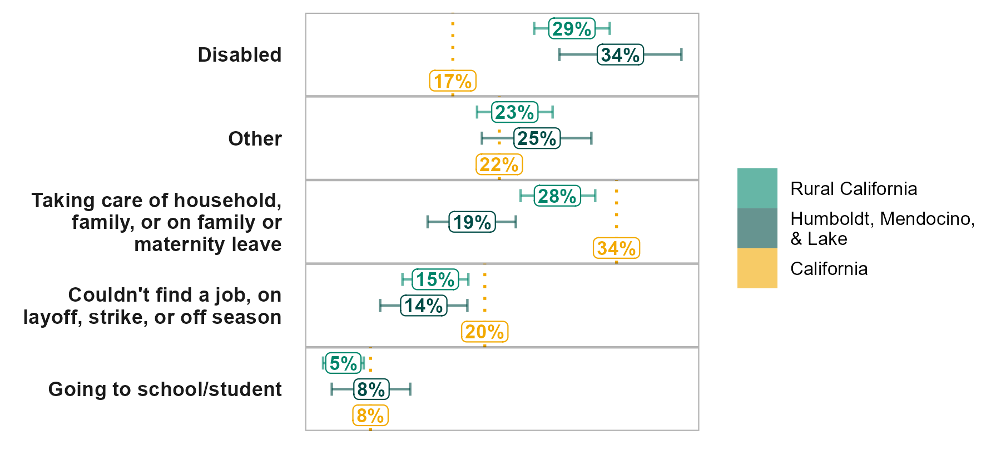
Why? Higher Rates of Disability Play a Role
Prime Age Adults Main Reason for Not Working (2011 - 2022)
Source: California Health Information Survey, Accessed via AskCHIS // Index of Relative Rurality
Notes:
Significantly more adults in the region cite disability as a reason for not working.

Slide 16
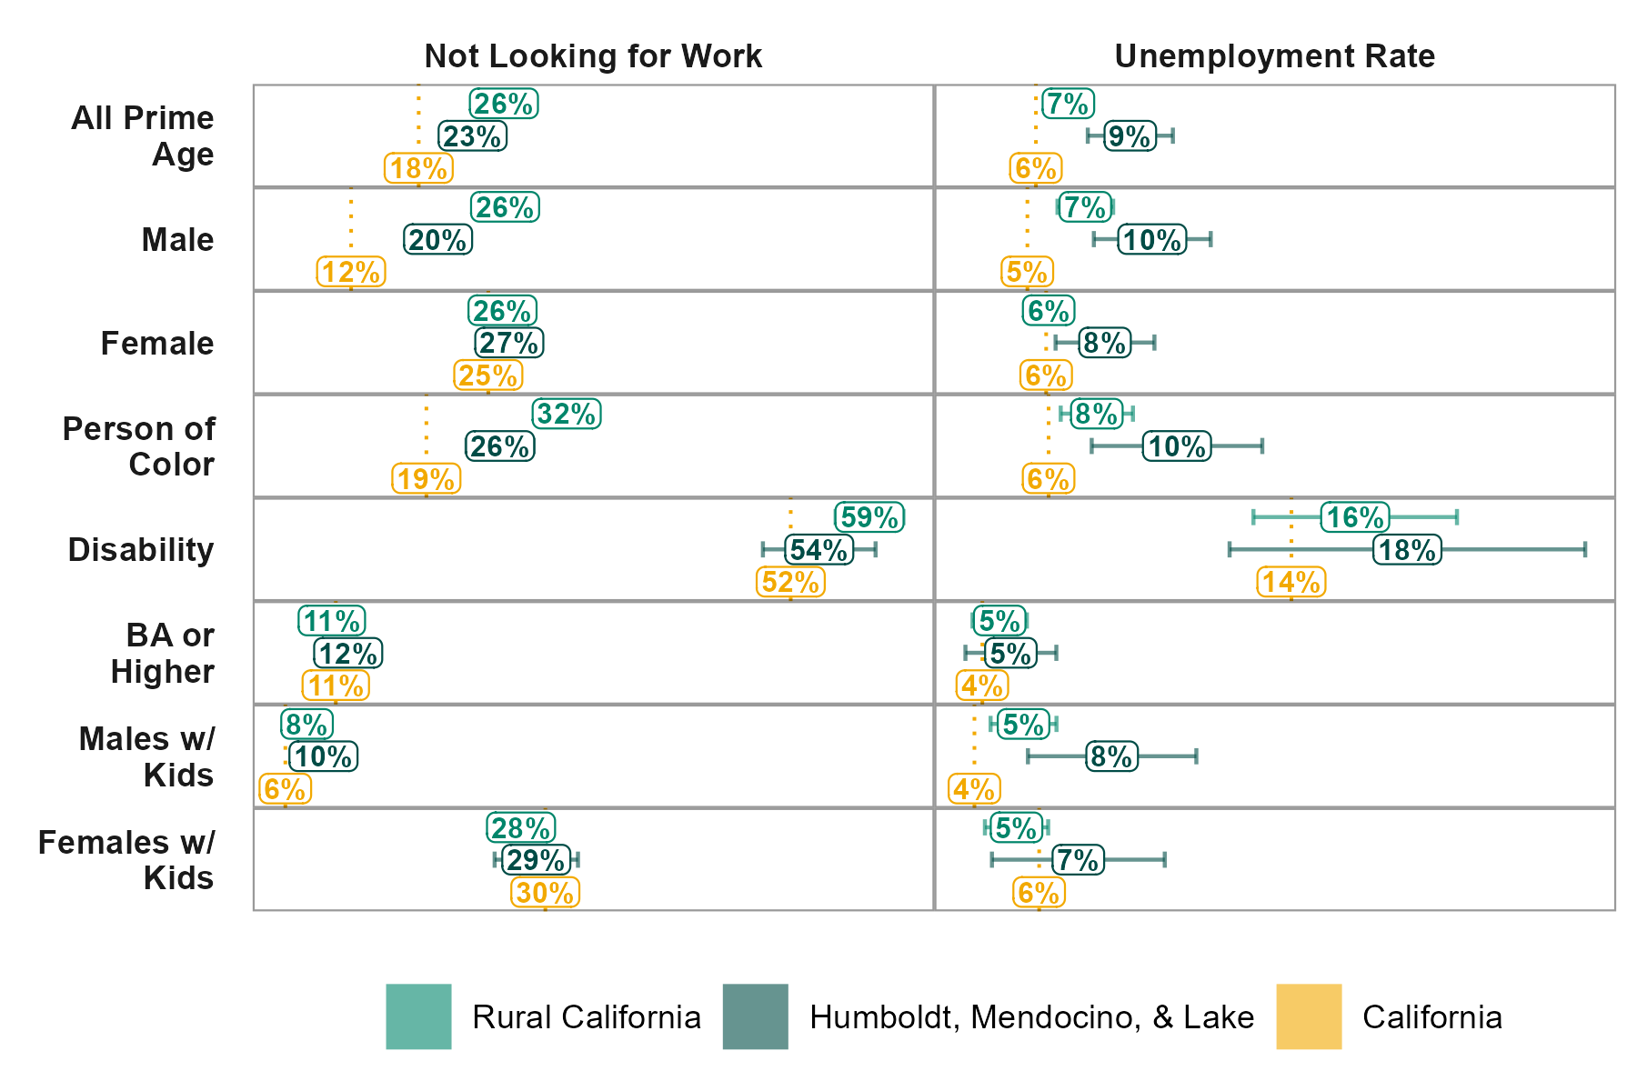
Who? Lower Participation Among Males and POC
Source: Census Public Use Micro Survey 2017-2021, Accessed via TidyCensus // Index of Relative Rurality
Notes:
Significantly more working age adults are NOT LOOKING and significantly more and looking for work and NOT FINDING WORK.
Discouragement??
Looking at where there are deviations from statewide trends: Males and POC

Slide 17
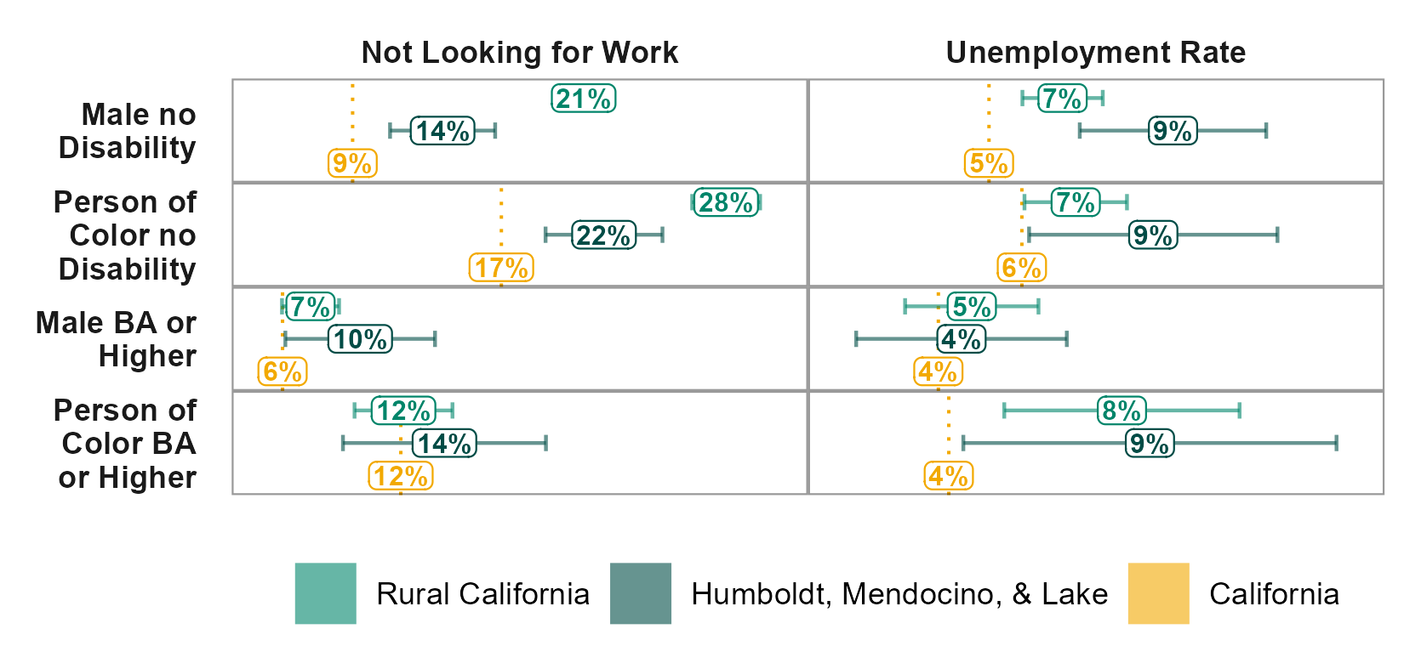
A Twist… Other Factors Clearly at Play…
Source: Census Public Use Micro Survey 2017-2021, Accessed via TidyCensus // Index of Relative Rurality
Notes:
Removing disability as a factor shows that something else is going on. Educational attainment??

Slide 18
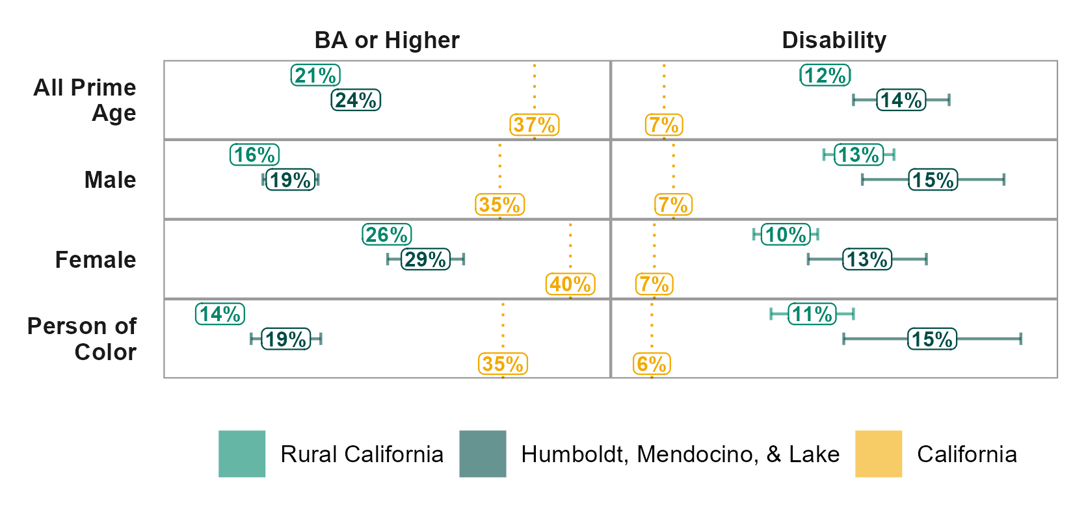
Substantially Lower Rates of BA Attainment
Source: Census Public Use Micro Survey 2017-2021, Accessed via TidyCensus // Index of Relative Rurality
Notes:
But higher disability is felt across demographics. What else could be going on that would disproportionately impact males and poc??
Substantially lower educational attainment among males and persons of color.

Slide 19
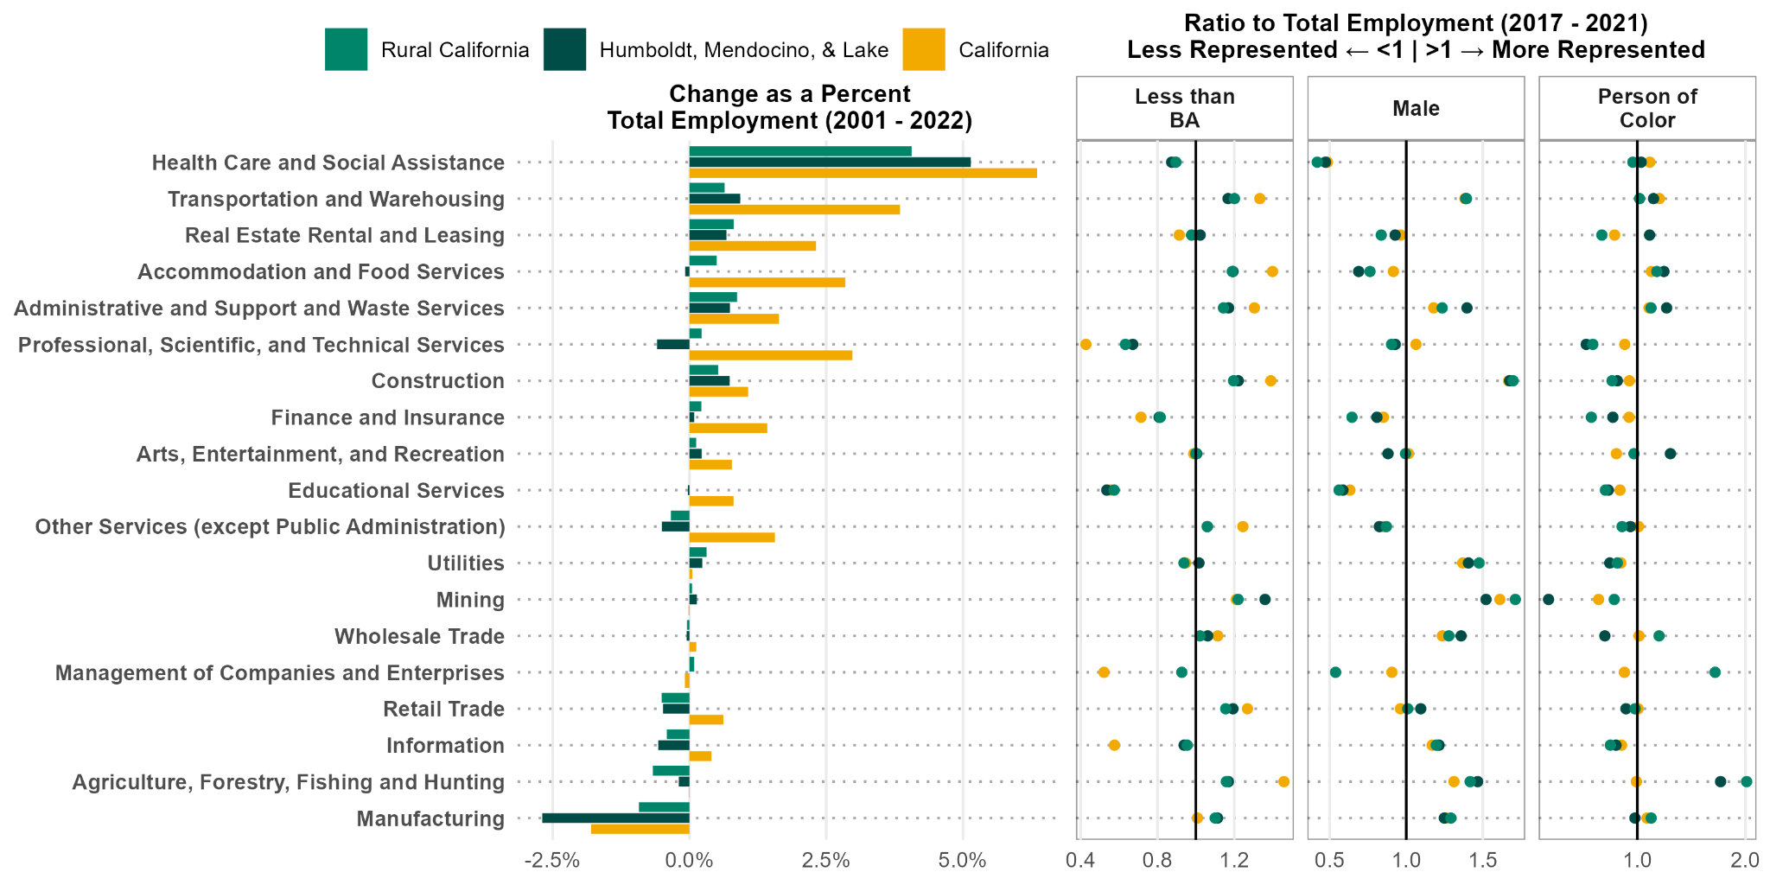
Loss of Manufacturing?
Source: IMPLAN // Census Public Use Micro Survey 2017-2021, Accessed via TidyCensus // Index of Relative Rurality
Notes:
Percent changes in employment are relative to the midpoint (average) of 2022 and 2001 total employment.

Slide 20
Takeaways
Disability appears to impact employment overall, but other factors (likely including educational attainment) disproportionately impact males and persons of color.
The combined loss of blue collar jobs and lower educational attainment of males and POC may be a critical trend.
These trends are similar to other rural California areas. We may be able to look to our peer regions to learn strategies for addressing this challenge.

Slide 21
Leveraging Your Insight: Mentimeter Questions
Mentimeter Link: www.menti.com/alngtv95xp33
Mentimeter (Spanish version): www.menti.com/alqee2pw4gh4
1) What are key considerations to raise employment rates among prime working-age adults (25-to-54) in the Redwood Region?
Could be related to demographics, industry-specific challenges, access to education and training, etc.
2) What local or regional level policies or strategies would be most effective in addressing these issues and the needs of our diverse communities?
Please consider the role that community organizations, local government, and regional partnerships might play in the implementation of these solutions.

Slide 22
Collaborative Discussion Part 1: Job Creation, Quality, and Access in Our Region (1)
Creating project criteria for RRRISE Rubric
Invited to start the conversation:
Workforce Development Boards: Workforce Alliance of the North Bay, Humboldt County Workforce Development Board, NoRTEC
Job Centers: SMART Center, the Job Market, Career Point.
→ What are we doing to prepare our workforce for current and future industries?
→ How are we helping people overcome workforce barriers?
→ Innovative approaches to highlight?

Slide 23
Collaborative Discussion Part 1: Job Creation, Quality, and Access in Our Region (2)
What standard would you like to see upheld by funded projects?
What things could make a difference for job seekers and working families?
→ With respect to job quality
→ With respect to job access
→ With respect to job creation

Slide 24
Collaborative Discussion Part 1: Job Creation, Quality, and Access in Our Region (3)
Major Employers and Labor Groups Respond:
What are the biggest challenges in hiring and retaining employees?
2. What values does your firm(s) hold with respect to job quality? How is that communicated and invested in?
3. CA Jobs First is about bringing public and private investment into key industries (like yours) in our Region to create opportunities for people. What criteria would you like to see used to prioritize projects and initiatives?

Slide 25
Voting Members Vote on Jobs Criteria (1)
State Criteria for Job Quality and Access ESSENTIALS
Promote the creation of family-sustaining jobs:
Healthcare and retirement benefits
Upward mobility
Access to training
Consistent scheduling
Safe working conditions
Opportunities for collective worker input;
Equitable access to quality jobs for communities throughout the region.

Slide 26
Voting Members Vote on Jobs Criteria (2)
State Criteria for Job Quality and Access
BONUS POINTS:
Local or targeted hire provisions;
Project Labor Agreement or Community Workforce Agreement, or a Community Benefits Agreement;
Target training and support services to workers with employment barriers as defined in Chapter 2 of the California Unemployment Insurance Code
Funding of worker owned cooperatives

Slide 27
Voting Members Vote on Jobs Criteria (3)
Mentimeter Link for Voting Member Block
Ranking the State’s Criteria (see previous slides)
Feedback to the State?
What criteria are we missing?
Next Steps:
How do we want to measure these criteria?

Slide 28
Next Steps
March:
Collaborative meeting on Zoom (in-person meeting in April!)
Up Next:
Rubric design
Project inventory
Data Walks

Slide 29
Save the date for our
next meeting:
Calendar Link | Zoom Link
Redwood Region RISE Calender
Please contact us with any questions or concerns: ccrp@humboldt.edu
March 28
11:00 a.m.-12:30 p.m. (on Zoom)

