Slide 1
January 25, 2024
Redwood Region RISE (Resilient Inclusive Sustainable Economy) Creating a Shared Agenda for Shared Prosperity in our region
Learn More: bit.ly/Redwood-RISE

Slide 2
Welcome Everyone / ¡Bienvenidos todos!
You have arrived at the January Collaborative Meeting for Redwood Region RISE (Resilient Inclusive Sustainable Economy).
Please introduce yourself in the chat–name, affiliation (if applicable) and where you are zooming in from: https://native-land.ca/
Notes:
Before moving to housekeeping, lets do the Cal Poly Land Acknowledgement

Slide 3
Land Acknowledgement
Land Acknowledgement
Redwood Region RISE’s Collaborative is located on the present and ancestral Homeland and unceded territory of Indigenous People. Tribes and Nations in our region include:
Bear River Band of the Rohnerville Rancheria; Big Lagoon Rancheria; Big Valley Band Rancheria; Blue Lake Rancheria; Cahto Tribe; Coyote Valley Band of Pomo Indians; Elem Indian Colony; Elk Valley Rancheria; Guidiville Indian Rancheria; Habematolel Rancheria of Pomo Indians; Hoopa Valley Tribe; Hopland Band of Pomo Indians; Karuk; Koi Nation; Manchester Band of Pomo Indians; Mattole; Middletown Rancheria of Pomo Indians; Pinoleville Pomo Nation; Potter Valley Tribe; Redwood Valley Little River Band of Pomo Indians; Resighini Rancheria; Robinson Rancheria; Round Valley Reservation; Scotts Valley Band of Pomo Indians; Sherwood Valley Rancheria; Tsnungwe; Tolowa; Tolowa Dee-ni' Nation; Trinidad Rancheria; Wailaki; Wiyot; Yurok Tribe.
We make this land acknowledgement in recognition that our words must be matched by action and approach. Learn more: "What Good Is a Land Acknowledgment?"
Notes:
Before moving to housekeeping, lets do the Cal Poly Land Acknowledgement

Slide 4
Some Housekeeping Notes
Team👋🏽
Welcome!
Spanish Interpretations are available
Speak at a manageable pace → and let us know if we aren’t!
Questions in chat → we gather & answer your questions
Please mute your microphone while in the public Zoom room.

Slide 5
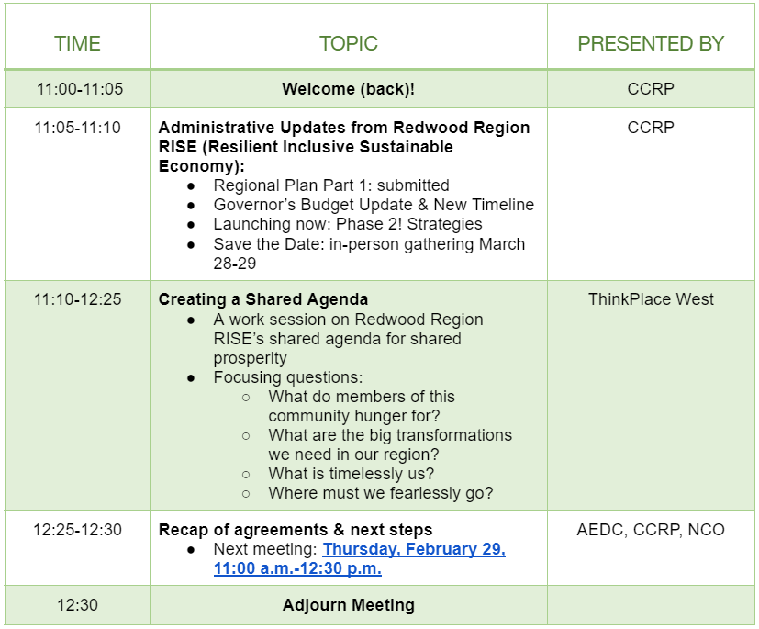
Agenda for today’s meeting

Slide 6
Administrative Updates RRRISE
Regional Plan Part 1: Submitted!
Governor’s Budget Update & New Timeline
Partner Directory
Strategies Phase kick-off
Save the Date: in-person gathering: March 28-29

Slide 7
Overall shared agenda
Through Jobs First, Redwood Region RISE aims to:
Notes:
Note to self: make sure document is dropped in chat.
What shared agenda should this collaborative set internally and with the state through this regional plan that creates deep impact and advantages this region in the space of jobs that are good for people and the planet?

Slide 8
Collaborative Bodies: Flow Chart
California Jobs First is a $600 million statewide initiative designed to promote a sustainable and equitable recovery from
the economic distress of COVID-19.
Notes:
This is an opportunity created by this initiative, and we have an opportunity to take this up in a way that is uniquely ours. What shared agenda can we create in this moment of crisis to create opportunity for economic & social justice transformation?

Slide 9
Redwood Region, where are you?
Who’s represented here today?
If you woke up tomorrow and shared prosperity is real, what do you see?
Three words for what Shared Prosperity IS
Three words for what shared prosperity IS NOT
Click the link in the chat to respond.
Having technical trouble? Enter your answer into chat and we’ll enter it for you.
Notes:
We are doing this work together, let’s start this work by becoming present to who is in the room today and how our region is represented. and how do we even begin to think about shared prosperity we have some warm up exercises to put us in that frame of mind.

Slide 10
Results
Notes:
Read out at a high level

Slide 11
Building a shared agenda-lets get started
Notes:
We are going to take you through a series of questions to get us started, surfacing what is important and relevant across the region as well as our differences, and that is ok.

Slide 12
What permissions do we give ourselves today so that we are successful in kicking this process off in a concrete way?
Give yourself permission to use your tacit knowledge and accumulated experience as you develop responses to the questions and conversations in small groups
Give yourself permission to dream and explore, because this is iterative
There will be space for others to weigh in, informed by research and community conversations, but for each of you here to today, we invite you to lean in and make this tangible so that it is real
Good enough, will give us momentum to keep thinking in this way

Slide 13
Here is the plan
First, Break Outs for first three questions
In between we will share out
Then, Break Out and we all work on 4th question
Finally, Reflection

Slide 14
Break Out Groups - Focusing Questions
Mentimeter Group 3
What question do you want to grapple with?
Redwood Region RISE shared agenda for shared prosperity
Mentimeter Group 1
Mentimeter Group 2
Links to each poll are in the chat

Slide 15
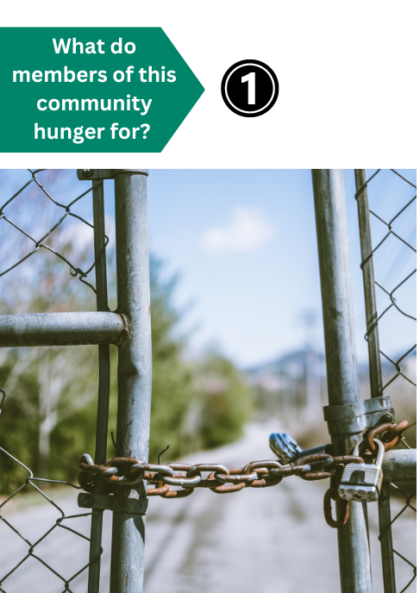
Grab a sticky as a facilitator if you need to capture what the group is discussing
What keeps coming up over and over as barriers and problems?
What is clearly standing out for the group as the things the community is hungering for?
Group 1 Mentimeter Group 1
These are the poll questions in Mentimeter, in case your group is unable to use the poll

Slide 16
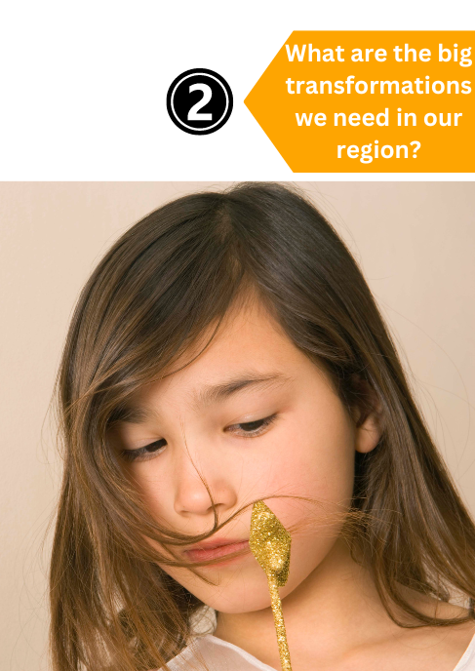
Grab a sticky as a facilitator if you need to capture what the group is discussing
Group 2
Mentimeter Group 2
If you could wave a magic wand, what are the big social and economic issues you would fix today?
What is clearly standing out for the group as the big transformations we need in our region?
These are the poll questions in Mentimeter, in case your group is unable to use the poll

Slide 17
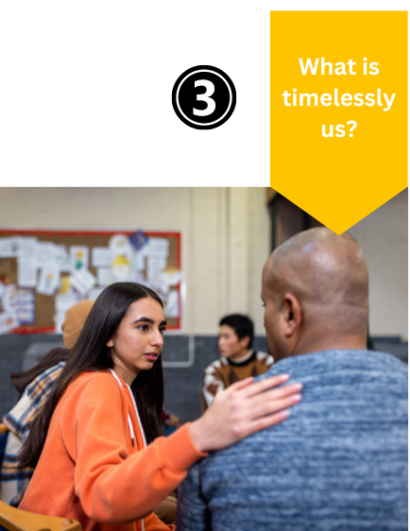
Grab a sticky as a facilitator if you need to capture what the group is discussing
What about this region sustains us and can propel us forward?
What is clearly standing out for the group as timelessly us?
Group 3
Mentimeter Group 3
These are the poll questions in Mentimeter, in case your group is unable to use the poll

Slide 18
Break Out Groups - Focusing Questions
Redwood Region RISE shared agenda for shared prosperity

Slide 19
Walking through our work
Group
Group
Group
After we share out we are going to respond to the final question,
“Where must we fearlessly go?”
Use this as your focusing question as we walk through the answers you’ve created together. Then we will go into breakouts to collect and discuss your thoughts on where must we fearlessly go.
Mentimeter results
Mentimeter Results
Mentimeter results

Slide 20
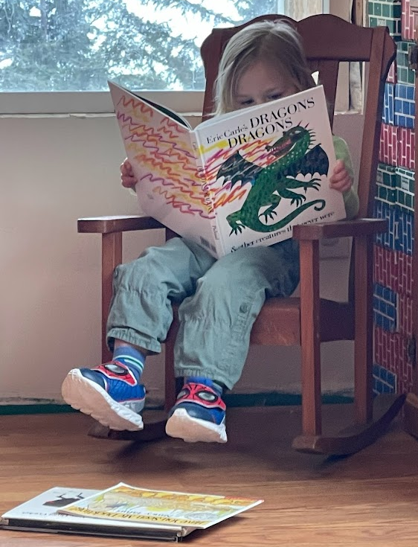
Grab a sticky as a facilitator if you need to capture what the group is discussing
Now we will go into four random Breakout Groups to answer Question 4, using mentimeter
Mentimeter Group 4
These are the poll questions in Mentimeter, in case your group is unable to use the poll
What must we courageously and collectively do to make the most of this opportunity?
What is clearly standing out for the group as where we must fearlessly go?
Mentimeter results

Slide 21
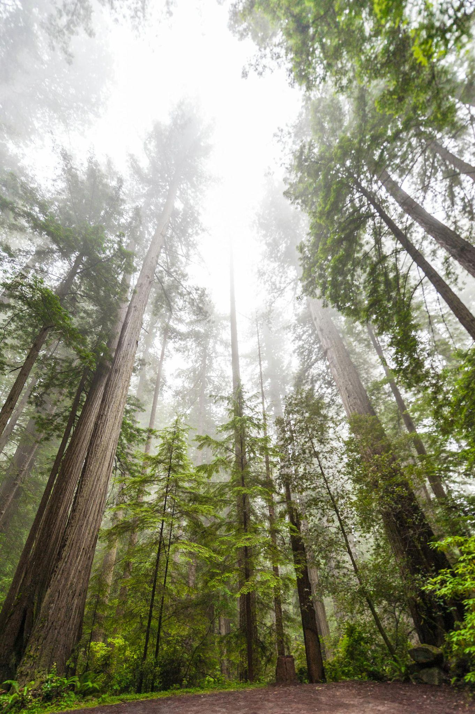
Reflecting
Take some time to reflect
What are some thoughts and ideas on how we continue to build on this shared agenda across the region?
Drop your comments in the chat
and participate in our
Mentimeter Poll
Mentimeter Results
Notes:
We are going to continue this process, thanks for leaning in. There will be lots of outreach and events taking place in your local communities as well as some of our regional groups continuing to advance this shared agenda for shared prosperity.

Slide 22
Save the date for our
next meeting:
Calendar Link / Zoom Link
Please contact us with any questions or concerns: ccrp@humboldt.edu
Thursday, February 29
11:00 a.m. - 12:30 p.m.

