Slide 1
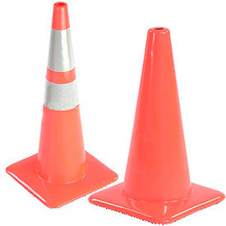
Downtown Ukiah streetscape project
Shannon Riley
Deputy City Manager
City of Ukiah

Slide 2
DOWNTOWN STREETSCAPE
Notes:
ADA ramps installation and upgrades are a requirement when a street is being overlayed

Slide 3
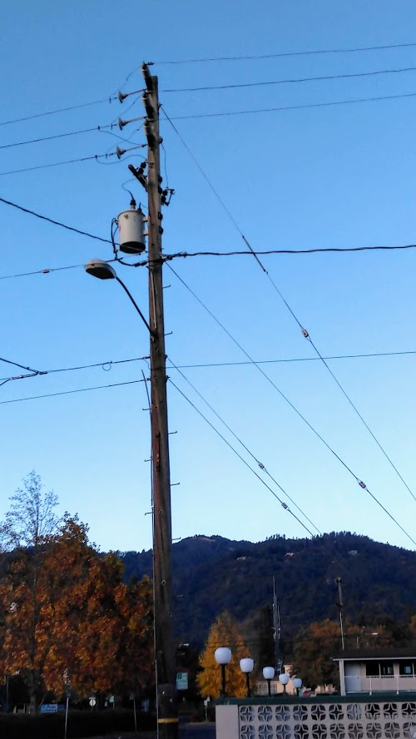
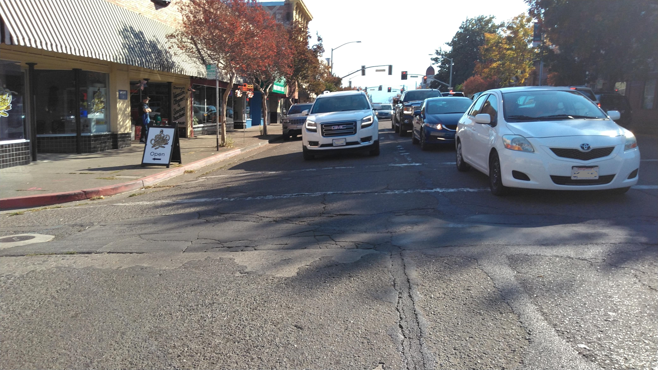
Before:
Former Hwy 101
100-year-old water and sewer lines
Unsafe
Barrier to economic development

Slide 4
Timeline
1969 - Ukiah “bypassed”—Hwy 101/State Street turned over to City when new freeway was developed
2005 - State Street identified as a barrier to economic development and a safety concern
2008 - City awarded funds from (Mendocino Council of Governments) MCOG to study and recommend solutions for this important corridor

Slide 5
Timeline, continued
2009 - Downtown Streetscape Improvement Plan and Traffic Study was approved by City Council, after numerous workshops and Council meetings
2011 - City awarded $815,000 for project from MCOG
2012 - City awarded $1,000,000 for project from CalTrans
2013 - City awarded $1,369,000 for project from MCOG (for future phase)
2017 - City awarded $489,000 from MCOG

Slide 6
Timeline, continued
2018 - Environmental review
2018 - Update provided to City Council; prepared to enter design phase
Feb. 2019 - Update to City Council
May 2019 - City awarded additional $550,000 for project from MCOG
May 2019 - Community Workshop

Slide 7
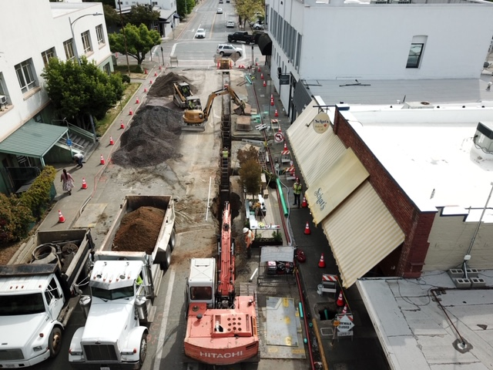
During:
water and sewer lines replaced – electric utility undergrounded – sidewalks widened – new trees – wider sidewalks – pedestrian enhancements – new landscaping – new streetlights and traffic signals – new fire hydrants

Slide 8
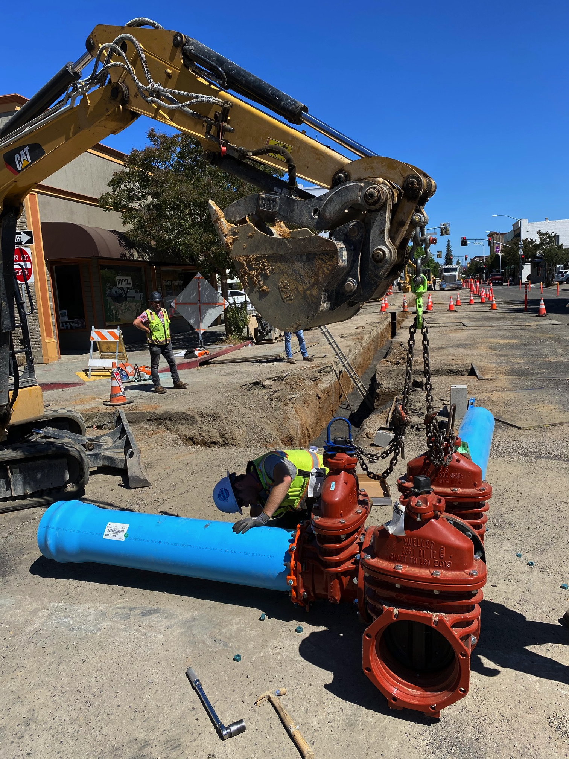
During:
By the numbers:
10 years of planning
16 months of construction
66 weeks of emails and hand-delivering 175 flyers, rain or shine

Slide 9
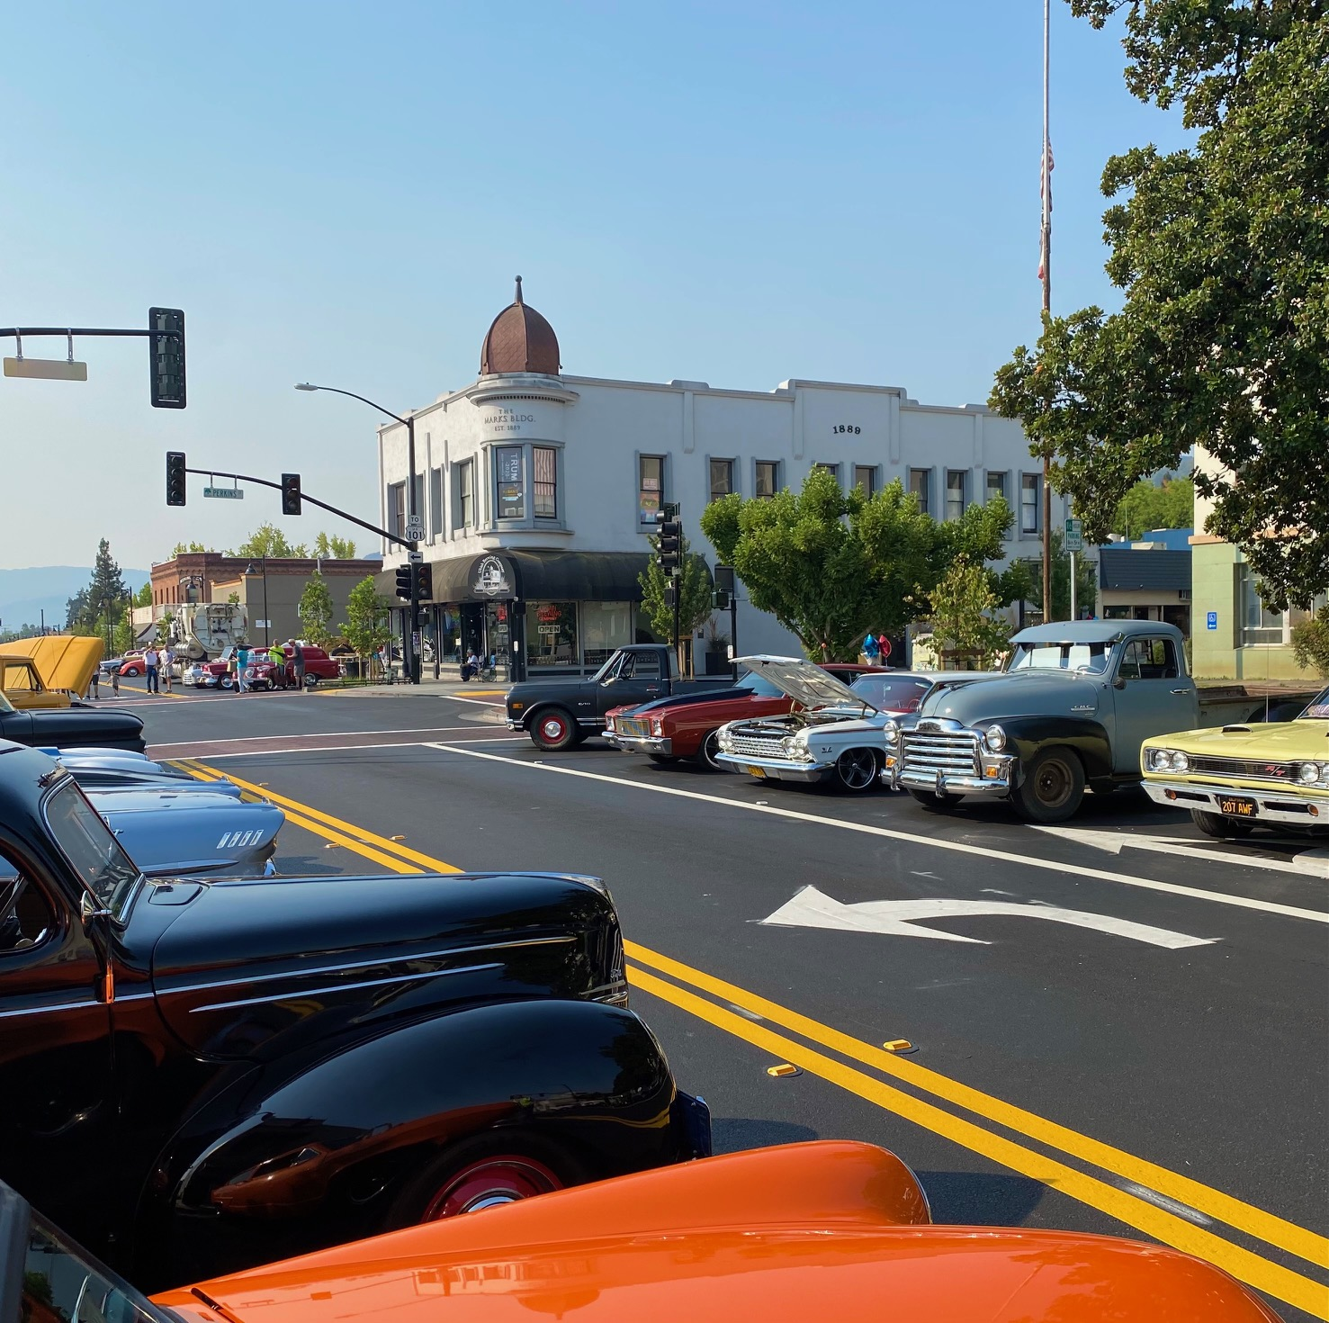
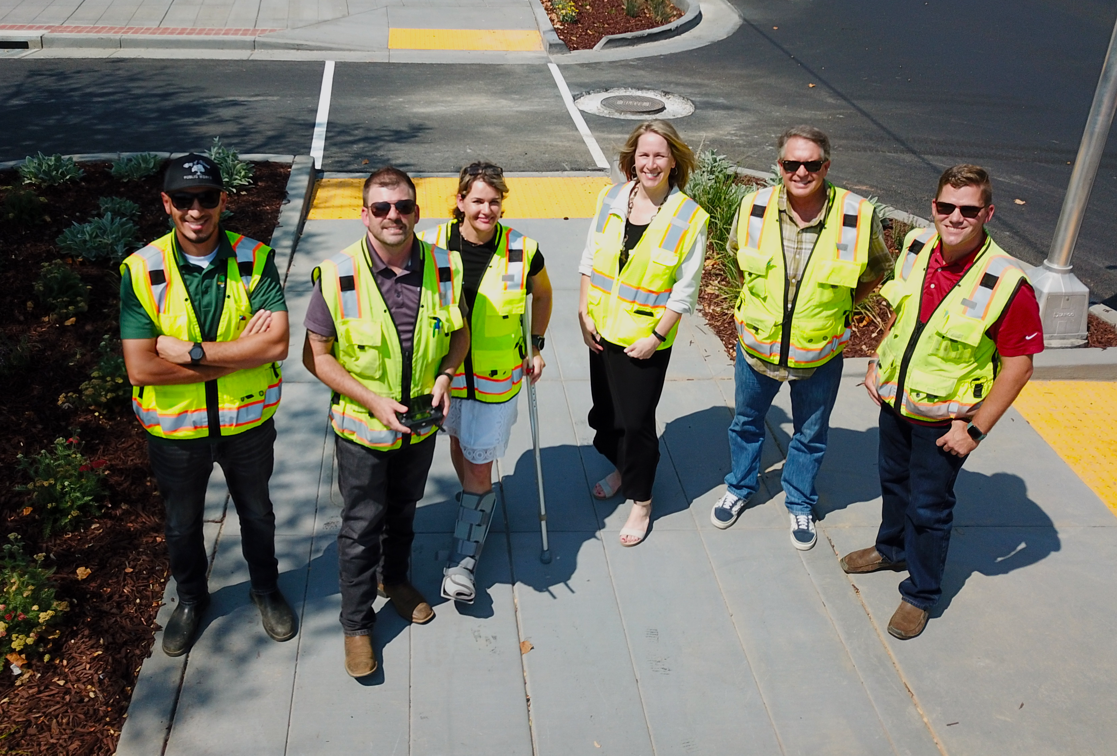
After:
City of Ukiah Project Team
Thriving downtown, new economic activity,
special events…on to Phase 2!

Slide 10
Funding
State Transportation Improvement Program (STIP)
Phase 1 initial funding: $815,000; additional funding: $489,000 (redistributed by MCOG from another project).
This project will provide streetscape improvements in downtown Ukiah on State Street, Perkins Street, and Standley Street, including sidewalk widening, curb ramps and bulb outs, street lights, street furniture and tree planting.
Phase 2 State Street from Norton to Henry and on State Street from Mill to Gobbi: $1,369,000
Phase 2 will construct streetscape improvements on State Street from Norton to Henry and on State Street from Mill to Gobbi, including sidewalk widening, curb ramps and bulb outs, street lights, street furniture and tree planting.
Notes:
ADA ramps installation and upgrades are a requirement when a street is being overlayed

Slide 11
Funding
Highway Safety Improvement Program (HSIP)
$900,000 in Federal Funds
$100,000 in local funds
The proposed HSIP project includes a road diet between Henry Street and Mill Street that will transform the existing four-lane road into a three-lane road with one travel lane in each direction and a two way left-turn lane in the center, while still maintaining on-street parking. Project includes traffic signal modifications.
Notes:
ADA ramps installation and upgrades are a requirement when a street is being overlayed

Slide 12
Funding
Additional Sources of Funding
Measure Y (dedicated sales tax)
Bond funds
Utility (water, sewer, electric) funds
Notes:
ADA ramps installation and upgrades are a requirement when a street is being overlayed

Slide 13
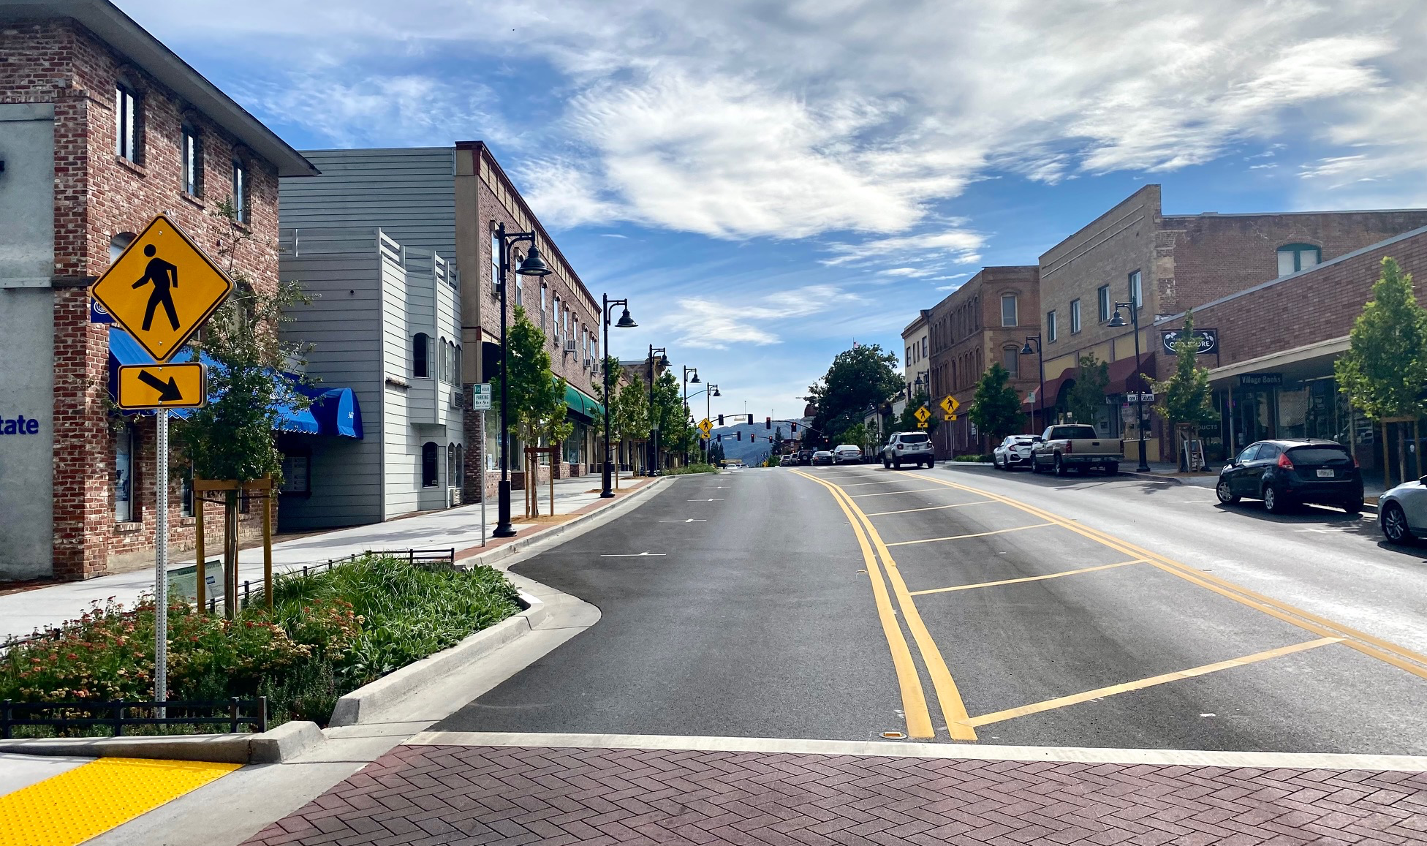
After:
A dramatic transformation!

Slide 14
Questions?
Shannon Riley
Deputy City Manager
City of Ukiah

